Slide 2
Number of Incident Home Dialysis Patients (pmp) 1994-2013
Year | Australia | New Zealand
1994 | 811 (46) | 250 (69)
1995 | 866 (48) | 243 (66)
1996 | 829 (45) | 252 (68)
1997 | 810 (44) | 274 (72)
1998 | 869 (47) | 302 (79)
1999 | 906 (48) | 306 (80)
2000 | 934 (49) | 305 (79)
2001 | 975 (51) | 326 (84)
2002 | 915 (47) | 347 (88)
2003 | 943 (48) | 317 (79)
2004 | 888 (45) | 332 (81)
2005 | 974 (48) | 318 (77)
2006 | 1183 (58) | 351 (84)
2007 | 1076 (52) | 289 (68)
2008 | 1161 (55) | 333 (78)
2009 | 1067 (49) | 365 (85)
2010 | 920 (42) | 366 (84)
2011 | 989 (44) | 312 (71)
2012 | 1210 (53) | 342 (78)
2013 | 1146 (50) | 370 (83)

Slide 7
Primary Renal Disease (%) of Incident Home Dialysis Patients 2013
Primary Renal Disease | Australia | New Zealand
GN | 274 (24) | 92 (25)
Analgesic | 16 (1) | 2 (1)
Polycystic | 74 (6) | 22 (6)
Reflux | 25 (2) | 13 (4)
Hypertension | 158 (14) | 28 (8)
Diabetes | 372 (32) | 169 (46)
Other | 142 (12) | 36 (10)
Uncertain | 68 (6) | 7 (2)
Not reported | 17 (1) | 1 (<1)
Total | 1146 | 370

Slide 18
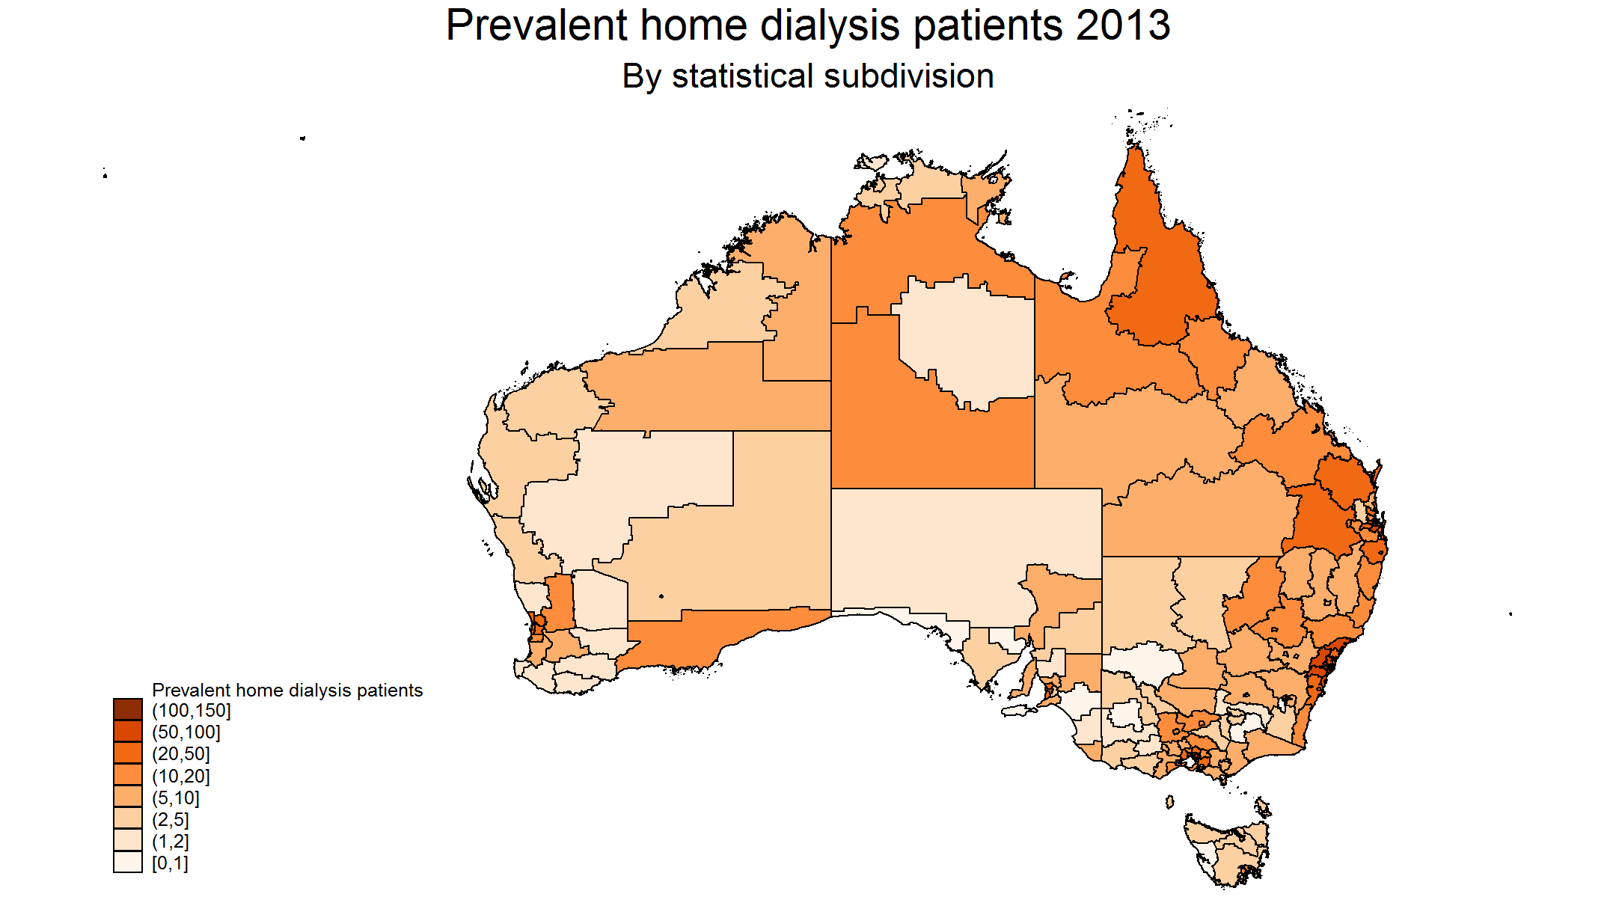

Slide 22
Home Dialysis Patient Numbers by State 2013
State | PD | Home HD | Other HD | Total
QLD | 430 | 263 | 1507 | 2200
NSW/ACT | 939 | 498 | 2615 | 4052
VIC | 518 | 200 | 2174 | 2892
TAS | 40 | 17 | 159 | 216
SA | 133 | 28 | 592 | 753
NT | 33 | 34 | 454 | 521
WA | 213 | 55 | 872 | 1140
NZ | 832 | 475 | 1277 | 2584
Total | 3138 | 1570 | 9650 | 14358

Slide 25
Outcome of incident home dialysis patients 2002-2013
Outcome | Australia | New Zealand
Transferred to facility haemodialysis | 4566 (37%) | 1220 (30%)
Died | 2692 (22%) | 1214 (30%)
Transplanted | 2248 (18%) | 523 (13%)
Lost to follow-up | 18 (<1%) | 8 (<1%)
Recovered native kidney function | 196 (2%) | 53 (1%)
Remained on home dialysis 31 Dec 2013 | 2752 (22%) | 1024 (25%)
Total | 12472 (100%) | 4,042 (100%)

Slide 28
Incident Home Dialysis Patient Survival by Era 2002-2013 (%, 95% CI)
Country | Era | 6 months | 1 year | 3 years | 5 years
Australia | 2002-2004 (n=2746) | 94 (93, 95) | 88 (87, 89) | 65 (63, 67) | 48 (46, 50)
 | 2005-2007 (n=3233) | 95 (94, 96) | 90 (89, 91) | 68 (66, 70) | 53 (51, 55)
 | 2008-2010 (n=3148) | 96 (95, 97) | 91 (90, 92) | 73 (71, 74) | 57 (55, 59)
 | 2011-2013 (n=3345) | 97 (96, 98) | 94 (93, 95) | - | -
New Zealand | 2002-2004 (n=996) | 96 (94, 97) | 88 (85, 90) | 60 (56, 63) | 40 (37, 43)
 | 2005-2007 (n=958) | 96 (94, 97) | 90 (88, 92) | 68 (65, 71) | 47 (44, 50)
 | 2008-2010 (n=1064) | 97 (95, 98) | 91 (89, 92) | 69 (66, 72) | 49 (45, 53)
 | 2011-2013 (n=1024) | 97 (96, 98) | 93 (91, 95) | - | -

Slide 31
Incident Home Dialysis Technique Survival by Era 2002-2013 (%, 95% CI)
Country | Era | 6 months | 1 year | 3 years | 5 years
Australia | 2002-2004 (n=2746) | 85 (83, 86) | 72 (70, 74) | 37 (35, 39) | 19 (17, 21)
 | 2005-2007 (n=3233) | 85 (84, 86) | 73 (71, 74) | 39 (37, 40) | 21 (20, 23)
 | 2008-2010 (n=3148) | 84 (83, 85) | 73 (72, 75) | 40 (39, 42) | 23 (21, 25)
 | 2011-2013 (n=3345) | 87 (85, 88) | 76 (74, 78) | - | -
New Zealand | 2002-2004 (n=996) | 89 (87, 91) | 77 (75, 80) | 40 (37, 43) | 19 (16, 22)
 | 2005-2007 (n=958) | 89 (87, 91) | 77 (75, 80) | 43 (40, 47) | 22 (19, 25)
 | 2008-2010 (n=1064) | 90 (88, 92) | 80 (78, 82) | 48 (44, 51) | 27 (23, 31)
 | 2011-2013 (n=1024) | 88 (86, 90) | 80 (77, 83) | - | -

Slide 34
Incident Home Dialysis Death-Censored Technique Survival by Era 2002-2013 (%, 95% CI)
Country | Era | 6 months | 1 year | 3 years | 5 years
Australia | 2002-2004 (n=2746) | 89 (88, 90) | 81 (79, 82) | 55 (52, 57) | 40 (37, 42)
 | 2005-2007 (n=3233) | 89 (88, 90) | 80 (79, 82) | 56 (54, 58) | 41 (38, 43)
 | 2008-2010 (n=3148) | 88 (86, 89) | 80 (78, 81) | 56 (54, 58) | 43 (40, 46)
 | 2011-2013 (n=3345) | 89 (88, 90) | 81 (79, 82) | - | -
New Zealand | 2002-2004 (n=996) | 93 (91, 94) | 87 (85, 89) | 64 (61, 68) | 48 (44, 53)
 | 2005-2007 (n=958) | 93 (91, 94) | 86 (83, 88) | 64 (60, 67) | 48 (44, 52)
 | 2008-2010 (n=1064) | 93 (91, 95) | 88 (85, 89) | 68 (65, 71) | 55 (50, 60)
 | 2011-2013 (n=1024) | 91 (89, 93) | 86 (83, 88) | - | -

Slide 37
Incident Home Dialysis Patient Survival by Age 2002-2013 (%, 95% CI)
Country | Age | 6 months | 1 year | 3 years | 5 years
Australia | <40 (n=1953) | 98 (97, 99) | 97 (96, 97) | 90 (88, 91) | 85 (83, 87)
 | 40-59 (n=4414) | 97 (96, 98) | 94 (93, 95) | 79 (77, 80) | 67 (65, 68)
 | 60-74 (n=4283) | 95 (94, 96) | 89 (88, 90) | 64 (62, 66) | 44 (42, 46)
 | ≥75 (n=1822) | 91 (90, 92) | 82 (80, 83) | 49 (46, 51) | 27 (24, 29)
New Zealand | <40 (n=578) | 99 (97, 99) | 96 (94, 97) | 85 (81, 88) | 77 (72, 81)
 | 40-59 (n=1652) | 97 (96, 98) | 94 (92, 95) | 73 (70, 75) | 53 (50, 57)
 | 60-74 (n=1478) | 96 (94, 97) | 87 (85, 89) | 59 (56, 62) | 35 (32, 38)
 | ≥75 (n=334) | 91 (87, 94) | 80 (75, 84) | 44 (39, 50) | 21 (16, 26)

Slide 40
Incident Home Dialysis Technique Survival by Age 2002-2013 (%, 95% CI)
Country | Age | 6 months | 1 year | 3 years | 5 years
Australia | <40 (n=1953) | 90 (88, 91) | 78 (76, 80) | 52 (49, 55) | 39 (35, 43)
 | 40-59 (n=4414) | 87 (86, 88) | 77 (76, 78) | 46 (44, 48) | 29 (27, 31)
 | 60-74 (n=4283) | 84 (82, 85) | 72 (70, 73) | 36 (34, 37) | 17 (16, 19)
 | ≥75 (n=1822) | 79 (77, 81) | 64 (62, 66) | 27 (25, 29) | 9 (8, 11)
New Zealand | <40 (n=578) | 90 (87, 92) | 81 (77, 84) | 52 (47, 57) | 37 (32, 43)
 | 40-59 (n=1652) | 90 (89, 92) | 82 (80, 84) | 48 (45, 51) | 28 (25, 31)
 | 60-74 (n=1478) | 89 (87, 91) | 76 (74, 78) | 41 (38, 44) | 17 (15, 20)
 | ≥75 (n=334) | 83 (79, 87) | 70 (64, 74) | 30 (25, 35) | 9 (5, 13)

