Slide 1
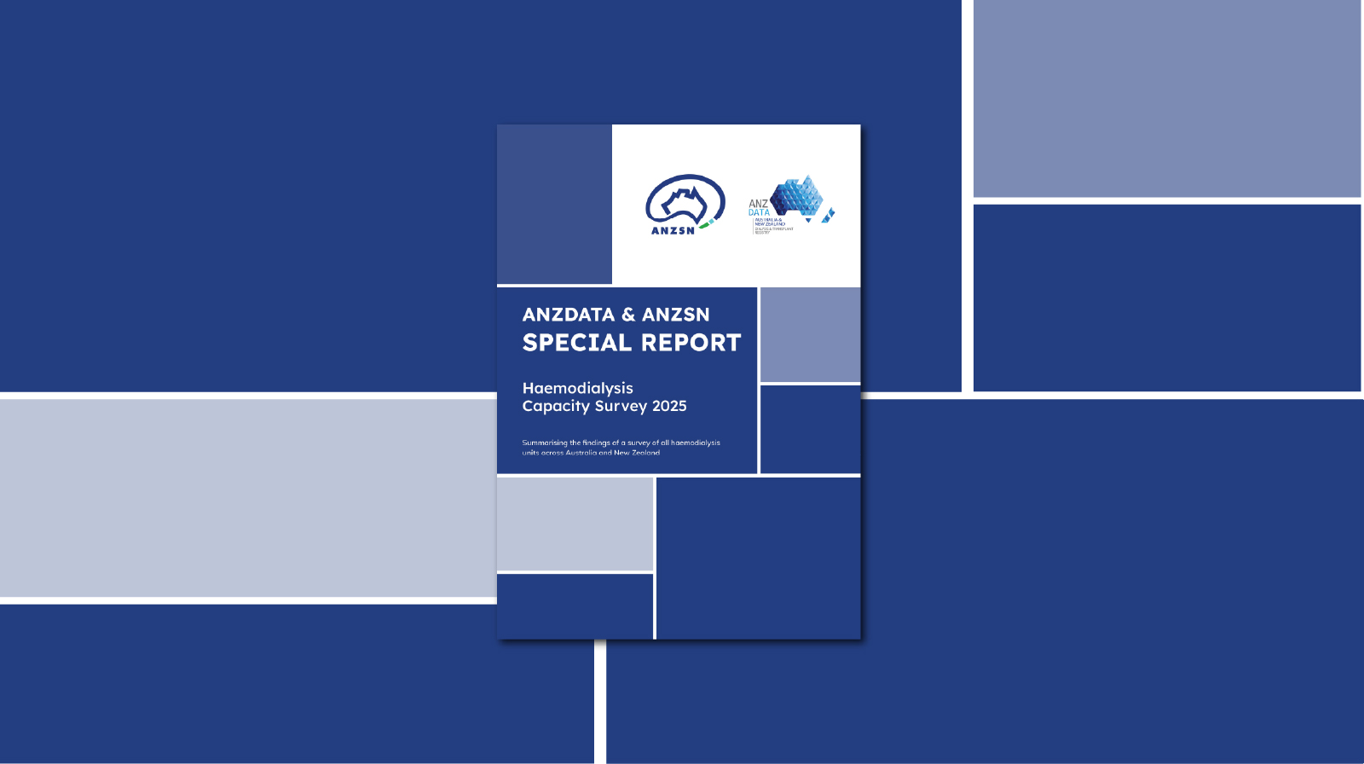
List of Figures
Figure 4.1.1 Actual Deceased Donors by Age Category - Australia 2006–2025
Figure 4.1.2 Actual Deceased Donors by Age Category - New Zealand 2006–2025
Figure 4.2.1 Actual and Intended Deceased Donor Mean Age - Australia 2005-2025
Figure 4.2.2 Actual and Intended Deceased Donor Mean Age - New Zealand 2005-2025

Slide 2
Citation
Forcey D, Au E, Eddington H, Henderson A, Keuskamp D, Irish G, Clayton P, Gray N, Ford S, Krishnasamy R, Kotwal S, Pilmore H, McDonald S. ANZDATA & ANZSN Special Report: Dialysis Capacity 2025. Australia and New Zealand Dialysis and Transplant Registry, Adelaide, Australia. 2025. ISBN: 978-0-6453621-9-0.
Available at https://anzorrg.org.au/reports/anzdata-anzsn-special-report-haemodialysis-capacity-survey-2025

Slide 3

List of Figures
Australian Figures
  Figure 1
  With ordinary staffing, one haemodialysis machine enables care for four people per week
  Figure 2
  Role of individuals who completed the survey
  Figure 3
  Proportion of dialysis units open by number of days of the week
  Figure 4
  Non-utilised haemodialysis machines across Australia by Statistical Area 4 areas
  Figure 5
  Map of Australia with the ratio of individuals receiving maintenance or ‘acute’ haemodialysis to haemodialysis machines presented for each Australian Statistical Geography Standard Statistical Area 4 level
  Figure 6
  Map of Sydney and Canberra regions with the ratio of individuals receiving maintenance or ‘acute’ haemodialysis to haemodialysis machines presented for each Australian Statistical Geography Standard Statistical Area 4 level
  Figure 7
  Map of Darwin region with the ratio of individuals receiving maintenance or ‘acute’ haemodialysis to haemodialysis machines presented for each Australian Statistical Geography Standard Statistical Area 4 level
  Figure 8
  Map of Brisbane region with the ratio of individuals receiving maintenance or ‘acute’ haemodialysis to haemodialysis machines presented for each Australian Statistical Geography Standard Statistical Area 4 level
  Figure 9
  Map of Adelaide region with the ratio of individuals receiving maintenance or ‘acute’ haemodialysis to haemodialysis machines presented for each Australian Statistical Geography Standard Statistical Area 4 level
  Figure 10
  Map of Melbourne region with the ratio of individuals receiving maintenance or ‘acute’ haemodialysis to haemodialysis machines presented for each Australian Statistical Geography Standard Statistical Area 4 level
  Figure 11
  Map of Perth region with the ratio of individuals receiving maintenance or ‘acute’ haemodialysis to haemodialysis machines presented for each Australian Statistical Geography Standard Statistical Area 4 level

Slide 4
List of Figures
Australian Figures
  Figure 11
  Map of Perth region with the ratio of individuals receiving maintenance or ‘acute’ haemodialysis to haemodialysis machines presented for each Australian Statistical Geography Standard Statistical Area 4 level
  Figure 12
  Map of Tasmania with the ratio of individuals receiving maintenance or ‘acute’ haemodialysis to haemodialysis machines presented for each Australian Statistical Geography Standard Statistical Area 4 level
  Figure 13
  Waiting lists to commence or transfer haemodialysis care across Australia by Statistical Area 4 areas
New Zealand Figures
Figure 14
Map of New Zealand with the ratio of individuals receiving maintenance haemodialysis to haemodialysis machines presented for each services region

Slide 5
Figure 1
With ordinary staffing, one haemodialysis machine enables care for four people per week

Slide 6
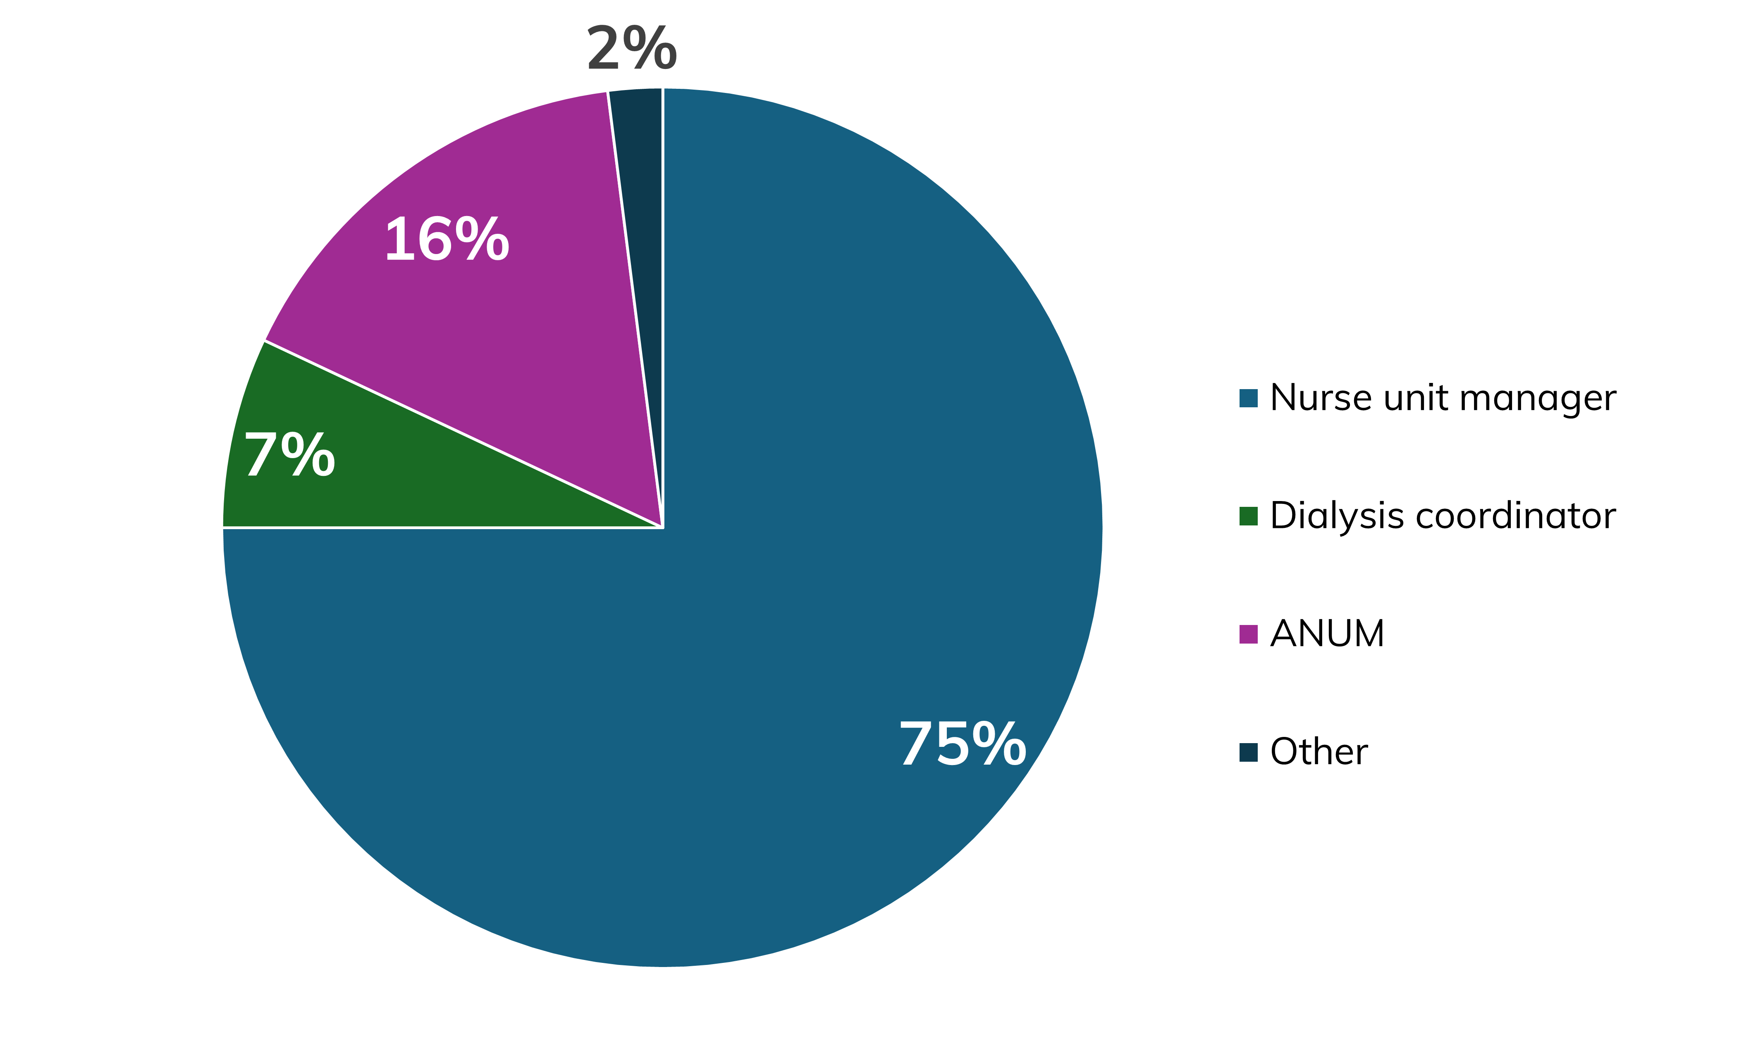
Figure 2
Role of individuals who completed the survey

Slide 7
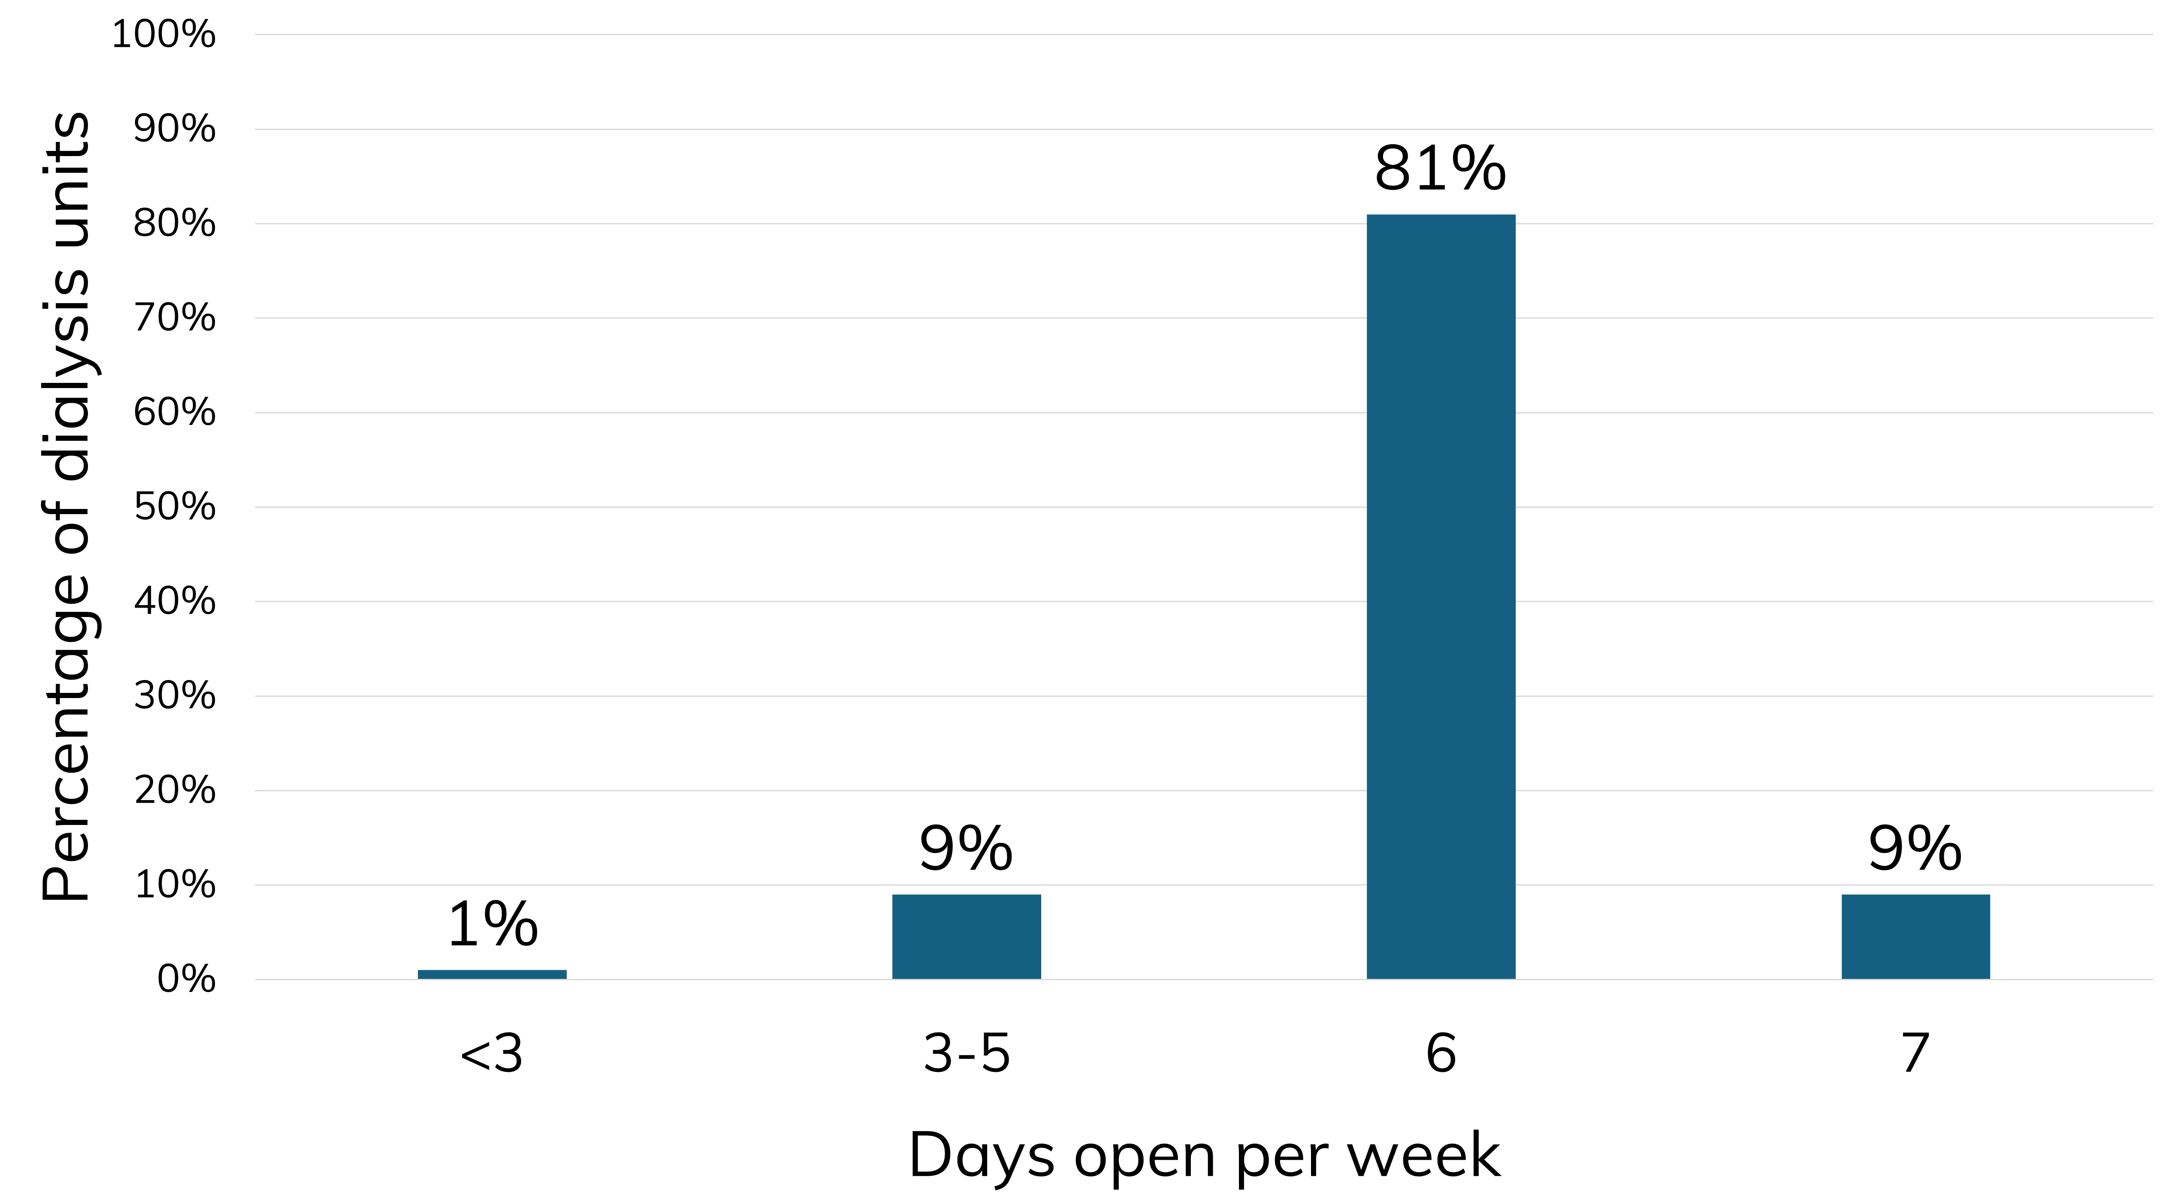
Figure 3
Proportion of dialysis units open by number of days of the week

Slide 8
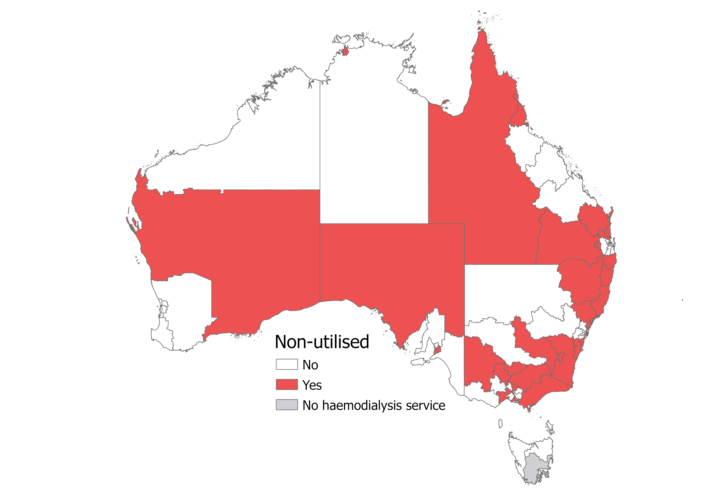
Figure 4
Non-utilised haemodialysis machines across Australia by Statistical Area 4 areas

Slide 9
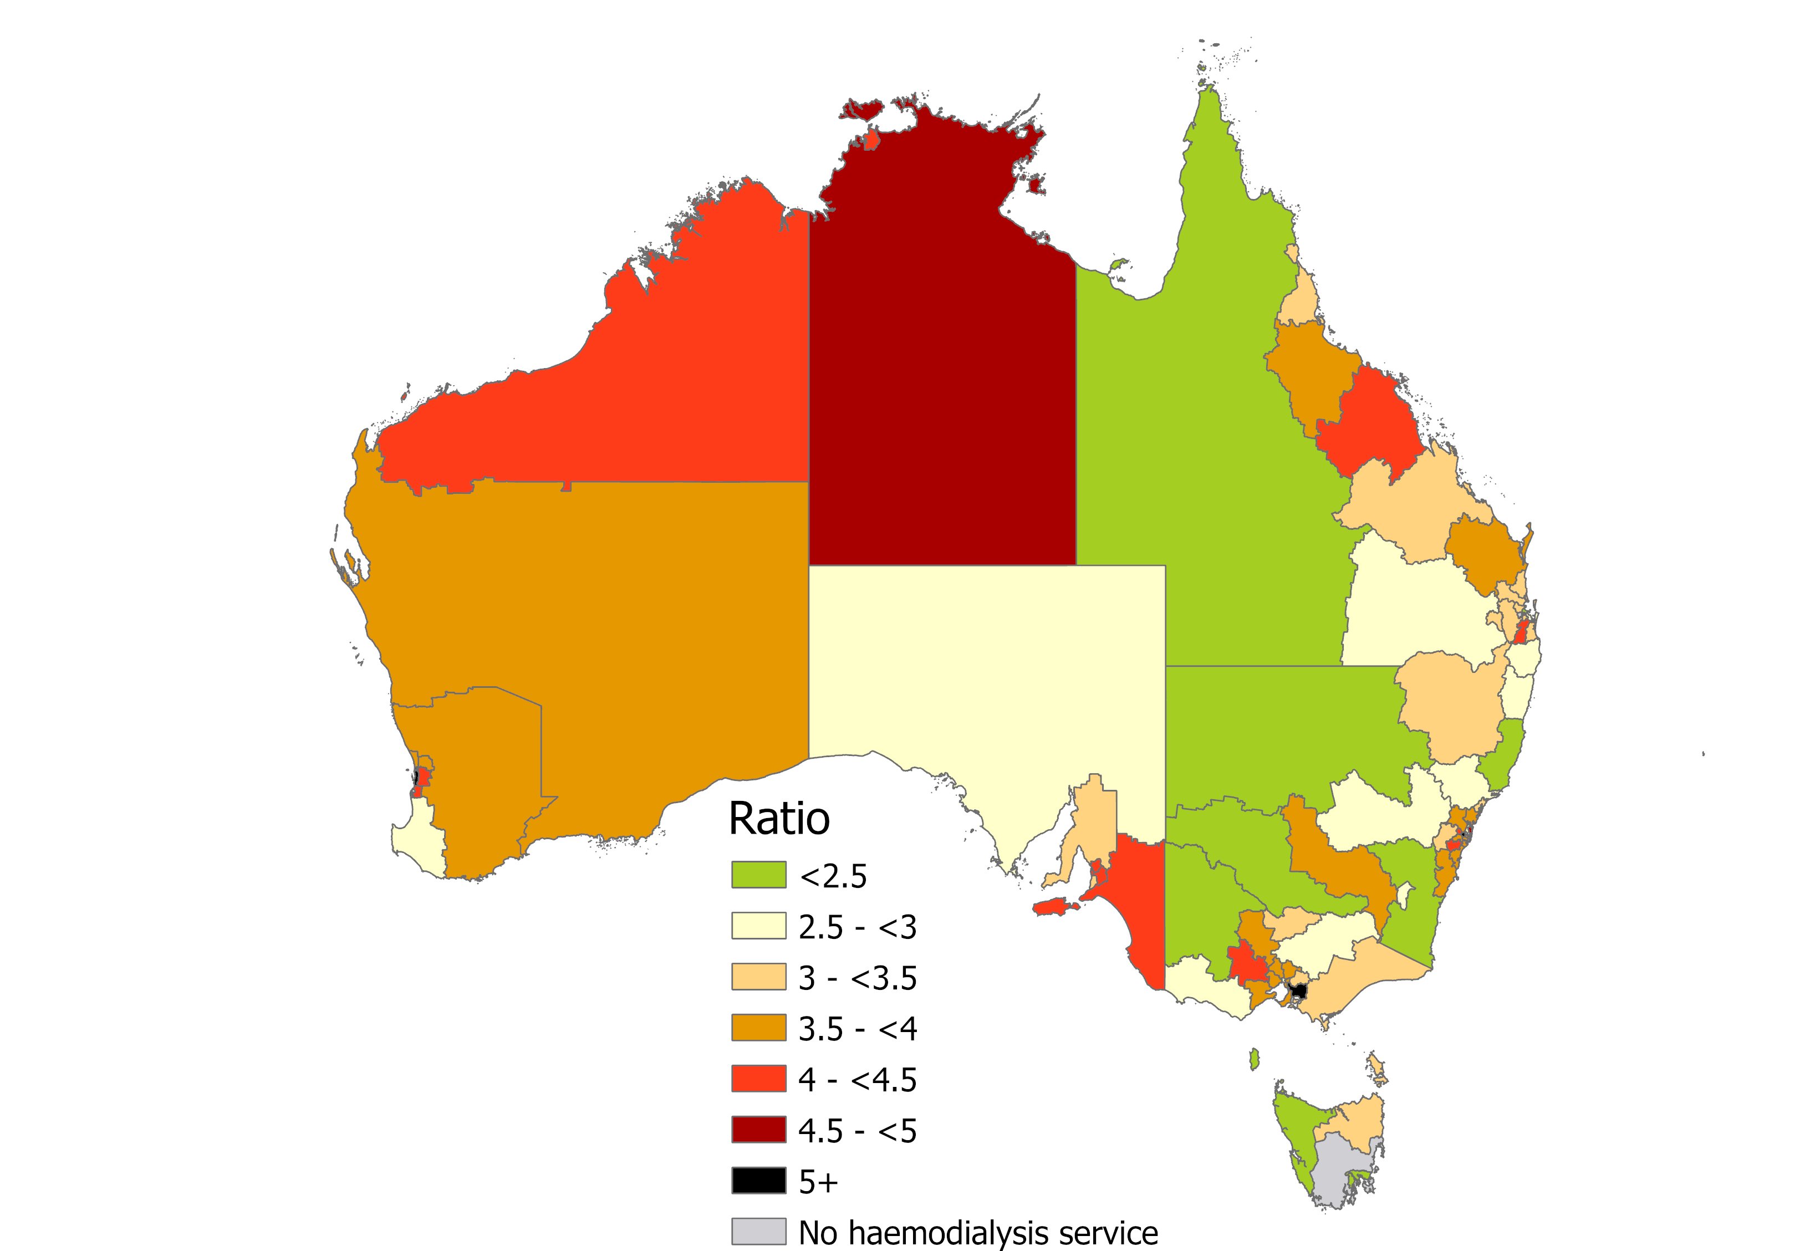
Figure 5
Map of Australia with the ratio of individuals receiving maintenance or ‘acute’ haemodialysis to haemodialysis
machines presented for each Australian Statistical Geography Standard Statistical Area 4 level

Slide 10
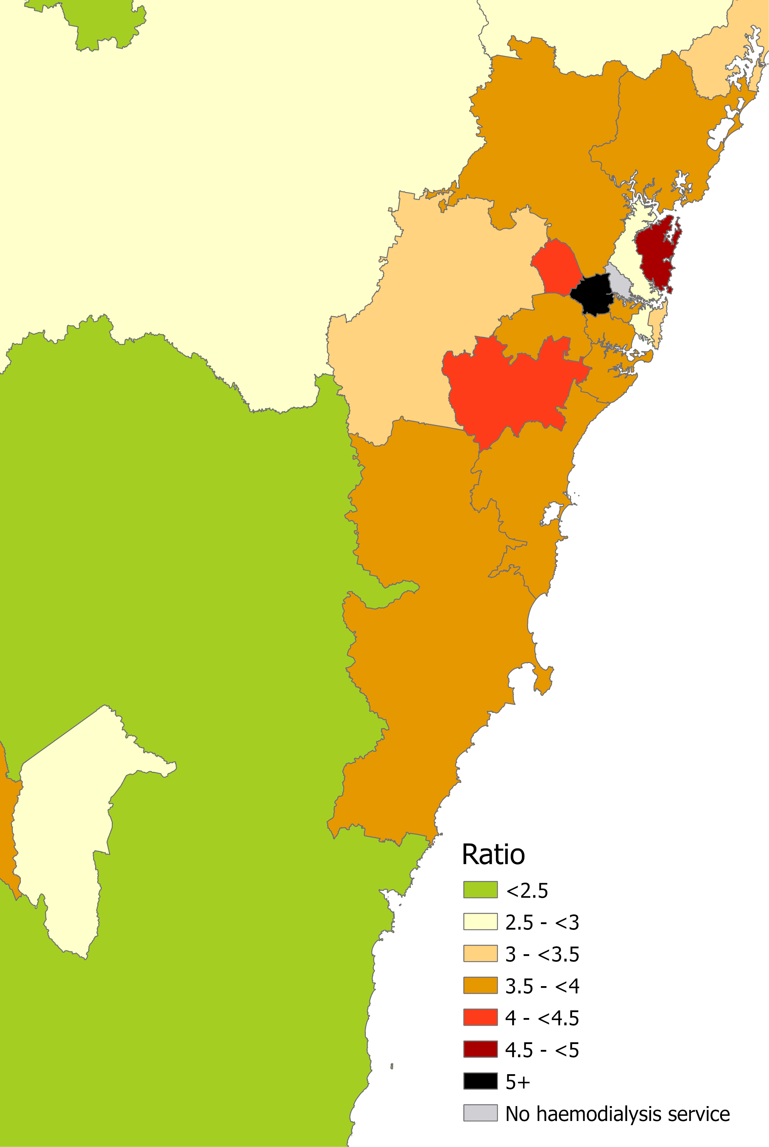
Figure 6
Map of Sydney and Canberra regions with the ratio of individuals receiving maintenance or ‘acute’ haemodialysis to haemodialysis machines presented for each Australian Statistical Geography Standard Statistical Area 4 level

Slide 11
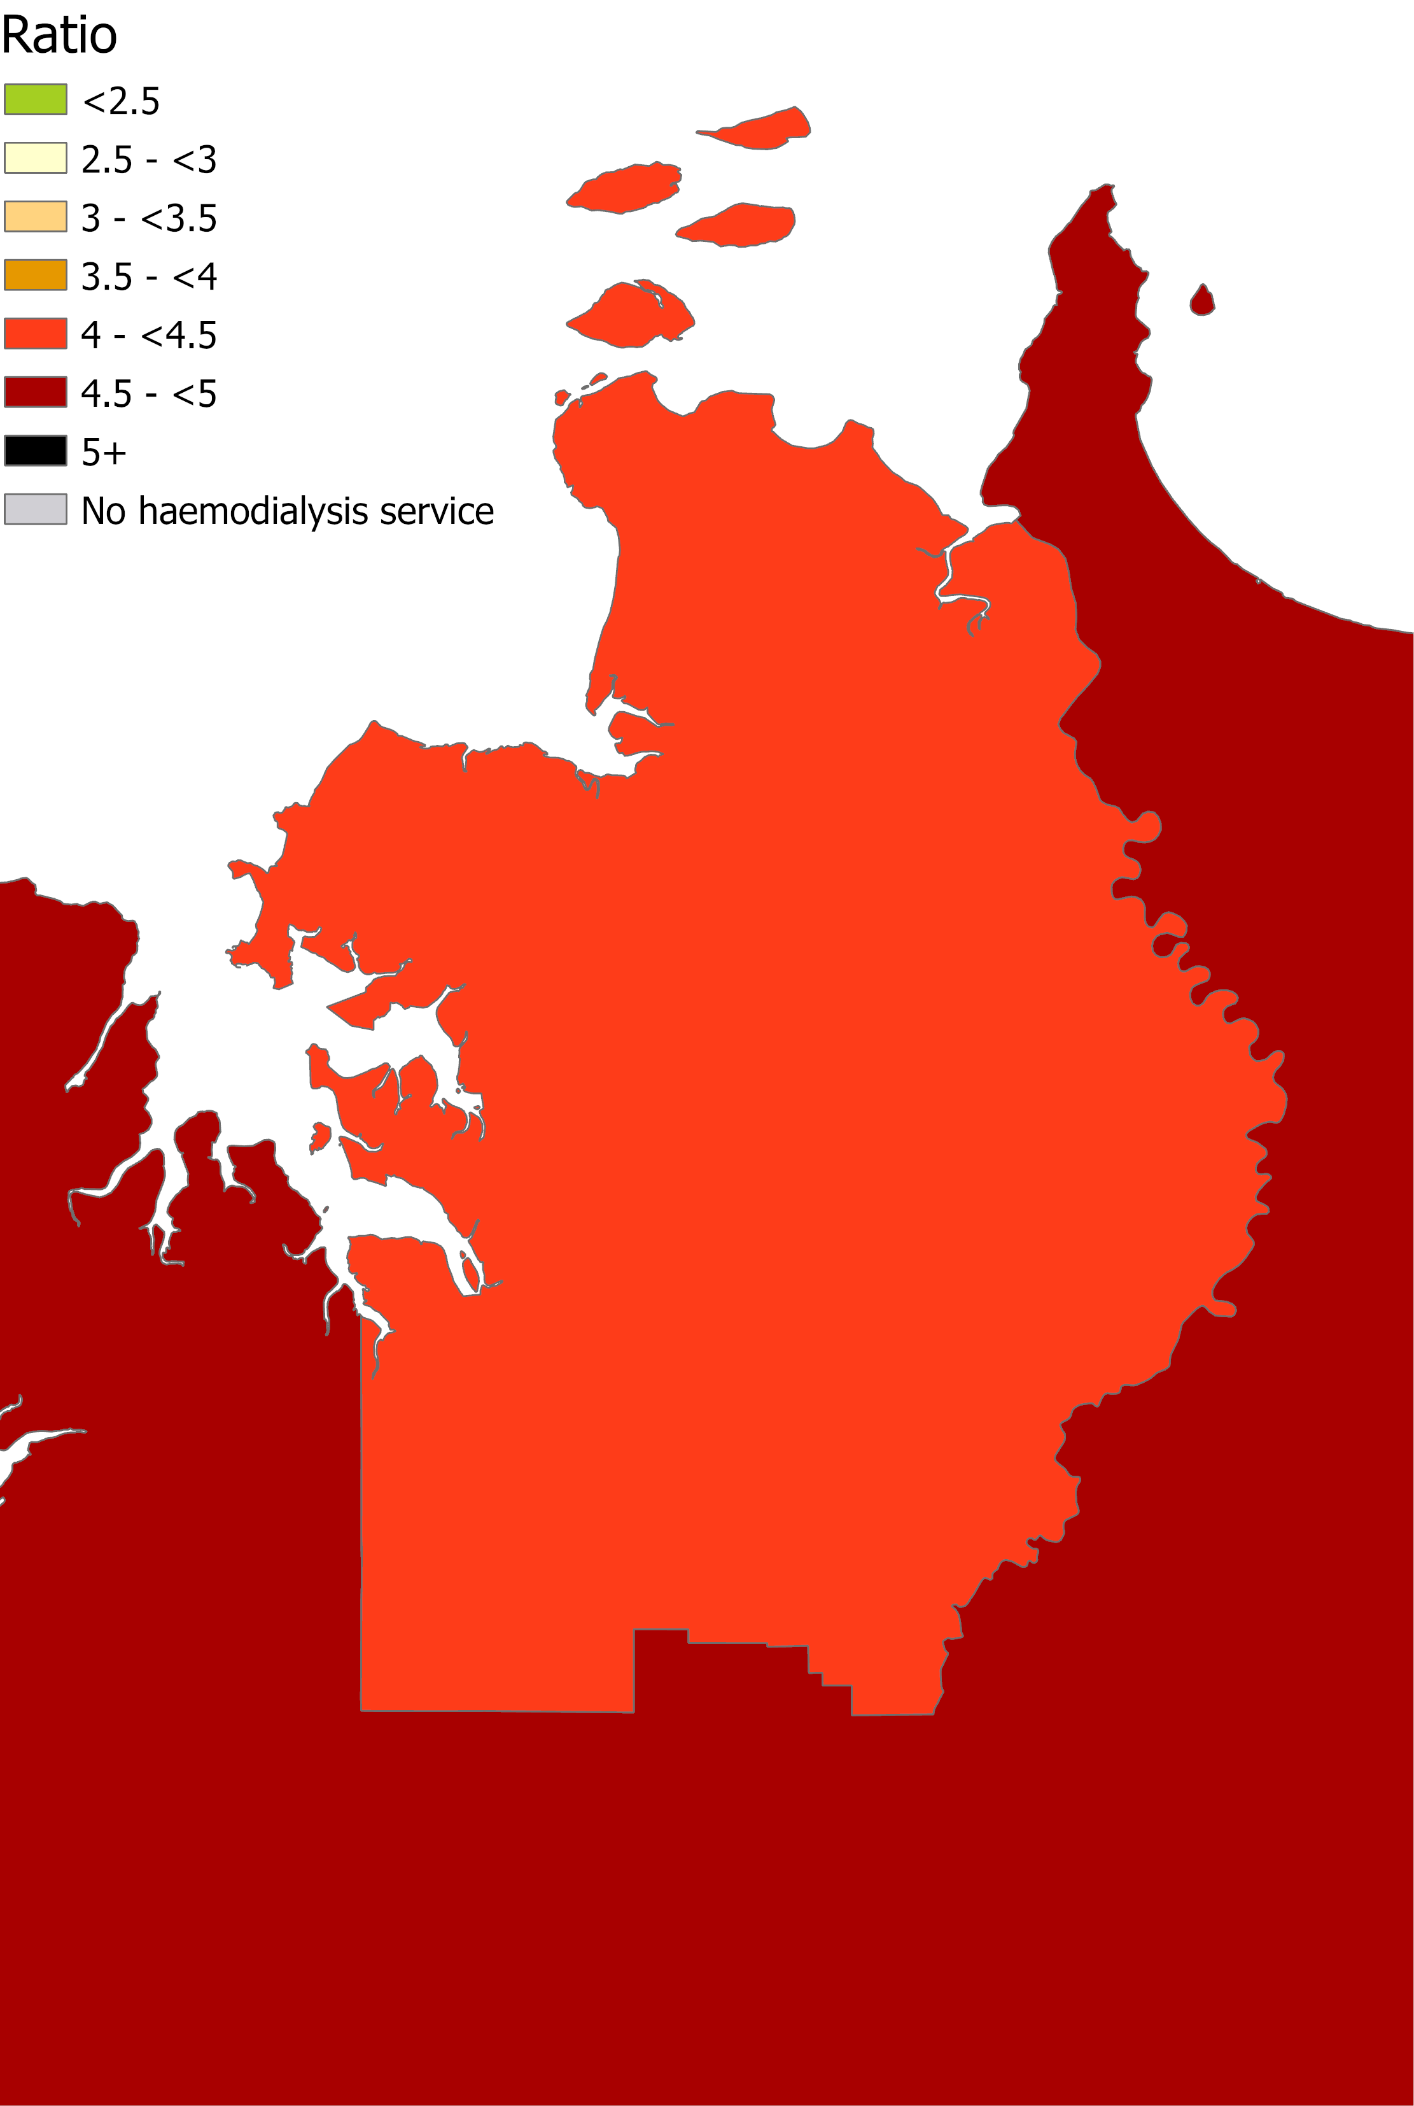
Figure 7
Map of Darwin region with the ratio of individuals receiving maintenance or ‘acute’ haemodialysis to haemodialysis machines presented for each Australian Statistical Geography Standard Statistical Area 4 level

Slide 12
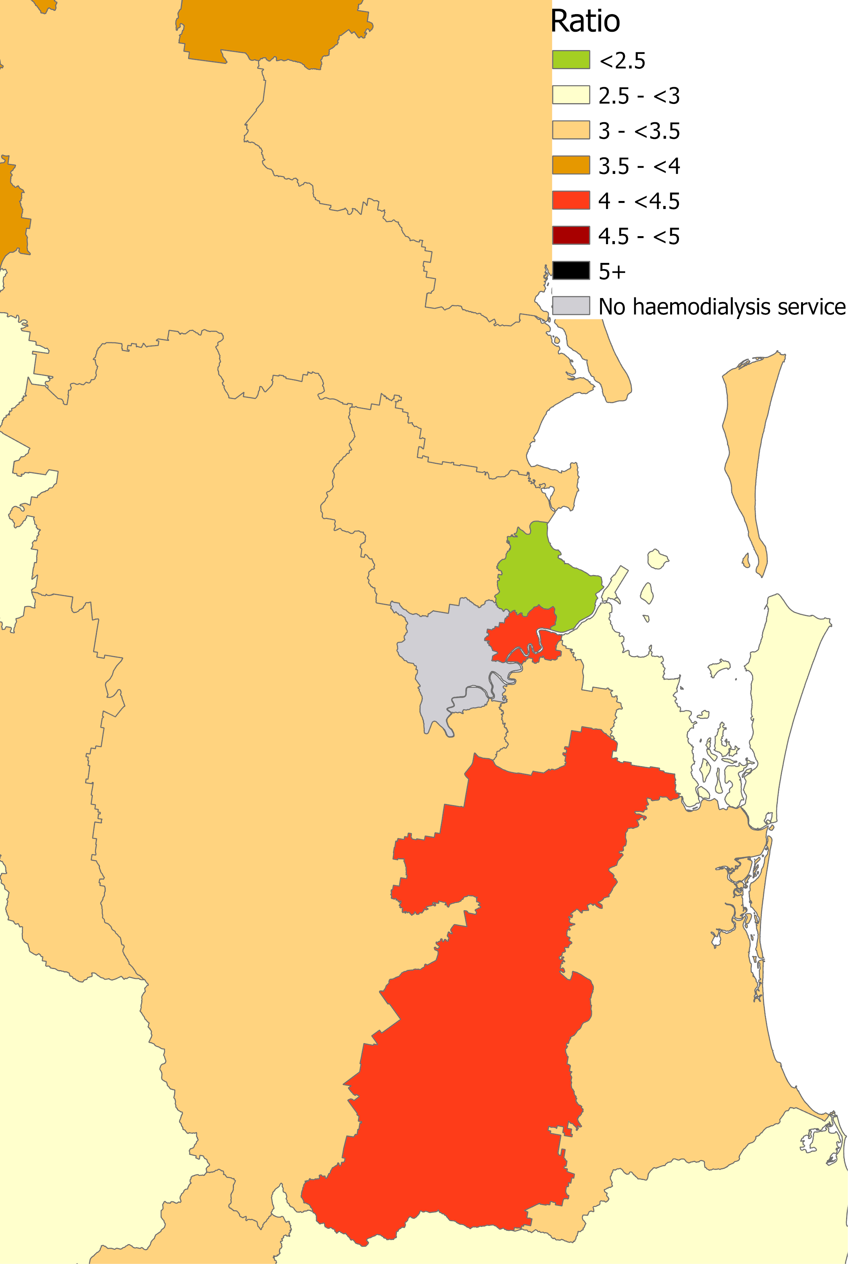
Figure 8
Map of Brisbane region with the ratio of individuals receiving maintenance or ‘acute’ haemodialysis to
haemodialysis machines presented for each Australian Statistical Geography Standard Statistical Area 4 level

Slide 13
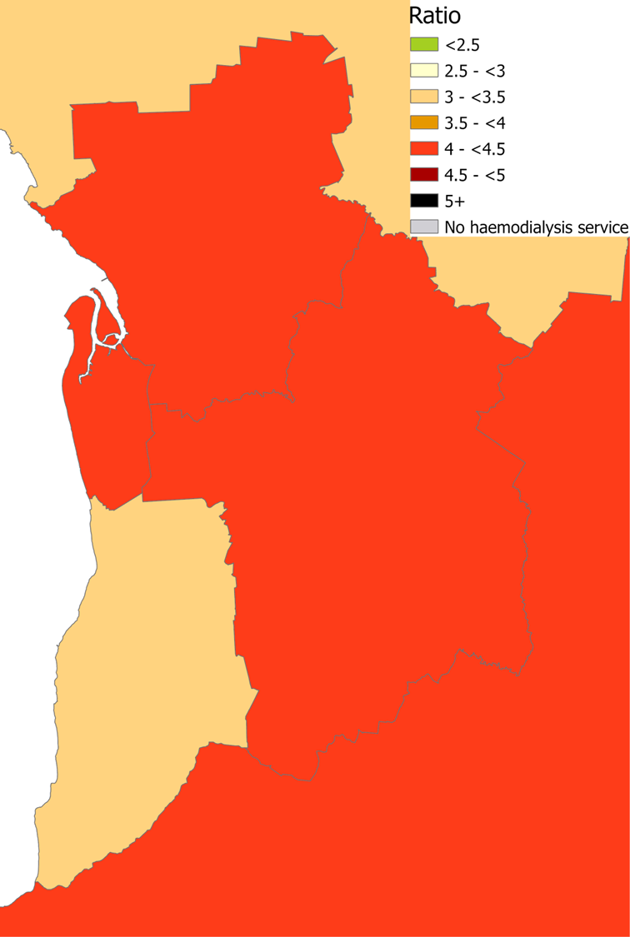
Figure 9
Map of Adelaide region with the ratio of individuals receiving maintenance or ‘acute’ haemodialysis to
haemodialysis machines presented for each Australian Statistical Geography Standard Statistical Area 4 level

Slide 14
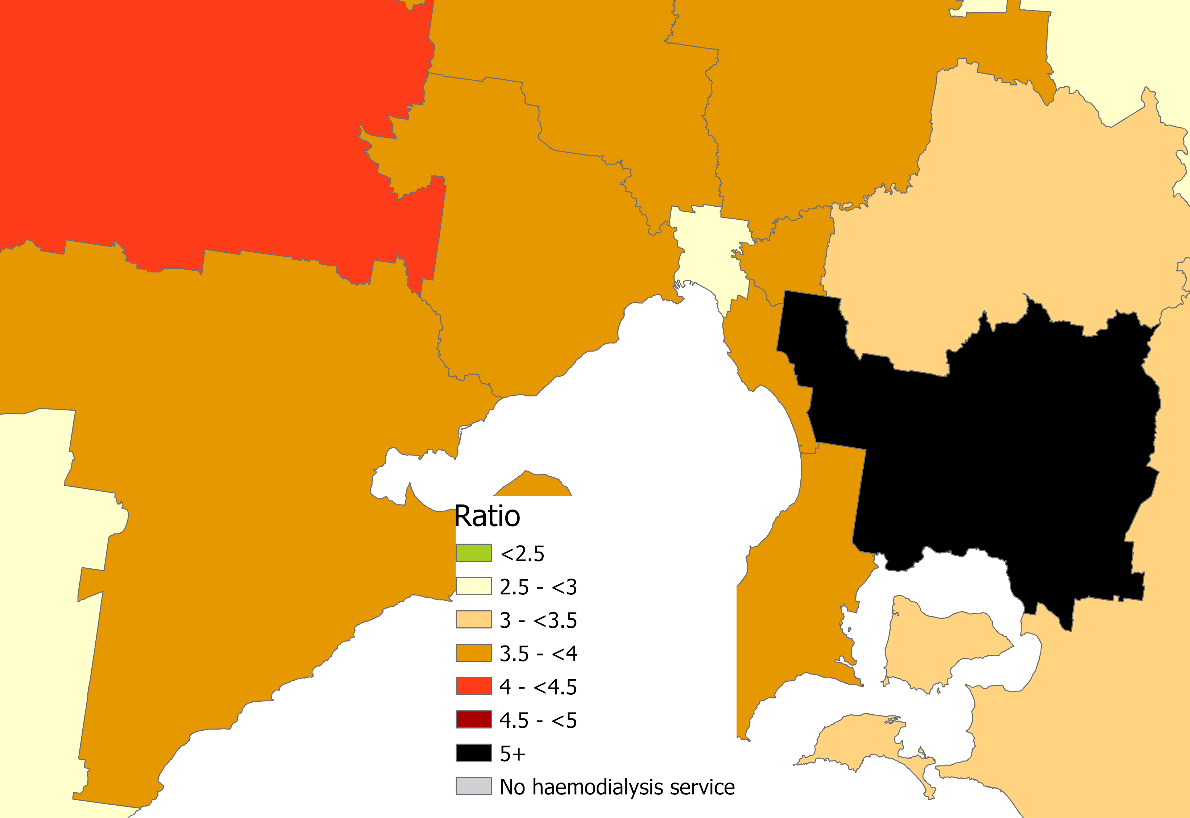
Figure 10
Map of Melbourne region with the ratio of individuals receiving maintenance or ‘acute’ haemodialysis to
haemodialysis machines presented for each Australian Statistical Geography Standard Statistical Area 4 level

Slide 15
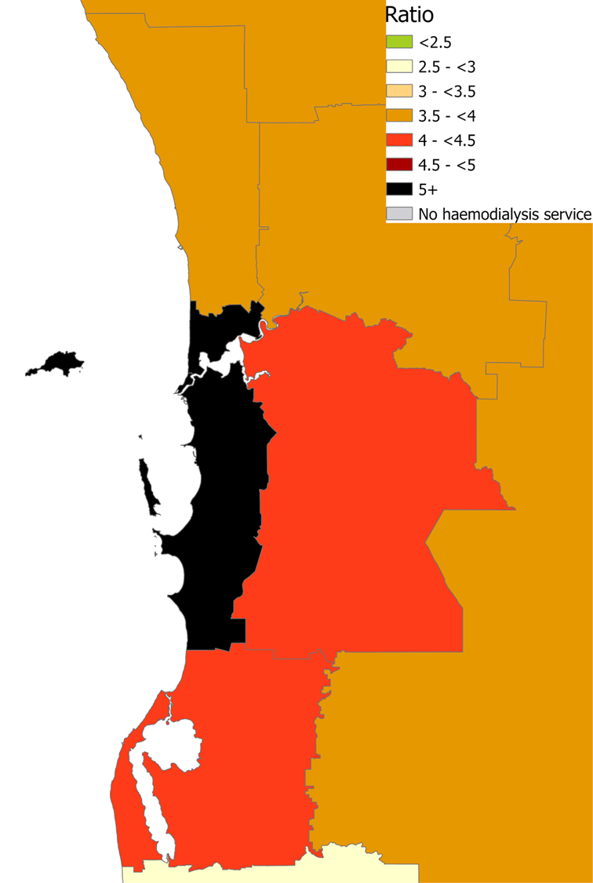
Figure 11
Map of Perth region with the ratio of individuals receiving maintenance or ‘acute’ haemodialysis to haemodialysis
machines presented for each Australian Statistical Geography Standard Statistical Area 4 level

Slide 16
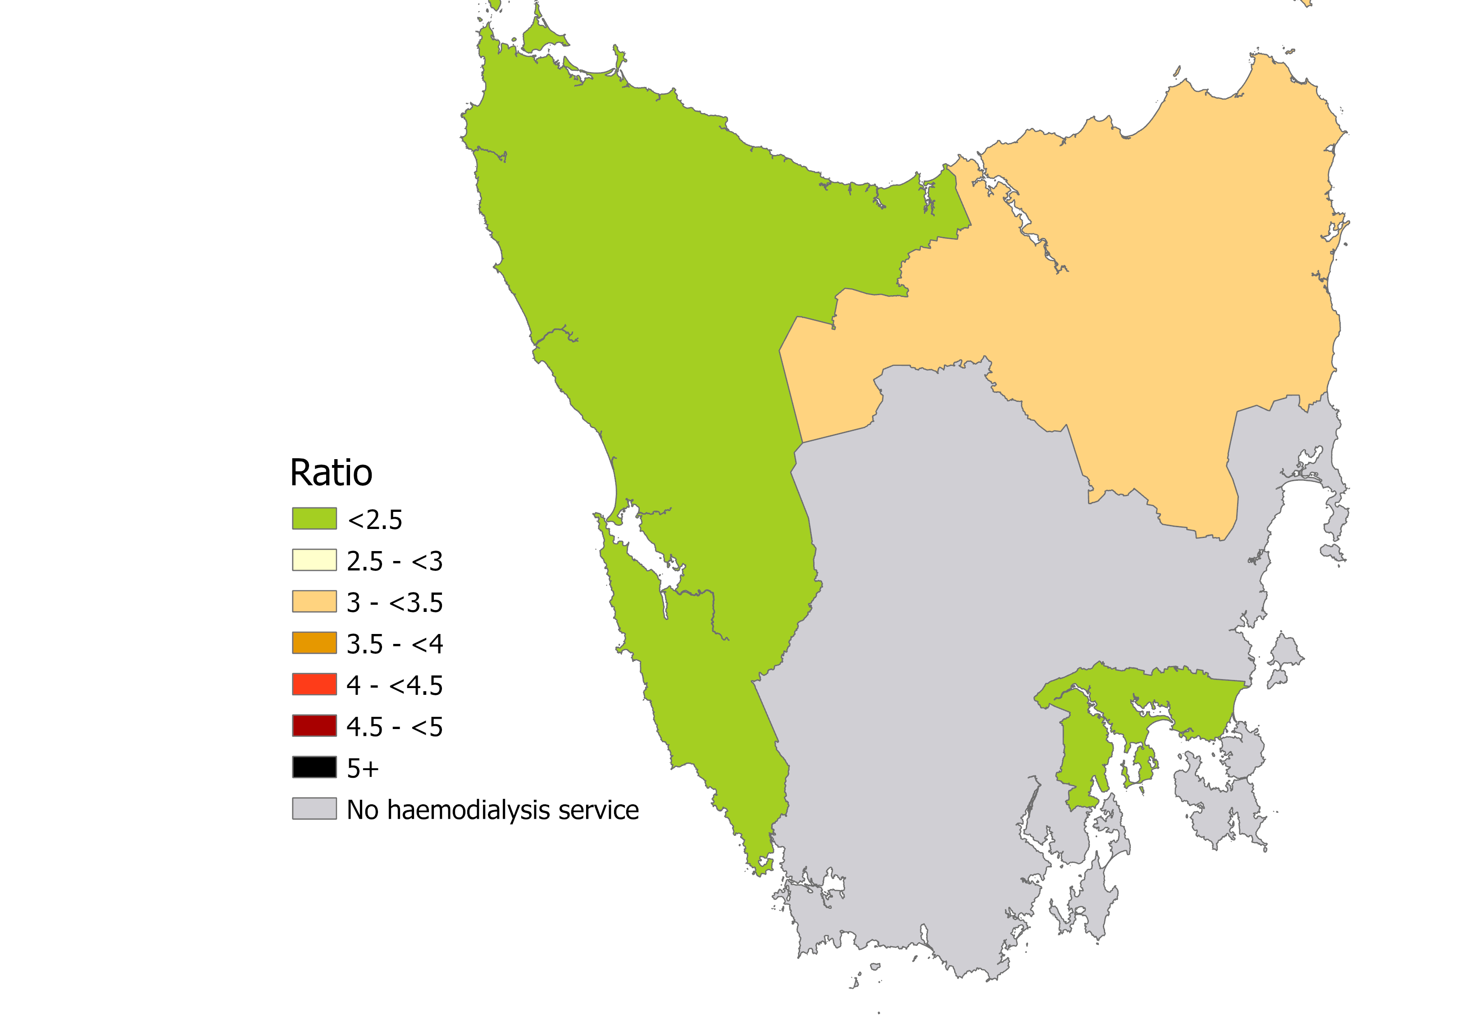
Figure 12
Map of Tasmania with the ratio of individuals receiving maintenance or ‘acute’ haemodialysis to haemodialysis
machines presented for each Australian Statistical Geography Standard Statistical Area 4 level

Slide 17
Figure 13
Waiting lists to commence or transfer haemodialysis care across Australia by
Statistical Area 4 areas

Slide 18
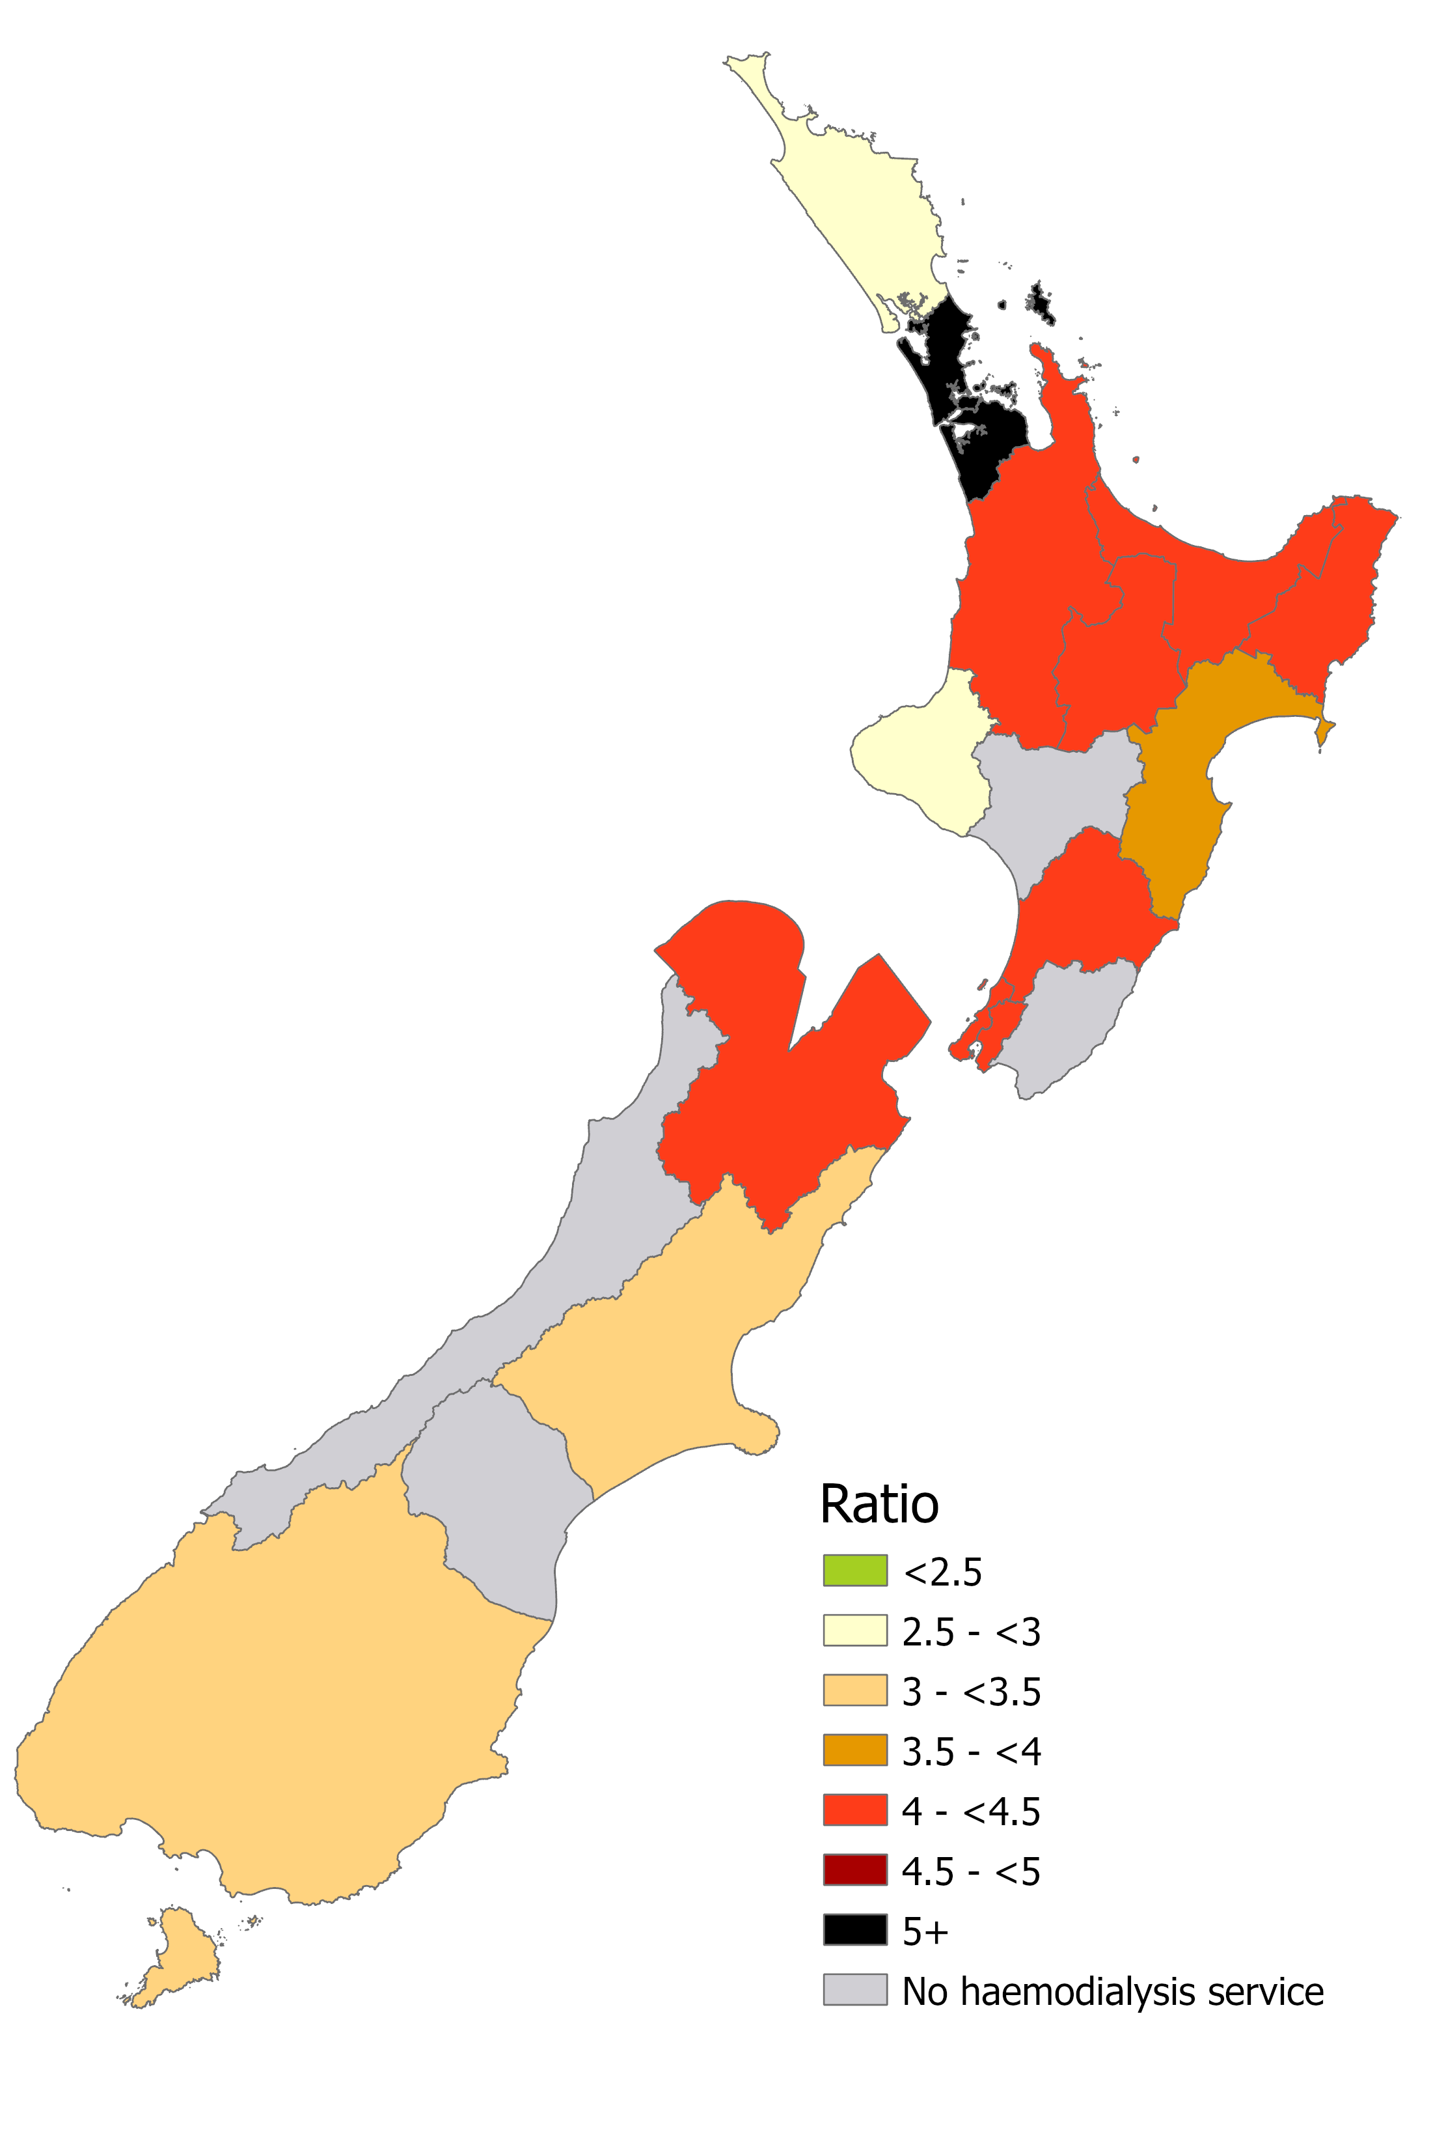
Figure 14
Map of New Zealand with the ratio of individuals receiving maintenance haemodialysis to haemodialysis machines presented for each services region

Slide 19

Citation
Forcey D, Au E, Eddington H, Henderson A, Keuskamp D, Irish G, Clayton P, Gray N, Ford S, Krishnasamy R, Kotwal S, Pilmore H, McDonald S. ANZDATA & ANZSN Special Report: Dialysis Capacity 2025. Australia and New Zealand Dialysis and Transplant Registry, Adelaide, Australia. 2025. ISBN: 978-0-6453621-9-0.
Available at: https://anzorrg.org.au

