Slide 1
ANZDATA Epidemiology Fellow
Matthew Sypek
Activity report
Transplant wait listing in Australia

Slide 2


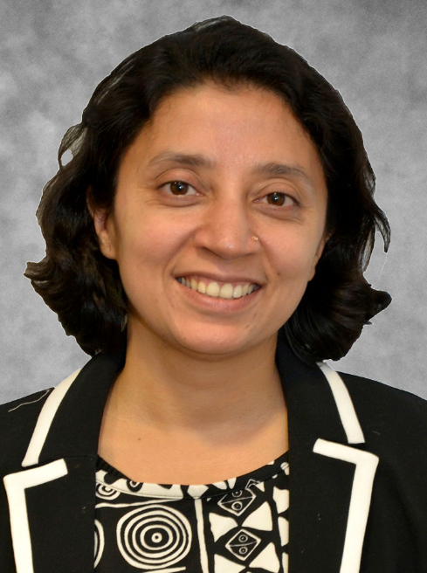


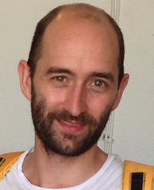
The ANZDATA Epidemiology Fellowship
Stephen McDonald
2001-2005
Andrew Brunskill
2008
Namrata Khanal
2014-2015
Sean Chang
2006-2007
Phil Clayton
2010-2013
Matthew Sypek
2017-

Slide 3
Internal Research Priorities
Transplant waiting list; organ discard rates; Impact of KDPI reporting; cause of death coding; travel time analysis
Research Collaborations
Adrian Hibberd: Restored Kidney Transplantation; David Semple: Outcomes in HHDx; Suetonia Palmer; Late referral in NZ; Kathy Pazis: Machine Learning techniques in Organ Allocation
Personal Research Projects
HLA epitope based matching in paediatric renal transplantation
Organ allocation for highly sensitized patients
HLA epitope based organ allocation
Research
BEAT CKD Program
Community preferences for organ allocation – Kirsten Howard/Martin Howell
Requests Management
Review
Service Improvement
Updating and establishing MoU for data sharing
Reviewing data collection eg Primary Renal Disease coding
Revising internal policies and procedures review
Liaise, clarify, explain and assist
Extract and review code
PROMS
Ethical aspects of organ allocation policy
Service Delivery and Development
Clinical Input in to Registry Activities
Data entry queries
Reviewing content of ANZDATA reports
Statistical analysis
Education
ANZDATA Education Forum
External Events: ANZDATA symposium, BEAT CKD
Individualized education for contributors and stakeholders

Slide 4
Wait-listing for Kidney Transplantation in Australia

Slide 5
ESKD
Conservative care
Suitable for Transplantation?
No
Long-term dialysis
Yes
Living Donor Transplant
Deceased Donor Wait Listing
Organ Availability
Treatment of End Stage Kidney Disease
Organ Allocation
Organ Acceptance
Deceased Donor Transplant

Slide 6
ESKD
Conservative care
Suitable for Transplantation?
No
Long-term dialysis
Yes
Living Donor Transplant
Deceased Donor Wait Listing
Organ Non-Utilisation
Organ Availability
Community Preferences
cPRA Modelling
Treatment of End Stage Kidney Disease
Organ Allocation
HLA Epitopes
Ethics of Allocation
Organ Acceptance
Deceased Donor Transplant

Slide 7
ESKD
Conservative care
Suitable for Transplantation?
No
Long-term dialysis
Yes
Living Donor Transplant
Deceased Donor Wait Listing
Organ Non-Utilisation
Organ Availability
Community Preferences
cPRA Modelling
Treatment of End Stage Kidney Disease
Organ Allocation
HLA Epitopes
Ethics of Allocation
Organ Acceptance
Deceased Donor Transplant

Slide 8
Time to Waitlisting
Aims
To determine the factors associated with time to wait listing and time to transplantation for incident RRT patients in Australia
To determine if time to waitlisting is significantly associated with time to transplant
To determine the factors associated with time from waitlist to transplant

Slide 9
Inclusion/Exclusion
Inclusion criteria:
All incident dialysis patients starting RRT in Australia from July 2006-July 2015
Exclusion criteria:
Patients ever wait listed for multi-organ transplant
Patients who regained native kidney function
Patients < 18 years of age
Patients >75 years of age
Outcome
Event = date of first active listing or date of first transplant
Censor = death or date of last follow up

Slide 10
Covariates
Age at starting RRT
Year of starting RRT
Gender
Primary renal disease - categories
Country of Birth - Australia vs other
Ethnic Origin - categories
State at commencing RRT
Co-morbidites
DM, IHD, Lung, PVD, CVD
History of Cancer
Solid Organ
Skin Cancer
Smoking status
BMI - Categories
Late referral
SES based on postcode
Remoteness based on postcode at starting RRT

Slide 11
Statistical Methods
Univariate analysis
Non-parametric – Kaplan Meier Survival Curves with Log Rank test of significance
Semi-parametric – Cox Proportional Hazards Regression
Multivariate analysis
Piecewise Cox Proportional Hazards Model

Slide 12
Please help get the most out of ANZDATA
To read our reports and for more information:
www.anzdata.org.au
If you know what you need:
requests@anzdata.org.au
If you have a question or need some advice:
matthew@anzdata.org.au

