Slide 1

CHAPTER 1
STOCK AND FLOW

Slide 2
Figure 1.1
Prevalent Patients 2006 - 2010 (Number Per Million Population at 31st December)
 | 2006 | 2007 | 2008 | 2009 | 2010
Australia Total | 16120 (779) | 16842 (799) | 17660 (822) | 18317 (834) | 18971 (849)
No. Functioning Transplants • # | 6860 (331) | 7113 (338) | 7500 (349) | 7892 (359) | 8381 (375)
No. Dialysis Patients | 9260 (447) | 9729 (462) | 10160 (473) | 10425 (475) | 10590 (474)
Proportion Home * | 31% | 31% | 31% | 30% | 28%
Proportion Satellite HD | 43% | 45% | 46% | 47% | 50%
Proportion CAPD/APD | 22% | 22% | 22% | 21% | 19%
New Zealand Total | 3244 (775) | 3354 (793) | 3454 (809) | 3680 (852) | 3821 (874)
No. Functioning Transplants • # | 1247 (298) | 1283 (303) | 1348 (316) | 1400 (324) | 1443 (330)
No. Dialysis Patients | 1997 (477) | 2071 (490) | 2106 (493) | 2280 (528) | 2378 (544)
Proportion Home * | 54% | 52% | 52% | 51% | 53%
Proportion Satellite HD | 17% | 18% | 19% | 18% | 17%
Proportion CAPD/APD | 38% | 36% | 36% | 35% | 35%
• Country of Transplant # Patients lost to follow up are not included * Proportion of all patients dialysing currently receiving home-based treatment (either PD or HD)

Slide 3
Figure 1.2
Patient Flow Summary 2006 - 2010 (Number Per Million Population at 31st December) * Country of Transplant
 | 2006 | 2007 | 2008 | 2009 | 2010
Australia
Total New Patients | 2432 (118) | 2382 (113) | 2545 (118) | 2402 (109) | 2257 (101)
Total New Transplants * | 641 (31) | 615 (29) | 813 (38) | 773 (35) | 846 (38)
Living Donor Transplants | 273 | 271 | 354 | 327 | 296
Subsequent Transplants | 92 | 88 | 105 | 99 | 102
Total Deaths | 1475 | 1629 | 1674 | 1687 | 1561
Dialysis Patients | 1325 | 1459 | 1493 | 1538 | 1401
Transplant Patients | 150 | 170 | 181 | 149 | 160
New Zealand
Total New Patients | 499 (119) | 469 (111) | 497 (116) | 583 (135) | 503 (115)
Total New Transplants * | 90 (21) | 123 (29) | 122 (29) | 121 (28) | 110 (25)
Living Donor Transplants | 49 | 58 | 69 | 67 | 60
Subsequent Transplants | 10 | 11 | 11 | 12 | 6
Total Deaths | 367 | 343 | 388 | 365 | 353
Dialysis Patients | 333 | 296 | 360 | 331 | 319
Transplant Patients | 34 | 47 | 28 | 34 | 34

Slide 4
Figure 1.3

Slide 5
Figure 1.4

Slide 6
Figure 1.5

Slide 7
Figure 1.6

Slide 8
Figure 1.7

Slide 9
Figure 1.8
Prevalence and Incidence by Indigenous Racial Origin, 2006 - 2010 (Number Per Million Population Per Year for Patients) Aboriginal and Torres Strait Islanders Combined
Race |  |  | 2006 | 2007 | 2008 | 2009 | 2010
Australia
Aboriginal and Torres Strait Islanders | New Patients |  | 221 (428) | 239 (453) | 251 (466) | 195 (355) | 198 (353)
 | Dialysis |  | 989 (1916) | 1092 (2072) | 1159 (2153) | 1177 (2141) | 1208 (2151)
 | Functioning Transplants * |  | 148 (287) | 148 (281) | 159 (295) | 160 (291) | 177 (315)
 | Transplant Operations |  | 27 (52) | 18 (34) | 31 (58) | 24 (44) | 28 (50)
 | Deaths |  | 140 (271) | 134 (254) | 164 (305) | 174 (316) | 160 (285)
New Zealand
Maori | New Patients |  | 169 (271) | 147 (232) | 157 (244) | 176 (270) | 154 (232)
 | Dialysis |  | 684 (1096) | 687 (1085) | 688 (1070) | 724 (1109) | 759 (1143)
 | Functioning Transplants * |  | 111 (178) | 113 (178) | 117 (182) | 127 (194) | 138 (208)
 | Transplant Operations |  | 10 (16) | 17 (27) | 12 (19) | 19 (29) | 20 (30)
 | Deaths |  | 125 (200) | 134 (212) | 152 (236) | 126 (193) | 114 (172)
Pacific People
 | New Patients |  | 79 (262) | 77 (248) | 87 (273) | 103 (314) | 106 (315)
 | Dialysis |  | 371 (1231) | 409 (1318) | 433 (1357) | 485 (1480) | 541 (1608)
 | Functioning Transplants * |  | 77 (255) | 78 (251) | 85 (266) | 87 (265) | 89 (265)
 | Transplant Operations |  | 7 (23) | 6 (19) | 10 (31) | 6 (18) | 9 (27)
 | Deaths |  | 54 (179) | 34 (110) | 55 (172) | 48 (146) | 50 (149)
 | * By Transplanting Country

Slide 10
Figure 1.9
National and State Stock and Flow 1-Jan-2010 to 31-Dec-2010 ( ) 31-Dec-2009 Figures
State | New Patients | Transplant Operations * | Deaths |  | Dialysis Dependent | Functioning Transplants # * | Total
 |  |  | Dialysis | Transplant
Queensland | 439 (491) | 141 (136) | 293 (311) | 36 (29) | 1994 (1944) | 1631 (1567) | 3625 (3511)
New South Wales | 690 (747) | 239 (223) | 448 (497) | 53 (54) | 3441 (3374) | 2376 (2232) | 5817 (5606)
Aust. Capital Territory | 53 (41) | 21 (14) | 26 (27) | 3 (4) | 245 (239) | 215 (199) | 460 (438)
Victoria | 563 (546) | 247 (211) | 297 (347) | 25 (21) | 2598 (2513) | 2186 (2028) | 4784 (4541)
Tasmania | 47 (57) | 31 (20) | 28 (27) | 2 (1) | 192 (194) | 203 (190) | 395 (384)
South Australia | 175 (205) | 82 (82) | 114 (107) | 19 (19) | 674 (670) | 911 (861) | 1585 (1531)
Northern Territory | 64 (72) | 5 (5) | 43 (45) | 0 (4) | 439 (418) | 69 (68) | 508 (486)
Western Australia | 226 (243) | 80 (82) | 152 (177) | 56 (51) | 1007 (989) | 818 (781) | 1825 (1770)
Australia | 2257 (2402) | 846 (773) | 1401 (1538) | 160 (149) | 10590 (10341) | 8409 (7926) | 18999 (18267)
New Zealand | 503 (583) | 110 (121) | 319 (331) | 34 (34) | 2378 (2260) | 1415 (1379) | 3793 (3639)
# Patients lost to follow-up are not included * Resident State

Slide 11
Figure 1.10
Prevalent Transplant and Dialysis Patients 1985 to 2010 Country of Transplant # Patients Lost of Follow-up are not included (Number Per Million Population at 31 December)
 | Australia |  |  | New Zealand
Year | Transplant # | Dialysis | Total | Transplant # | Dialysis | Total
1985 | 2163 (137) | 2230 (141) | 4393 (278) | 377 (114) | 402 (122) | 779 (236)
1986 | 2392 (149) | 2339 (146) | 4731 (295) | 426 (129) | 402 (121) | 828 (250)
1987 | 2574 (158) | 2526 (155) | 5100 (314) | 452 (135) | 437 (131) | 889 (266)
1988 | 2798 (169) | 2675 (162) | 5473 (331) | 484 (145) | 482 (144) | 966 (289)
1989 | 3054 (182) | 2750 (164) | 5804 (345) | 531 (158) | 527 (156) | 1058 (314)
1990 | 3265 (191) | 2956 (173) | 6221 (365) | 579 (170) | 557 (163) | 1136 (333)
1991 | 3493 (202) | 3138 (182) | 6631 (384) | 607 (174) | 630 (180) | 1237 (354)
1992 | 3699 (211) | 3383 (193) | 7082 (405) | 677 (192) | 674 (191) | 1351 (382)
1993 | 3872 (219) | 3703 (210) | 7575 (429) | 705 (197) | 721 (202) | 1426 (399)
1994 | 4064 (228) | 4099 (230) | 8163 (457) | 731 (202) | 784 (216) | 1515 (418)
1995 | 4236 (234) | 4518 (250) | 8754 (484) | 783 (213) | 850 (231) | 1633 (444)
1996 | 4449 (243) | 4882 (267) | 9331 (510) | 824 (221) | 934 (250) | 1758 (471)
1997 | 4697 (254) | 5190 (280) | 9887 (534) | 882 (233) | 1017 (269) | 1899 (502)
1998 | 4921 (263) | 5536 (296) | 10457 (559) | 936 (245) | 1126 (295) | 2062 (540)
1999 | 5091 (269) | 6019 (318) | 11110 (587) | 983 (256) | 1230 (321) | 2213 (577)
2000 | 5294 (276) | 6409 (335) | 11703 (611) | 1023 (265) | 1331 (345) | 2354 (610)
2001 | 5507 (284) | 6851 (353) | 12358 (637) | 1063 (273) | 1462 (376) | 2525 (650)
2002 | 5782 (294) | 7263 (370) | 13045 (664) | 1116 (282) | 1594 (403) | 2710 (686)
2003 | 6003 (302) | 7719 (388) | 13722 (690) | 1168 (290) | 1711 (425) | 2879 (715)
2004 | 6292 (313) | 8004 (398) | 14296 (710) | 1221 (299) | 1774 (434) | 2995 (733)
2005 | 6545 (321) | 8640 (424) | 15185 (745) | 1239 (300) | 1878 (454) | 3117 (754)
2006 | 6860 (331) | 9260 (447) | 16120 (779) | 1247 (298) | 1997 (477) | 3244 (775)
2007 | 7113 (338) | 9729 (462) | 16842 (799) | 1283 (303) | 2071 (490) | 3354 (793)
2008 | 7500 (349) | 10160 (473) | 17660 (822) | 1348 (316) | 2106 (493) | 3454 (809)
2009 | 7892 (359) | 10425 (475) | 18317 (834) | 1400 (324) | 2280 (528) | 3680 (852)
2010 | 8382 (375) | 10590 (474) | 18972 (849) | 1442 (330) | 2378 (544) | 3820 (874)

Slide 12
Figure 1.11
Comparison of Prevalent Transplant and Dialysis Dependent Patients 2006 - 2010 (Number Per Million Population at 31 December)
 | 2006 | 2007 | 2008 | 2009 | 2010
Transplants **
Queensland | 1356 (331) | 1403 (334) | 1483 (344) | 1556 (351) | 1631 (361)
New South Wales* | 1992 (301) | 2034 (304) | 2133 (314) | 2234 (323) | 2376 (338)
Aust. Capital Territory* | 188 (347) | 193 (351) | 197 (353) | 198 (349) | 215 (373)
Victoria | 1688 (329) | 1766 (338) | 1887 (354) | 2028 (372) | 2186 (394)
Tasmania | 154 (314) | 165 (335) | 177 (355) | 190 (378) | 203 (400)
South Australia | 746 (476) | 784 (494) | 830 (517) | 862 (531) | 911 (554)
Northern Territory | 73 (347) | 78 (363) | 74 (336) | 67 (296) | 69 (300)
Western Australia | 681 (331) | 703 (333) | 744 (342) | 782 (348) | 818 (356)
Australia | 6878 (332) | 7126 (338) | 7525 (350) | 7917 (360) | 8409 (376)
New Zealand | 1229 (294) | 1270 (300) | 1323 (310) | 1375 (318) | 1415 (324)
** By Resident State and Country
Dialysis
Queensland | 1704 (417) | 1809 (431) | 1885 (438) | 1957 (442) | 1994 (442)
New South Wales* | 3025 (458) | 3192 (477) | 3356 (493) | 3408 (493) | 3441 (490)
Aust. Capital Territory* | 206 (380) | 215 (391) | 235 (421) | 239 (421) | 245 (425)
Victoria | 2348 (458) | 2411 (462) | 2482 (466) | 2524 (463) | 2598 (468)
Tasmania | 163 (333) | 175 (355) | 179 (359) | 198 (393) | 192 (378)
South Australia | 604 (385) | 626 (395) | 631 (393) | 682 (420) | 674 (410)
Northern Territory | 334 (1586) | 368 (1713) | 398 (1805) | 417 (1844) | 439 (1911)
Western Australia | 876 (425) | 933 (442) | 994 (457) | 1000 (445) | 1007 (439)
Australia | 9260 (447) | 9729 (462) | 10160 (473) | 10425 (475) | 10590 (474)
New Zealand | 1997 (477) | 2071 (490) | 2106 (493) | 2280 (528) | 2378 (544)
* NSW population excludes residents of the Southern Area Health Service * ACT population includes residents of the Southern Area Health Service (Medical services in the ACT service this Southern Area Region) Transplanted patients lost to follow up have been excluded

Slide 13
Figure 1.12

Slide 14
Figure 1.13

Slide 15
Figure 1.14 - ACT

Slide 16
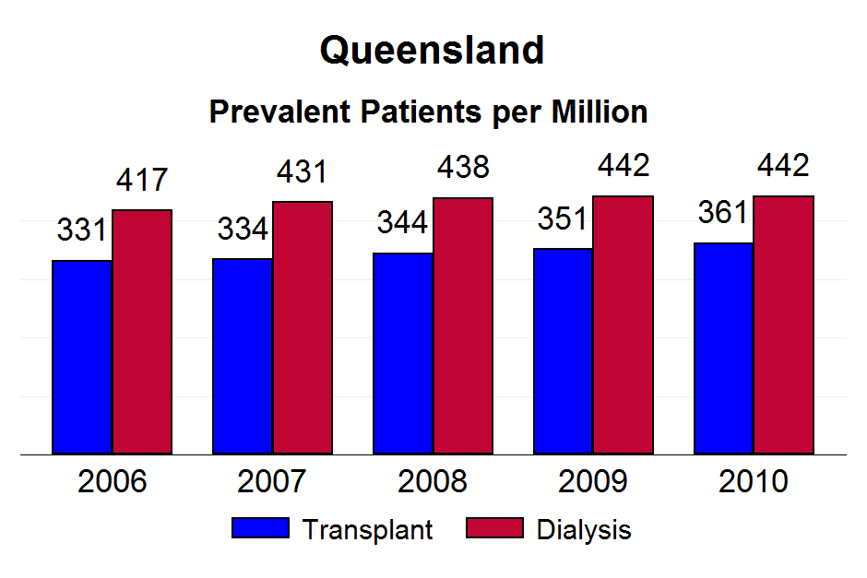

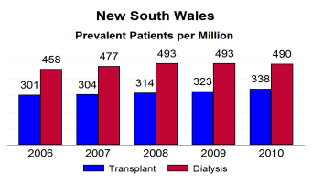

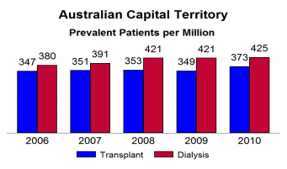
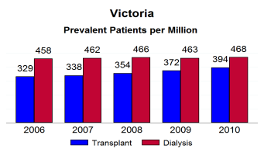
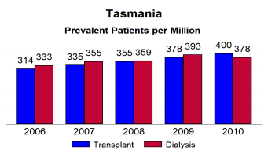
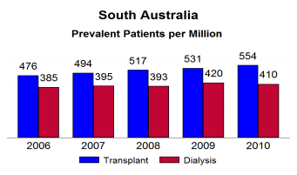
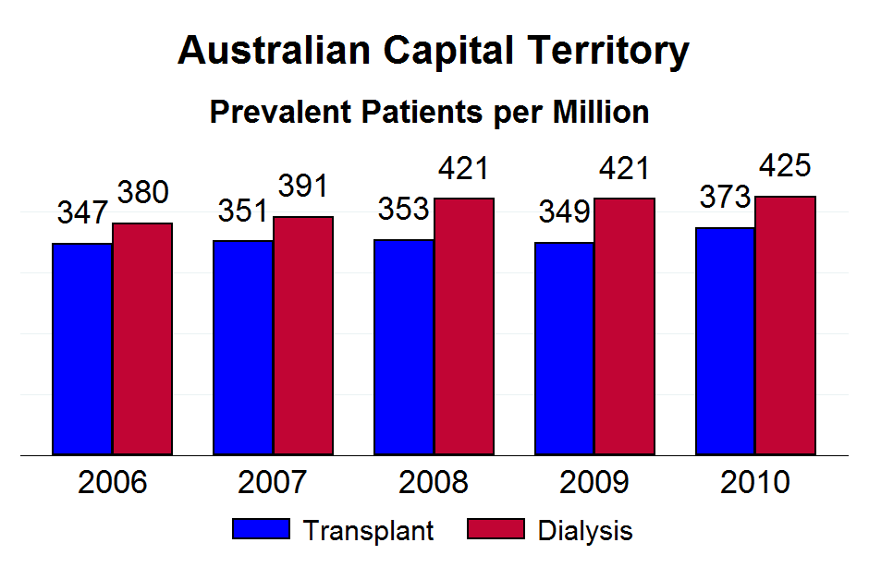

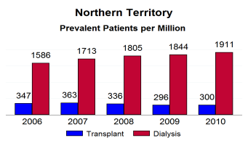
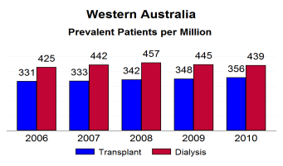




Figure 1.14 - NSW

Slide 17
Figure 1.14 - NT

Slide 18
Figure 1.14 - QLD

Slide 19
Figure 1.14 - SA

Slide 20
Figure 1.14 - TAS

Slide 21
Figure 1.14 - VIC

Slide 22
Figure 1.14 - WA

