Slide 1

CHAPTER 2
NEW PATIENTS
COMMENCING TREATMENTS IN 2010

Slide 2
Figure 2.1
Annual Intake of New Patients 2006 - 2010 (Number Per Million Population)
 | 2006 | 2007 | 2008 | 2009 | 2010
Queensland | 496 (121) | 469 (112) | 533 (124) | 491 (111) | 439 (97)
New South Wales | 769 (116) | 760 (114) | 810 (119) | 747 (108) | 690 (98)
Aust. Capital Territory | 55 (102) | 55 (100) | 61 (109) | 41 (72) | 53 (92)
Victoria | 566 (110) | 544 (104) | 538 (101) | 546 (100) | 563 (101)
Tasmania | 51 (104) | 55 (112) | 54 (108) | 57 (113) | 47 (93)
South Australia | 184 (117) | 166 (105) | 186 (116) | 205 (126) | 175 (106)
Northern Territory | 76 (361) | 76 (354) | 90 (408) | 72 (318) | 64 (279)
Western Australia | 235 (114) | 257 (122) | 273 (125) | 243 (108) | 226 (98)
Australia | 2432 (118) | 2382 (113) | 2545 (118) | 2402 (109) | 2257 (101)
New Zealand | 499 (119) | 469 (111) | 497 (116) | 583 (135) | 503 (115)

Slide 3
Figure 2.2

Slide 4
Figure 2.3

Slide 5
Figure 2.4
Acceptance of Elderly New Patients 2006 - 2010 (Number Per Million Population)
Country | Age Groups | 2006 | 2007 | 2008 | 2009 | 2010
Australia | 60-64 years | 252 (255) | 271 (255) | 287 (255) | 265 (227) | 269 (222)
 | 65-69 years | 280 (358) | 249 (308) | 302 (363) | 286 (329) | 244 (268)
 | 70-74 years | 331 (525) | 296 (458) | 316 (476) | 297 (433) | 283 (398)
 | 75-79 years | 302 (547) | 286 (517) | 284 (515) | 291 (527) | 263 (477)
 | 80-84 years | 161 (397) | 179 (431) | 194 (457) | 168 (389) | 148 (337)
 | >=85 years | 49 (152) | 49 (143) | 61 (170) | 67 (179) | 76 (191)
 | Total | 1375 (373) | 1330 (347) | 1444 (365) | 1374 (336) | 1283 (304)
New Zealand | 60-64 years | 62 (331) | 59 (298) | 65 (308) | 72 (325) | 89 (386)
 | 65-69 years | 61 (392) | 56 (344) | 65 (391) | 75 (438) | 70 (398)
 | 70-74 years | 48 (399) | 47 (384) | 51 (405) | 65 (498) | 48 (350)
 | 75-79 years | 29 (280) | 29 (278) | 29 (277) | 50 (477) | 32 (304)
 | 80-84 years | 22 (297) | 9 (119) | 7 (90) | 16 (202) | 18 (223)
 | >=85 years | 6 (103) | 4 (66) | 0 (0) | 4 (60) | 3 (43)
 | Total | 228 (326) | 204 (282) | 217 (290) | 282 (364) | 260 (325)

Slide 6
Figure 2.5
Age and Gender of New Patients 1-Jan-2010 to 31-Dec-2010 (n = Number of Patients)
Age Groups Years | QLD (n=439) |  | NSW (n=690) |  | ACT (n=53) |  | VIC (n=563) |  | TAS (n=47) |  | SA (n=175) |  | NT (n=64) |  | WA (n=226) |  |  | Aust (n=2257) |  | NZ (n=503)
 | F | M | F | M | F | M | F | M | F | M | F | M | F | M | F | M |  | F | M | F | M
00-04 | 0 | 1 | 0 | 2 | 0 | 0 | 2 | 1 | 0 | 0 | 1 | 0 | 0 | 0 | 0 | 1 |  | 3 | 5 | 0 | 2
05-14 | 2 | 5 | 2 | 5 | 0 | 0 | 2 | 2 | 0 | 0 | 1 | 1 | 0 | 0 | 1 | 0 |  | 8 | 13 | 1 | 0
15-24 | 6 | 7 | 6 | 9 | 0 | 1 | 1 | 5 | 0 | 0 | 2 | 2 | 0 | 0 | 3 | 4 |  | 18 | 28 | 6 | 7
25-34 | 6 | 10 | 19 | 11 | 2 | 1 | 8 | 18 | 0 | 3 | 3 | 3 | 2 | 5 | 3 | 3 |  | 43 | 54 | 7 | 11
35-44 | 22 | 29 | 21 | 27 | 1 | 4 | 17 | 28 | 4 | 0 | 5 | 7 | 9 | 6 | 11 | 21 |  | 90 | 122 | 17 | 25
45-54 | 27 | 51 | 42 | 63 | 4 | 5 | 29 | 60 | 4 | 3 | 10 | 14 | 13 | 9 | 13 | 17 |  | 142 | 222 | 39 | 65
55-64 | 31 | 48 | 49 | 105 | 1 | 7 | 55 | 77 | 5 | 4 | 17 | 30 | 6 | 7 | 18 | 35 |  | 182 | 313 | 66 | 86
65-74 | 34 | 60 | 64 | 106 | 4 | 7 | 50 | 97 | 3 | 8 | 15 | 29 | 2 | 5 | 21 | 22 |  | 193 | 334 | 49 | 69
75-84 | 30 | 49 | 55 | 72 | 5 | 7 | 29 | 72 | 3 | 10 | 10 | 22 | 0 | 0 | 15 | 32 |  | 147 | 264 | 13 | 37
>=85 | 8 | 13 | 5 | 27 | 1 | 3 | 1 | 9 | 0 | 0 | 0 | 3 | 0 | 0 | 3 | 3 |  | 18 | 58 | 0 | 3
Total | 166 | 273 | 263 | 427 | 18 | 35 | 194 | 369 | 19 | 28 | 64 | 111 | 32 | 32 | 88 | 138 |  | 844 | 1413 | 198 | 305
Mean (yrs) | 60 | 60 | 60.5 | 62.6 | 62.7 | 63.1 | 59.7 | 61.5 | 59.4 | 66.4 | 58.6 | 62.5 | 49.3 | 49.4 | 60.1 | 60.4 |  | 59.6 | 61.4 | 57.6 | 58.8
All | 60 |  | 61.8 |  | 63 |  | 60.9 |  | 63.6 |  | 61.1 |  | 49.3 |  | 60.3 |  |  | 60.7 |  | 58.3
Median (yrs) | 62.4 |  | 64.1 |  | 65.6 |  | 63.4 |  | 69.1 |  | 63.2 |  | 49.4 |  | 61.8 |  |  | 62.9 |  | 60.3
Range | 4.8 - 93.2 |  | 1.3 - 90.8 |  | 21.4 - 87.8 |  | 0.2 - 89.3 |  | 27.9 - 82.7 |  | 0 - 86.3 |  | 29 - 71.4 |  | 2.1 - 88.7 |  |  | 0 - 93.2 |  | 0.8 - 86.5

Slide 7
Figure 2.6 - ACT

Slide 8
Figure 2.6 - NSW

Slide 9
Figure 2.6 - NT

Slide 10
Figure 2.6 - QLD

Slide 11
Figure 2.6 - SA

Slide 12
Figure 2.6 - TAS

Slide 13
Figure 2.6 - VIC

Slide 14
Figure 2.6 - WA

Slide 15
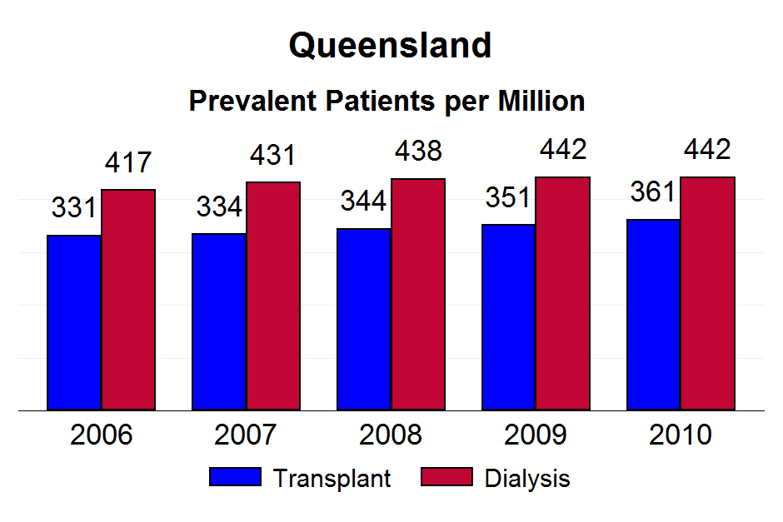

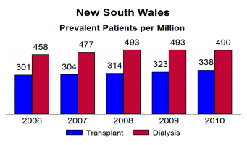

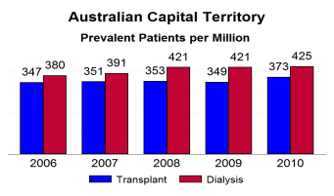
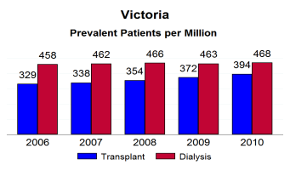
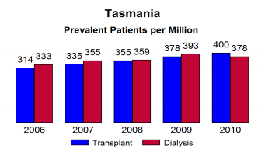
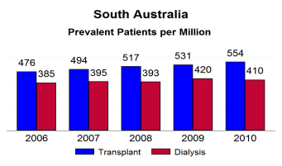
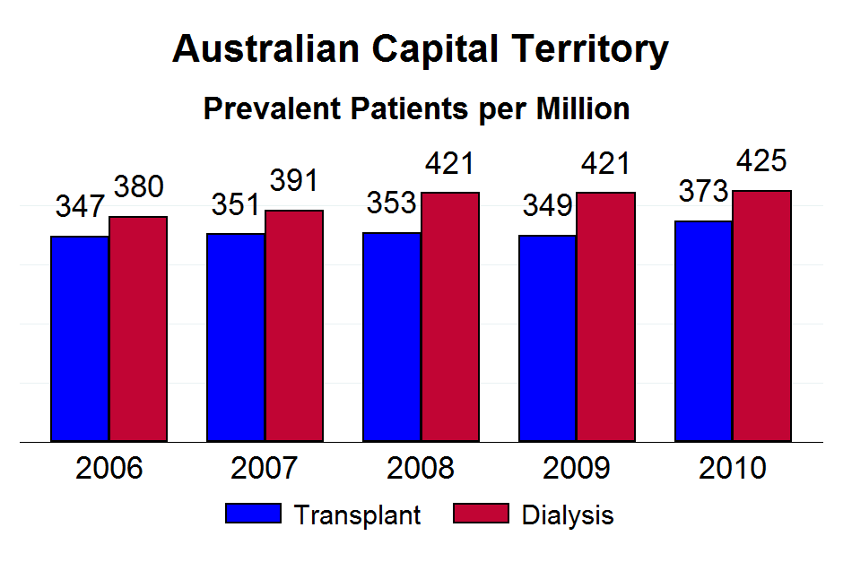

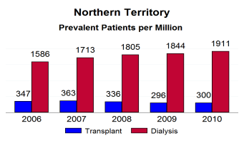
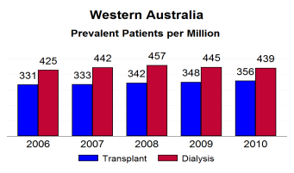




Figure 2.7 - ACT

Slide 16
Figure 2.7 - NSW

Slide 17
Figure 2.7 - NT

Slide 18
Figure 2.7 - QLD

Slide 19
Figure 2.7 - SA

Slide 20
Figure 2.7 - TAS

Slide 21
Figure 2.7 - VIC

Slide 22
Figure 2.7 - WA

Slide 23
Figure 2.8
Late Referral of New Patients 2010 Number of Patients (% Patients)
Primary Renal Disease | QLD | NSW | ACT | VIC | TAS | SA | NT | WA | Aust | NZ
Yes
Analgesic | 2 (2%) | 6 (4%) | 1 (13%) | 2 (1%) | 0 (0%) | 0 (0%) | 1 (20%) | 0 (0%) | 12 (2%) | 0 (0%)
T1 diabetes requiring insulin | 4 (4%) | 2 (1%) | 0 (0%) | 4 (3%) | 0 (0%) | 2 (7%) | 0 (0%) | 0 (0%) | 12 (2%) | 2 (2%)
T2 diabetes requiring insulin | 7 (7%) | 25 (15%) | 1 (13%) | 20 (15%) | 0 (0%) | 1 (3%) | 0 (0%) | 5 (9%) | 59 (12%) | 20 (24%)
T2 diabetes no insulin | 18 (18%) | 14 (8%) | 0 (0%) | 21 (16%) | 1 (14%) | 3 (10%) | 2 (40%) | 15 (27%) | 74 (15%) | 16 (20%)
Glomerulonephritis | 19 (19%) | 47 (28%) | 2 (25%) | 27 (20%) | 0 (0%) | 7 (24%) | 1 (20%) | 21 (38%) | 124 (25%) | 19 (23%)
Hypertension | 18 (18%) | 22 (13%) | 0 (0%) | 16 (12%) | 2 (29%) | 4 (14%) | 0 (0%) | 6 (11%) | 68 (13%) | 7 (9%)
Miscellaneous | 15 (15%) | 27 (16%) | 1 (13%) | 27 (20%) | 3 (43%) | 8 (28%) | 1 (20%) | 5 (9%) | 87 (17%) | 10 (12%)
Polycystic | 5 (5%) | 11 (7%) | 0 (0%) | 4 (3%) | 0 (0%) | 1 (3%) | 0 (0%) | 0 (0%) | 21 (4%) | 2 (2%)
Reflux | 0 (0%) | 4 (2%) | 0 (0%) | 3 (2%) | 0 (0%) | 0 (0%) | 0 (0%) | 0 (0%) | 7 (1%) | 1 (1%)
Uncertain | 11 (11%) | 8 (5%) | 3 (38%) | 10 (7%) | 1 (14%) | 3 (10%) | 0 (0%) | 4 (7%) | 40 (8%) | 5 (6%)
Subtotals | 99 (23%) | 166 (24%) | 8 (15%) | 134 (24%) | 7 (15%) | 29 (17%) | 5 (8%) | 56 (25%) | 504 ( 22%) | 82 (16%)
No
Analgesic | 6 (2%) | 13 (2%) | 2 (4%) | 3 (1%) | 0 (0%) | 0 (0%) | 0 (0%) | 1 (1%) | 25 (1%) | 2 (0%)
T1 diabetes requiring insulin | 8 (2%) | 11 (2%) | 5 (11%) | 24 (6%) | 2 (5%) | 10 (7%) | 2 (3%) | 6 (4%) | 68 (4%) | 10 (2%)
T2 diabetes requiring insulin | 62 (18%) | 99 (19%) | 2 (4%) | 76 (18%) | 8 (20%) | 28 (19%) | 13 (22%) | 27 (16%) | 315 (18%) | 133 (32%)
T2 diabetes no insulin | 50 (15%) | 70 (13%) | 7 (16%) | 64 (15%) | 4 (10%) | 25 (17%) | 20 (34%) | 30 (18%) | 270 (15%) | 75 (18%)
Glomerulonephritis | 63 (19%) | 126 (24%) | 9 (20%) | 90 (21%) | 10 (25%) | 22 (15%) | 6 (10%) | 39 (23%) | 365 (21%) | 90 (21%)
Hypertension | 54 (16%) | 60 (11%) | 11 (24%) | 56 (13%) | 9 (23%) | 14 (10%) | 11 (19%) | 25 (15%) | 240 (14%) | 51 (12%)
Miscellaneous | 32 (9%) | 73 (14%) | 4 (9%) | 39 (9%) | 4 (10%) | 15 (10%) | 2 (3%) | 16 (9%) | 185 (11%) | 30 (7%)
Polycystic | 25 (7%) | 40 (8%) | 3 (7%) | 41 (10%) | 2 (5%) | 11 (8%) | 2 (3%) | 15 (9%) | 139 (8%) | 13 (3%)
Reflux | 13 (4%) | 14 (3%) | 0 (0%) | 16 (4%) | 1 (3%) | 2 (1%) | 2 (3%) | 4 (2%) | 52 (3%) | 7 (2%)
Uncertain | 27 (8%) | 18 (3%) | 2 (4%) | 20 (5%) | 0 (0%) | 19 (13%) | 1 (2%) | 7 (4%) | 94 (5%) | 10 (2%)
Subtotals | 340 (77%) | 524 (76%) | 45 (85%) | 429 (76%) | 40 (85%) | 146 ( 83%) | 59 (92%) | 170 (75%) | 1753 (78%) | 421 (84%)
Total (100%) | 439 | 690 | 53 | 563 | 47 | 175 | 64 | 226 | 2257 | 503

Slide 24
Figure 2.9
Late Referral - All Modes of Treatment Including Pre-emptive Transplants New Patients 1-Jan-2006 to 31-Dec-2010
Country | Age Groups |  |  |  |  |  | Total
 | 0-19 | 20-44 | 45-64 | 65-74 | 75-84 | >=85
Australia
Yes | 57 (24%) | 466 (25%) | 940 (21%) | 640 (22%) | 487 (21%) | 96 (32%) | 2686 (22%)
No | 180 (76%) | 1389 (75%) | 3525 (79%) | 2245 (78%) | 1787 (79%) | 206 (68%) | 9332 (78%)
Total | 237 | 1855 | 4465 | 2885 | 2274 | 302 | 12018
New Zealand
Yes | 29 (40%) | 112 (27%) | 217 (18%) | 94 (16%) | 44 (18%) | 1 (6%) | 497 (19%)
No | 44 (60%) | 307 (73%) | 998 (82%) | 492 (84%) | 197 (82%) | 16 (94%) | 2054 (81%)
Total | 73 | 419 | 1215 | 586 | 241 | 17 | 2551

Slide 25
Figure 2.10
Late Referral - All Modes of Treatment Including Pre-emptive Transplants 2006 to 2010
Country | Years
 | 2006 | 2007 | 2008 | 2009 | 2010
Australia
Yes | 557 (23%) | 563 (24%) | 556 (22%) | 505 (21%) | 505 (22%)
No | 1875 (77%) | 1819 (76%) | 1989 (78%) | 1897 (79%) | 1752 (78%)
Total (100%) | 2432 | 2382 | 2545 | 2402 | 2257
New Zealand
Yes | 110 (22%) | 96 (20%) | 112 (23%) | 97 (17%) | 82 (16%)
No | 389 (78%) | 373 (80%) | 385 (77%) | 486 (83%) | 421 (84%)
Total (100%) | 499 | 469 | 497 | 583 | 503

Slide 26
Figure 2.11
Late Referral - All Modes of Treatment Including Pre-emptive Transplants By Race 2006 to 2010
Country | Race
 | Asian | Aboriginal/TSI | Caucasoid | Maori | Pacific People | Other
Australia
Yes | 269 (23%) | 380 (29%) | 2439 (22%) | 28 (26%) | 68 (29%) | 55 (27%)
No | 892 (77%) | 941 (71%) | 8840 (78%) | 81 (74%) | 170 (71%) | 147 (73%)
Total (100%) | 1161 | 1321 | 11279 | 109 | 238 | 202
New Zealand
Yes | 32 (15%) | - | 223 (17%) | 236 (25%) | 103 (20%) | 0 (0%)
No | 180 (85%) | - | 1099 (83%) | 705 (75%) | 423 (80%) | 11 (100%)
Total (100%) | 212 | - | 1322 | 941 | 526 | 11

Slide 27
Figure 2.12
Co-morbid Conditions at Entry to Program 2010 Number of Patients (% Patients)
Country |  | Chronic Lung Disease | Coronary Artery Disease | Peripheral Vascular Disease | Cerebro- Vascular Disease | Smoking |  | Diabetes (Including Diabetic Nephropathy )
Australia n=2257 | Yes | 317 (14%) | 784 (35%) | 411 (18%) | 257 (11%) | Current | 254 (11%) | Type 1 | 90 (4%)
 | Suspected | 89 (4%) | 156 (7%) | 189 (8%) | 65 (3%) | Former | 937 (42%) | T2 Ins Req | 440 (19%)
 | No | 1851 (82%) | 1317 (58%) | 1657 (73%) | 1935 (86%) | Never | 1064 (47%) | T2 Non ins | 520 (23%
 |  |  |  |  |  |  |  | No | 1207 (53%)
New Zealand n=503 | Yes | 84 (17%) | 129 (26%) | 67 (13%) | 51 (10%) | Current | 68 (14%) | Type 1 | 12 (2%)
 | Suspected | 19 (4%) | 62 (12%) | 32 (6%) | 12 (2%) | Former | 191 (38%) | T2 Ins Req | 160 (32%)
 | No | 400 (80%) | 312 (62%) | 404 (80%) | 440 (87%) | Never | 244 (49%) | T2 Non ins | 110 (22%
 |  |  |  |  |  |  |  | No | 221 (44%)

Slide 28
Figure 2.13

Slide 29
Figure 2.14

Slide 30
Figure 2.15

Slide 31
Figure 2.16

Slide 32
Figure 2.17

Slide 33
Figure 2.18

Slide 34
Figure 2.19
Causes of ESRD 2007 - 2010 Number of Patients (% Patients)
Disease | 2007 |  | 2008 | 2009 | 2010
Australia
Glomerulonephritis |  | 582 (24%) | 574 (23%) | 585 (24%) | 489 (22%)
Analgesic Nephropathy |  | 44 (2%) | 50 (2%) | 40 (2%) | 37 (2%)
Polycystic Kidney Disease |  | 145 (6%) | 161 (6%) | 175 (7%) | 160 (7%)
Reflux |  | 69 (3%) | 76 (3%) | 79 (3%) | 59 (3%)
Hypertension |  | 379 (16%) | 366 (14%) | 340 (14%) | 308 (14%)
Diabetic Nephropathy |  | 750 (31%) | 864 (34%) | 776 (32%) | 798 (35%)
Miscellaneous |  | 261 (11%) | 263 (10%) | 264 (11%) | 272 (12%)
Uncertain diagnosis |  | 152 (6%) | 191 (8%) | 143 (6%) | 134 (6%)
Australia Total |  | 2382 | 2545 | 2402 | 2257
New Zealand
Glomerulonephritis |  | 116 (25%) | 103 (21%) | 124 (21%) | 109 (22%)
Analgesic Nephropathy |  | 3 (1%) | 2 (0%) | 2 (0%) | 2 (0%)
Polycystic Kidney Disease |  | 29 (6%) | 23 (5%) | 34 (6%) | 15 (3%)
Reflux |  | 10 (2%) | 14 (3%) | 9 (2%) | 8 (2%)
Hypertension |  | 49 (10%) | 44 (9%) | 63 (11%) | 58 (12%)
Diabetic Nephropathy |  | 193 (41%) | 227 (46%) | 278 (48%) | 256 (51%)
Miscellaneous |  | 53 (11%) | 62 (12%) | 54 (9%) | 40 (8%)
Uncertain diagnosis |  | 16 (3%) | 22 (4%) | 19 (3%) | 15 (3%)
NZ Total |  | 469 | 497 | 583 | 503

Slide 35
Figure 2.20
Types of Glomerulonephritis 1-Jan-2010 to 31-Dec-2010 Number (% of all GN)
 | Australia | New Zealand
Presumed GN - No Biopsy Performed | 98 (20%) | 25 (23%)
Focal Sclerosing | 37 (8%) | 8 (7%)
Primary Focal Sclerosing | 31 (6%) | 12 (11%)
Secondary Focal Sclerosing | 6 (1%) | 0 (0%)
MCGN - Type 1 | 15 (3%) | 3 (3%)
MCGN - Type 2 | 3 (1%) | 0 (0%)
Membranous GN | 33 (7%) | 5 (5%)
Rapidly Progressive GN | 10 (2%) | 3 (3%)
Mesangioproliferative IgA+ | 117 (24%) | 19 (17%)
Mesangioproliferative IgA- | 7 (1%) | 0 (0%)
Mesangioproliferative No I.F. Studies | 6 (1%) | 1 (1%)
Focal and Segmental Proliferative GN | 16 (3%) | 4 (4%)
Advanced GN (end-stage type) | 16 (3%) | 11 (10%)
Goodpasture's Syndrome | 13 (3%) | 0 (0%)
Systemic Lupus | 24 (5%) | 6 (6%)
Henoch-Schonlein Purpura | 4 (1%) | 0 (0%)
Wegener's Granulomatosis | 18 (4%) | 4 (4%)
Microscopic Polyarteritis | 12 (2%) | 1 (1%)
Scleroderma | 7 (1%) | 0 (0%)
Other GN | 3 (1%) | 5 (5%)
Familial GN (including Alports) | 5 (1%) | 1 (1%)
Anti GBM (no haemoptysis) | 6 (1%) | 0 (0%)
GN (with systemic disease) | 2 (<1%) | 1 (1%)
Total | 489 | 109

Slide 36
Figure 2.21
Miscellaneous Causes of ESRD 1-Jan-2010 to 31-Dec-2010
Renal Disease | Aust (272) | NZ (40) | Renal Disease | Aust (272) | NZ (40)
Lead Nephropathy | 1 | 0 | Medullary Cystic Disease | 3 | 0
Interstitial Nephritis | 32 | 2 | Calculi | 16 | 2
Loss Of Single Kidney (Trauma-Surgery) | 2 | 0
Oxalosis | 1 | 0 | Haemolytic Uraemic Syndrome | 4 | 2
Cystinosis | 1 | 0 | Cortical Necrosis | 12 | 1
Balkan Nephropathy | 1 | 0
Lithium Toxicity | 13 | 4 | Congenital Renal Hypoplasia And Dysplasia | 18 | 2
Post Partum Nephropathy | 2 | 0 | Megaureter | 1 | 0
Calcineurin Inhibitor Toxicity | 6 | 2
Pyelonephritis | 1 | 0 | Amyloid Disease | 16 | 4
Gout | 1 | 0 | Paraproteinaemia (Including Multiple Myeloma) | 53 | 7
 |  |  | Light Chain Nephropathy (Not Malignant) | 2 | 0
Posterior Urethral Valves | 4 | 0
Pelvi-Ureteric Junction Obstruction | 1 | 0 | Renal Cell Carcinoma (Grawitz) | 10 | 1
Neuropathic Bladder | 3 | 1 | Transitional Cell Carcinoma Urinary Tract | 4 | 1
Spina Bifida Or Myelomeningocoele | 0 | 1
Bladder Neck Obstruction (Incl. Prostatomegaly) | 4 | 1 | Other | 31 | 5
Other Lower Urinary Tract Abnormalities (With 2Nd.Reflux) | 1 | 0
Ureteric Obstructive Nephropathy | 7 | 0
Obstructive Nephropathy | 21 | 4

Slide 37
Figure 2.22 - AUST

Slide 38
Figure 2.22 - NZ

Slide 39
Figure 2.23
Biopsy of New Patients 2010
Biopsy | Primary Renal Disease | Qld | NSW | ACT | Vic | Tas | SA | NT | WA | Aust | NZ
Yes | Analgesic Nephropathy | 3 | 1 | 0 | 1 | 0 | 0 | 0 | 0 | 5 | 0
 | Diabetes T1 Insulin Dependent | 2 | 1 | 1 | 5 | 0 | 5 | 0 | 3 | 17 | 1
 | Diabetes T2 Insulin Requiring | 11 | 20 | 1 | 12 | 0 | 1 | 1 | 4 | 50 | 16
 | Diabetes T2 Non-Insulin | 9 | 20 | 1 | 10 | 1 | 6 | 1 | 8 | 56 | 6
 | Glomerulonephritis | 64 | 125 | 10 | 90 | 8 | 25 | 5 | 44 | 371 | 82
 | Hypertension | 16 | 15 | 3 | 18 | 3 | 5 | 3 | 2 | 65 | 13
 | Miscellaneous | 13 | 42 | 2 | 27 | 1 | 8 | 2 | 6 | 101 | 17
 | Polycystic Kidney Disease | 1 | 0 | 0 | 0 | 1 | 3 | 0 | 0 | 5 | 0
 | Reflux | 1 | 4 | 0 | 2 | 0 | 0 | 0 | 0 | 7 | 1
 | Uncertain diagnosis | 5 | 3 | 0 | 0 | 0 | 2 | 0 | 2 | 12 | 1
 | Sub Total | 125 | 231 | 18 | 165 | 14 | 55 | 12 | 69 | 689 | 137
No | Analgesic Nephropathy | 5 | 18 | 3 | 4 | 0 | 0 | 1 | 1 | 32 | 2
 | Diabetes T1 Insulin Dependent | 10 | 12 | 4 | 23 | 2 | 7 | 2 | 3 | 63 | 11
 | Diabetes T2 Insulin Requiring | 58 | 104 | 2 | 84 | 8 | 28 | 12 | 28 | 324 | 137
 | Diabetes T2 Non-Insulin | 59 | 64 | 6 | 75 | 4 | 22 | 21 | 37 | 288 | 85
 | Glomerulonephritis | 18 | 48 | 1 | 27 | 2 | 4 | 2 | 16 | 118 | 27
 | Hypertension | 56 | 67 | 8 | 54 | 8 | 13 | 8 | 29 | 243 | 45
 | Miscellaneous | 34 | 58 | 3 | 39 | 6 | 15 | 1 | 15 | 171 | 23
 | Polycystic Kidney Disease | 29 | 51 | 3 | 45 | 1 | 9 | 2 | 15 | 155 | 15
 | Reflux | 12 | 14 | 0 | 17 | 1 | 2 | 2 | 4 | 52 | 7
 | Uncertain diagnosis | 33 | 23 | 5 | 30 | 1 | 20 | 1 | 9 | 122 | 14
 | Sub Total | 314 | 459 | 35 | 398 | 33 | 120 | 52 | 157 | 1568 | 366
Total |  | 439 | 690 | 53 | 563 | 47 | 175 | 64 | 226 | 2257 | 503

Slide 40
Figure 2.24 - AUST

Slide 41
Figure 2.24 - NZ

Slide 42
Figure 2.25 - AUST

Slide 43
Figure 2.25 - NZ

