Slide 1

Chapter 2: Overview of Organ Donation Activity in Australia and New Zealand
Annual Report
Data Collected to 31st December 2025

Slide 2
List of Figures
Figure 2.1.1 Total Number of Actual Deceased Organ Donors and Recipients Australia, 2006–2025
Figure 2.1.2 Total Number of Actual Deceased Organ Donors and Recipients pmp, Australia, 2006–2025
Figure 2.2.1 Total Number of Actual Deceased Organ Donors and Recipients New Zealand, 2006–2025
Figure 2.2.2 Total Number of Actual Deceased Organ Donors and Recipients pmp, New Zealand, 2006–2025
Figure 2.3 Number of Actual Deceased Donors Australian States and Territories 2006–2025
Figure 2.4 Number of Actual Deceased Organ Donors Per 10,000 Deaths - Australia and New Zealand, 2005–2024
Figure 2.5.1 Organs Transplanted by Organ Type 2006–2025 Per Million Population, Australia
Figure 2.5.2 Organs Transplanted by Organ Type 2006–2025 Per Million Population, New Zealand
Figure 2.6.1 Organ Recipients by Organ Type 2006–2025 Per Million Population, Australia
Figure 2.6.2 Organ Recipients by Organ Type 2006–2025 Per Million Population, New Zealand

Slide 3

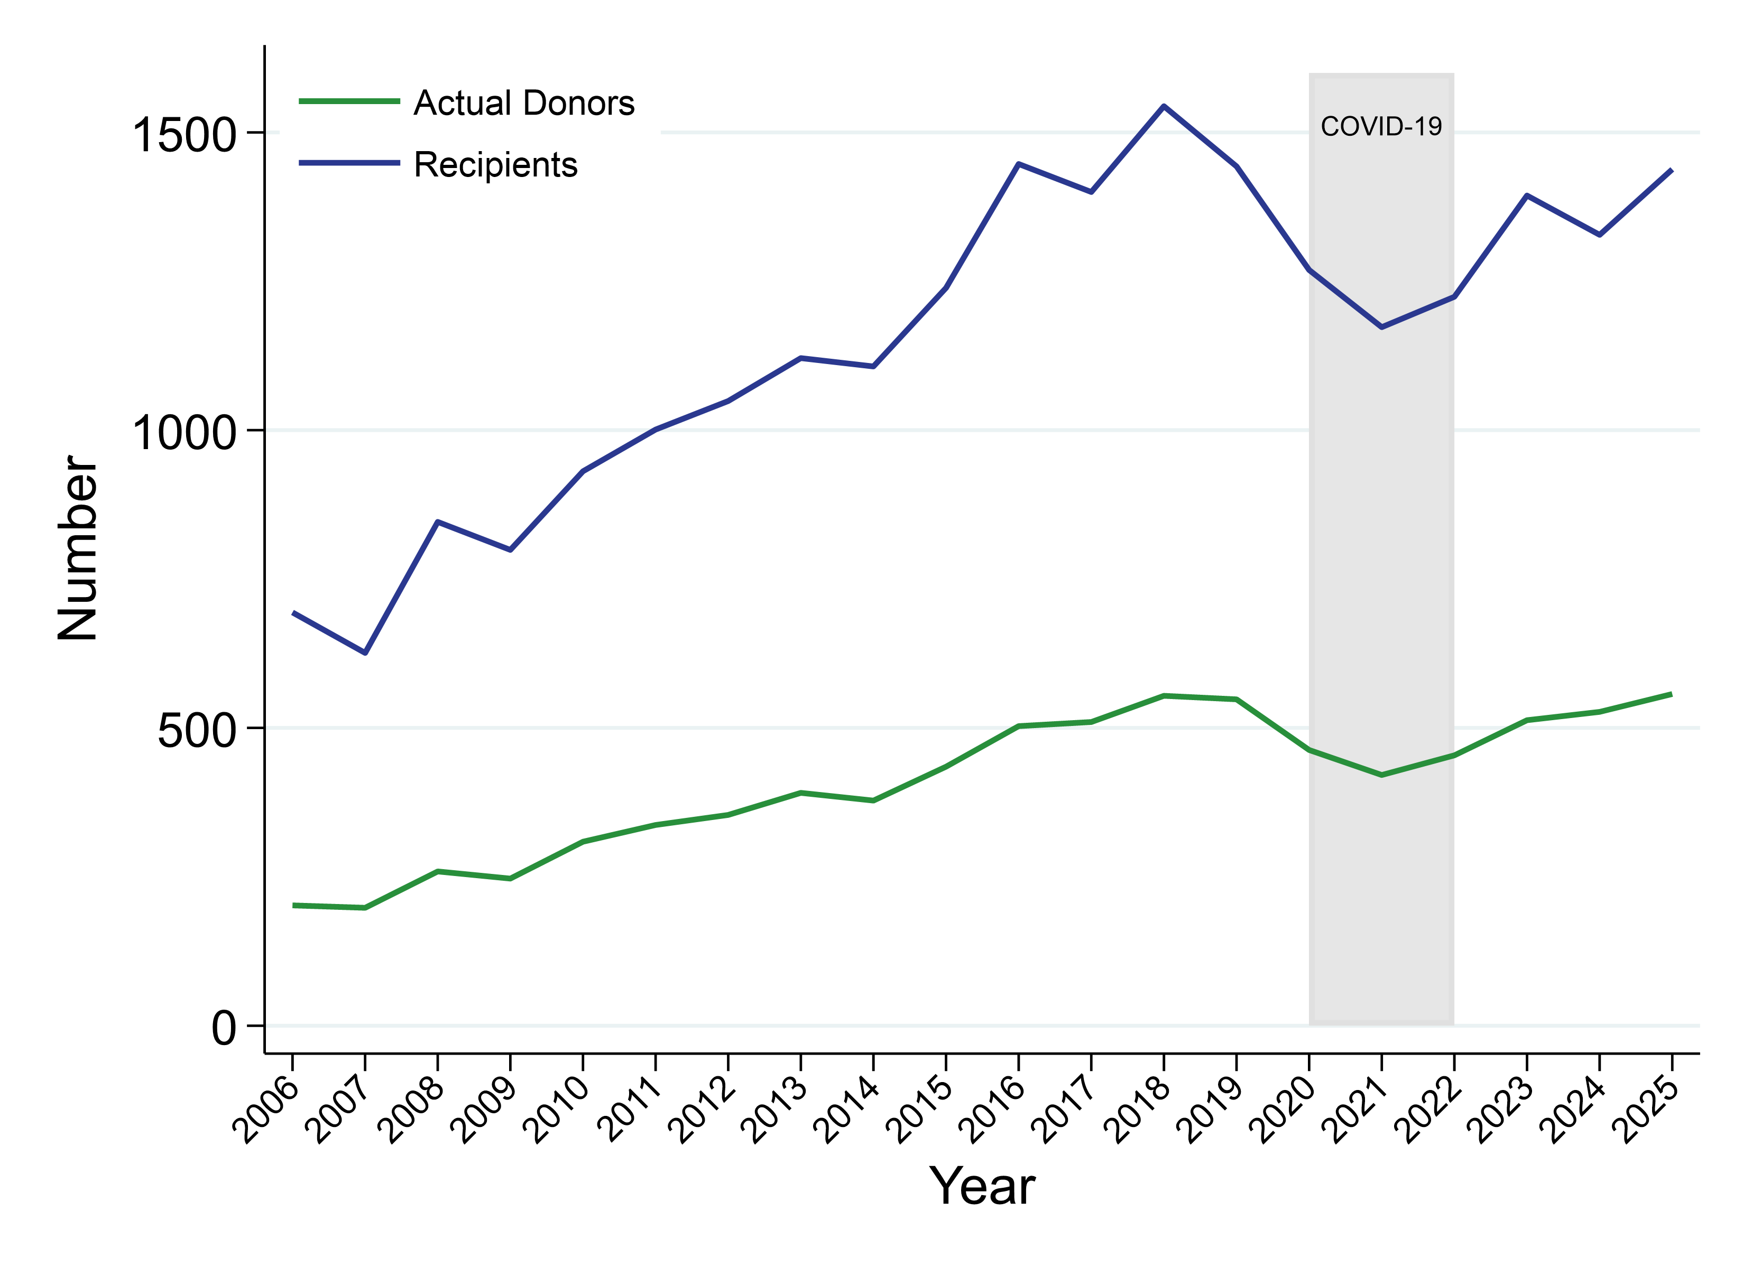
Figure 2.1.1
Total Number of Actual Deceased Organ Donors and Recipients Australia, 2006–2025

Slide 4
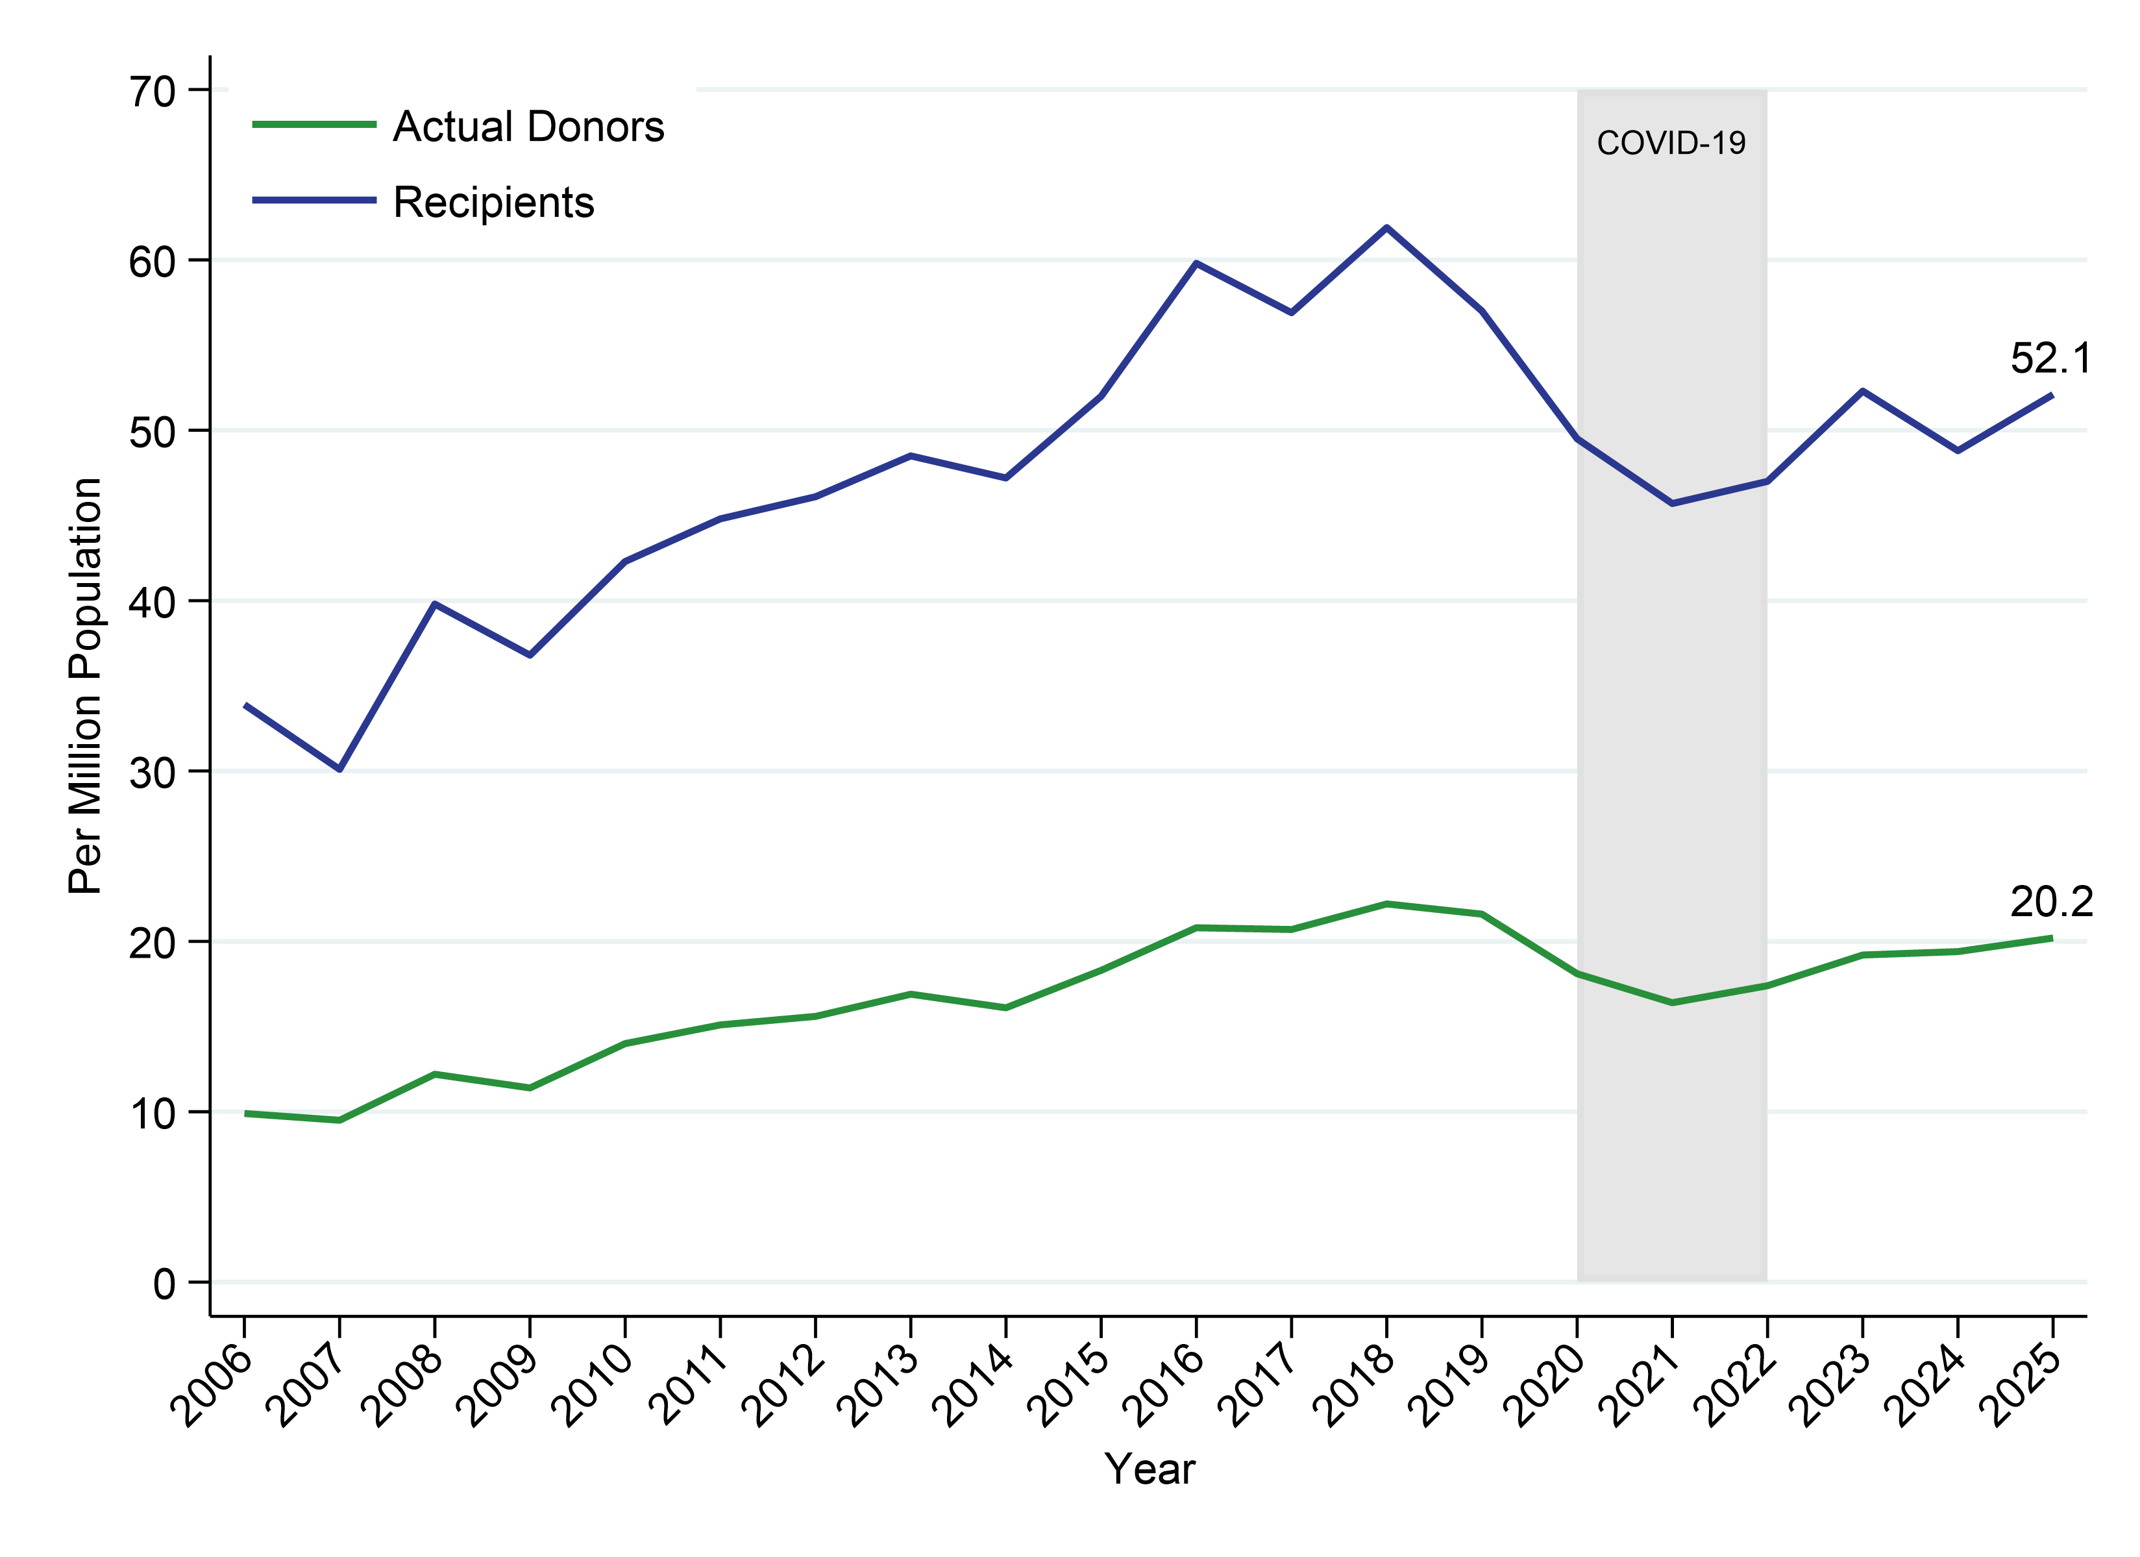
Figure 2.1.2
Total Number of Actual Deceased Organ Donors and Recipients pmp, Australia, 2006–2025

Slide 5
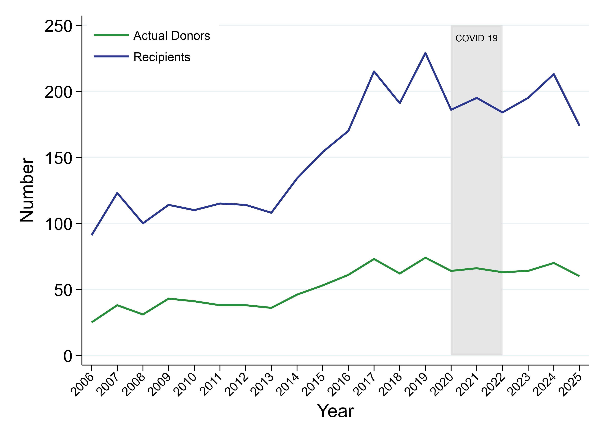
Figure 2.2.1
Total Number of Actual Deceased Organ Donors and Recipients New Zealand, 2006–2025

Slide 6
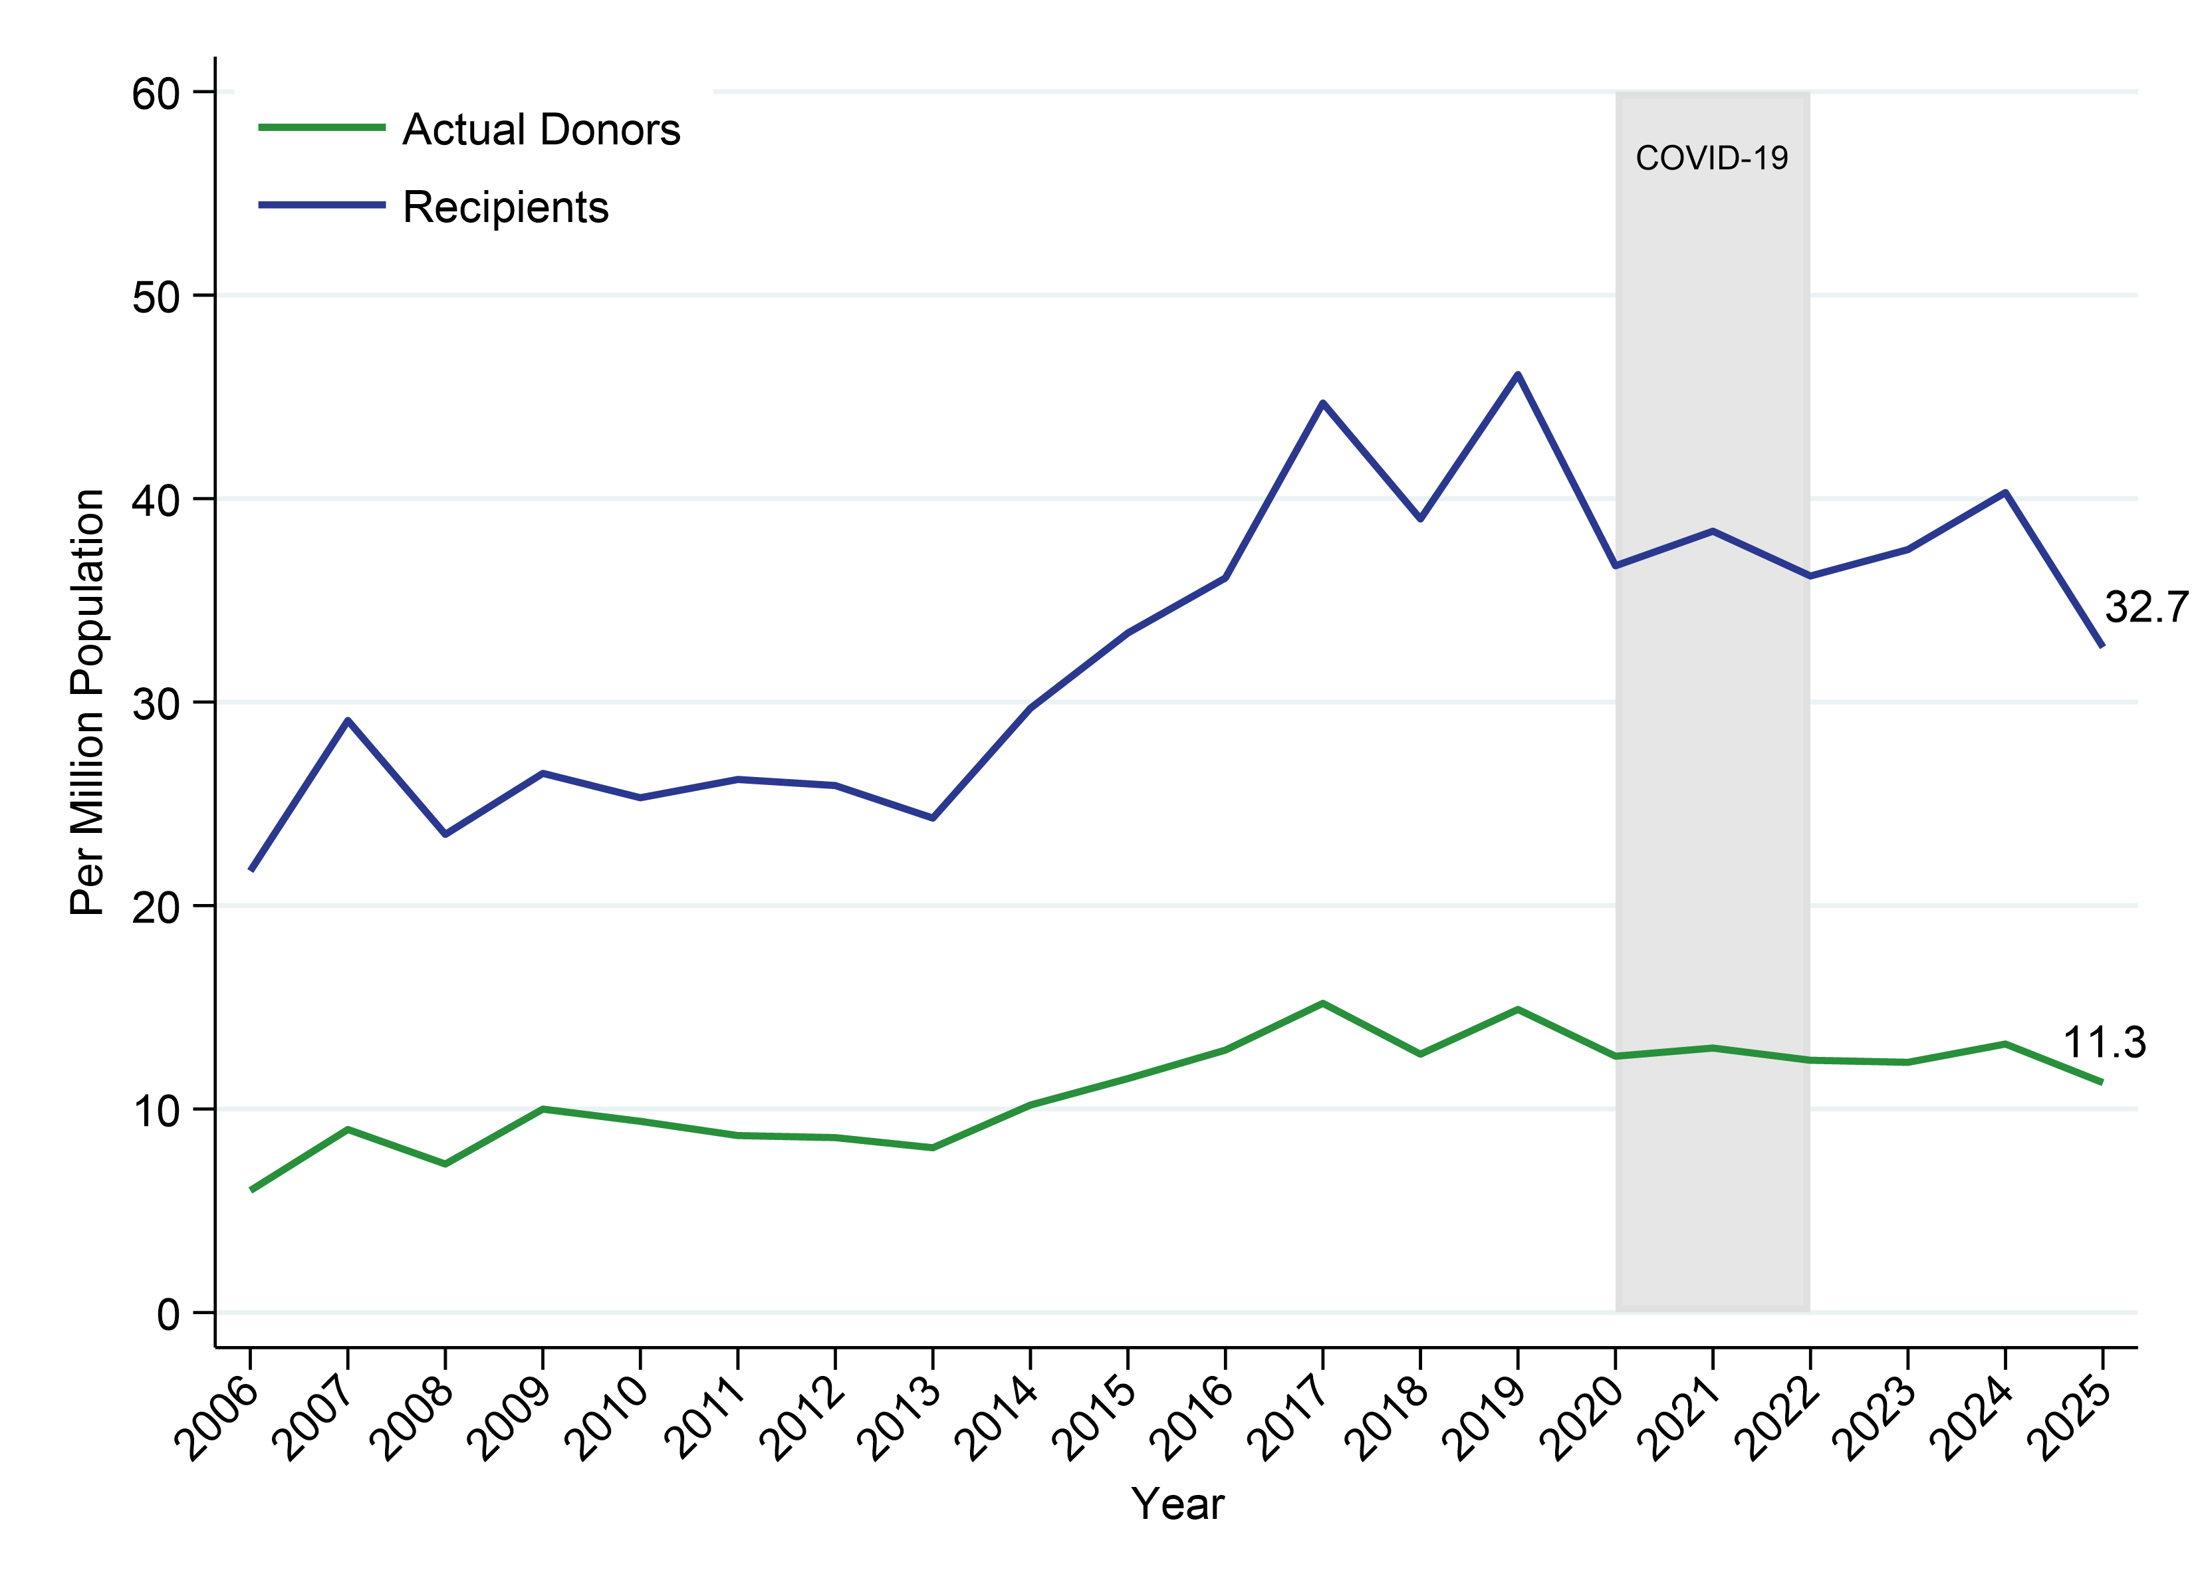
Figure 2.2.2
Total Number of Actual Deceased Organ Donors and Recipients pmp, New Zealand, 2006–2025

Slide 7
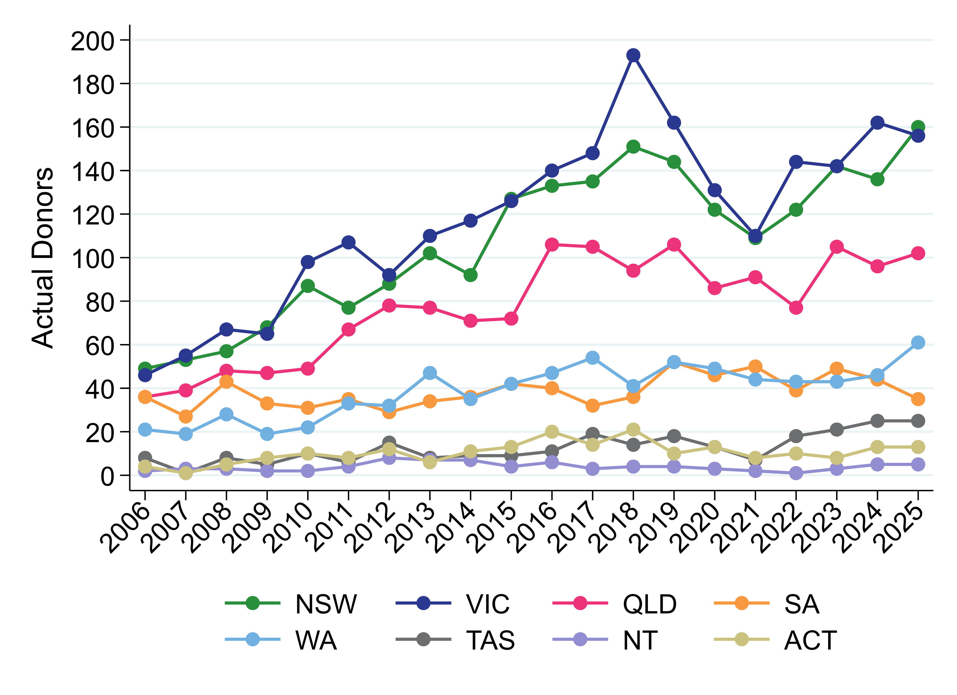
Figure 2.3
Number of Actual Deceased Donors Australian States and Territories 2006–2025

Slide 8
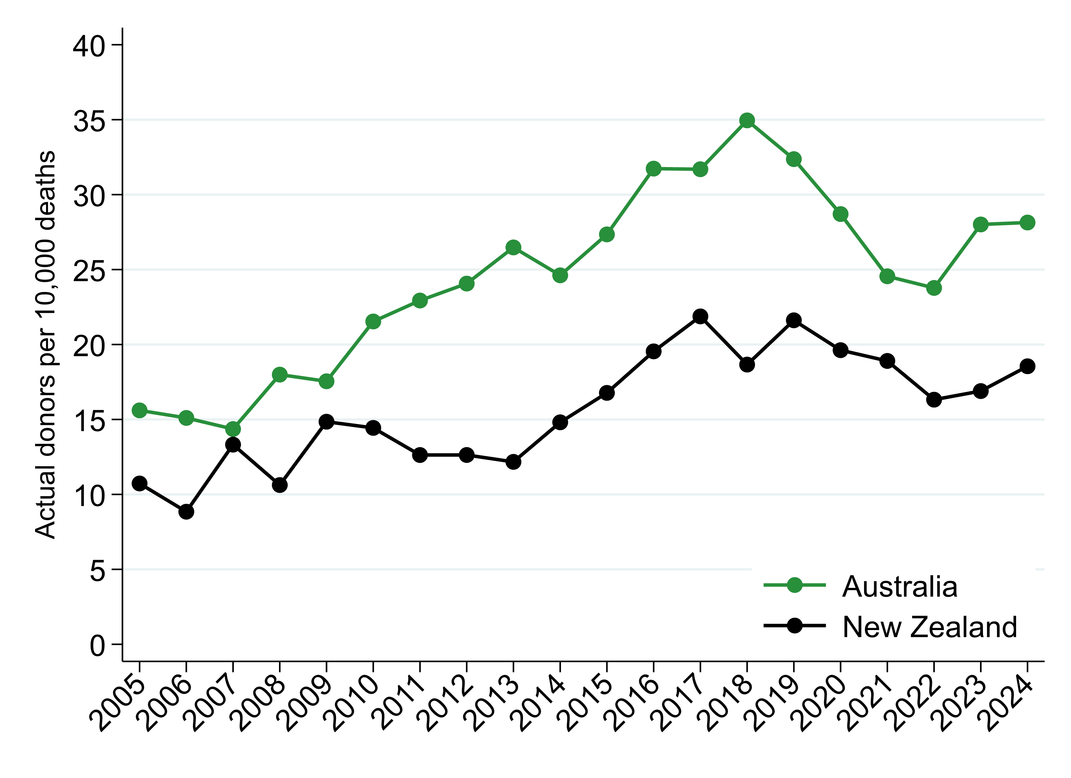
Figure 2.4
Number of Actual Deceased Organ Donors Per 10,000 Deaths - Australia and New Zealand, 2005–2024

Slide 9
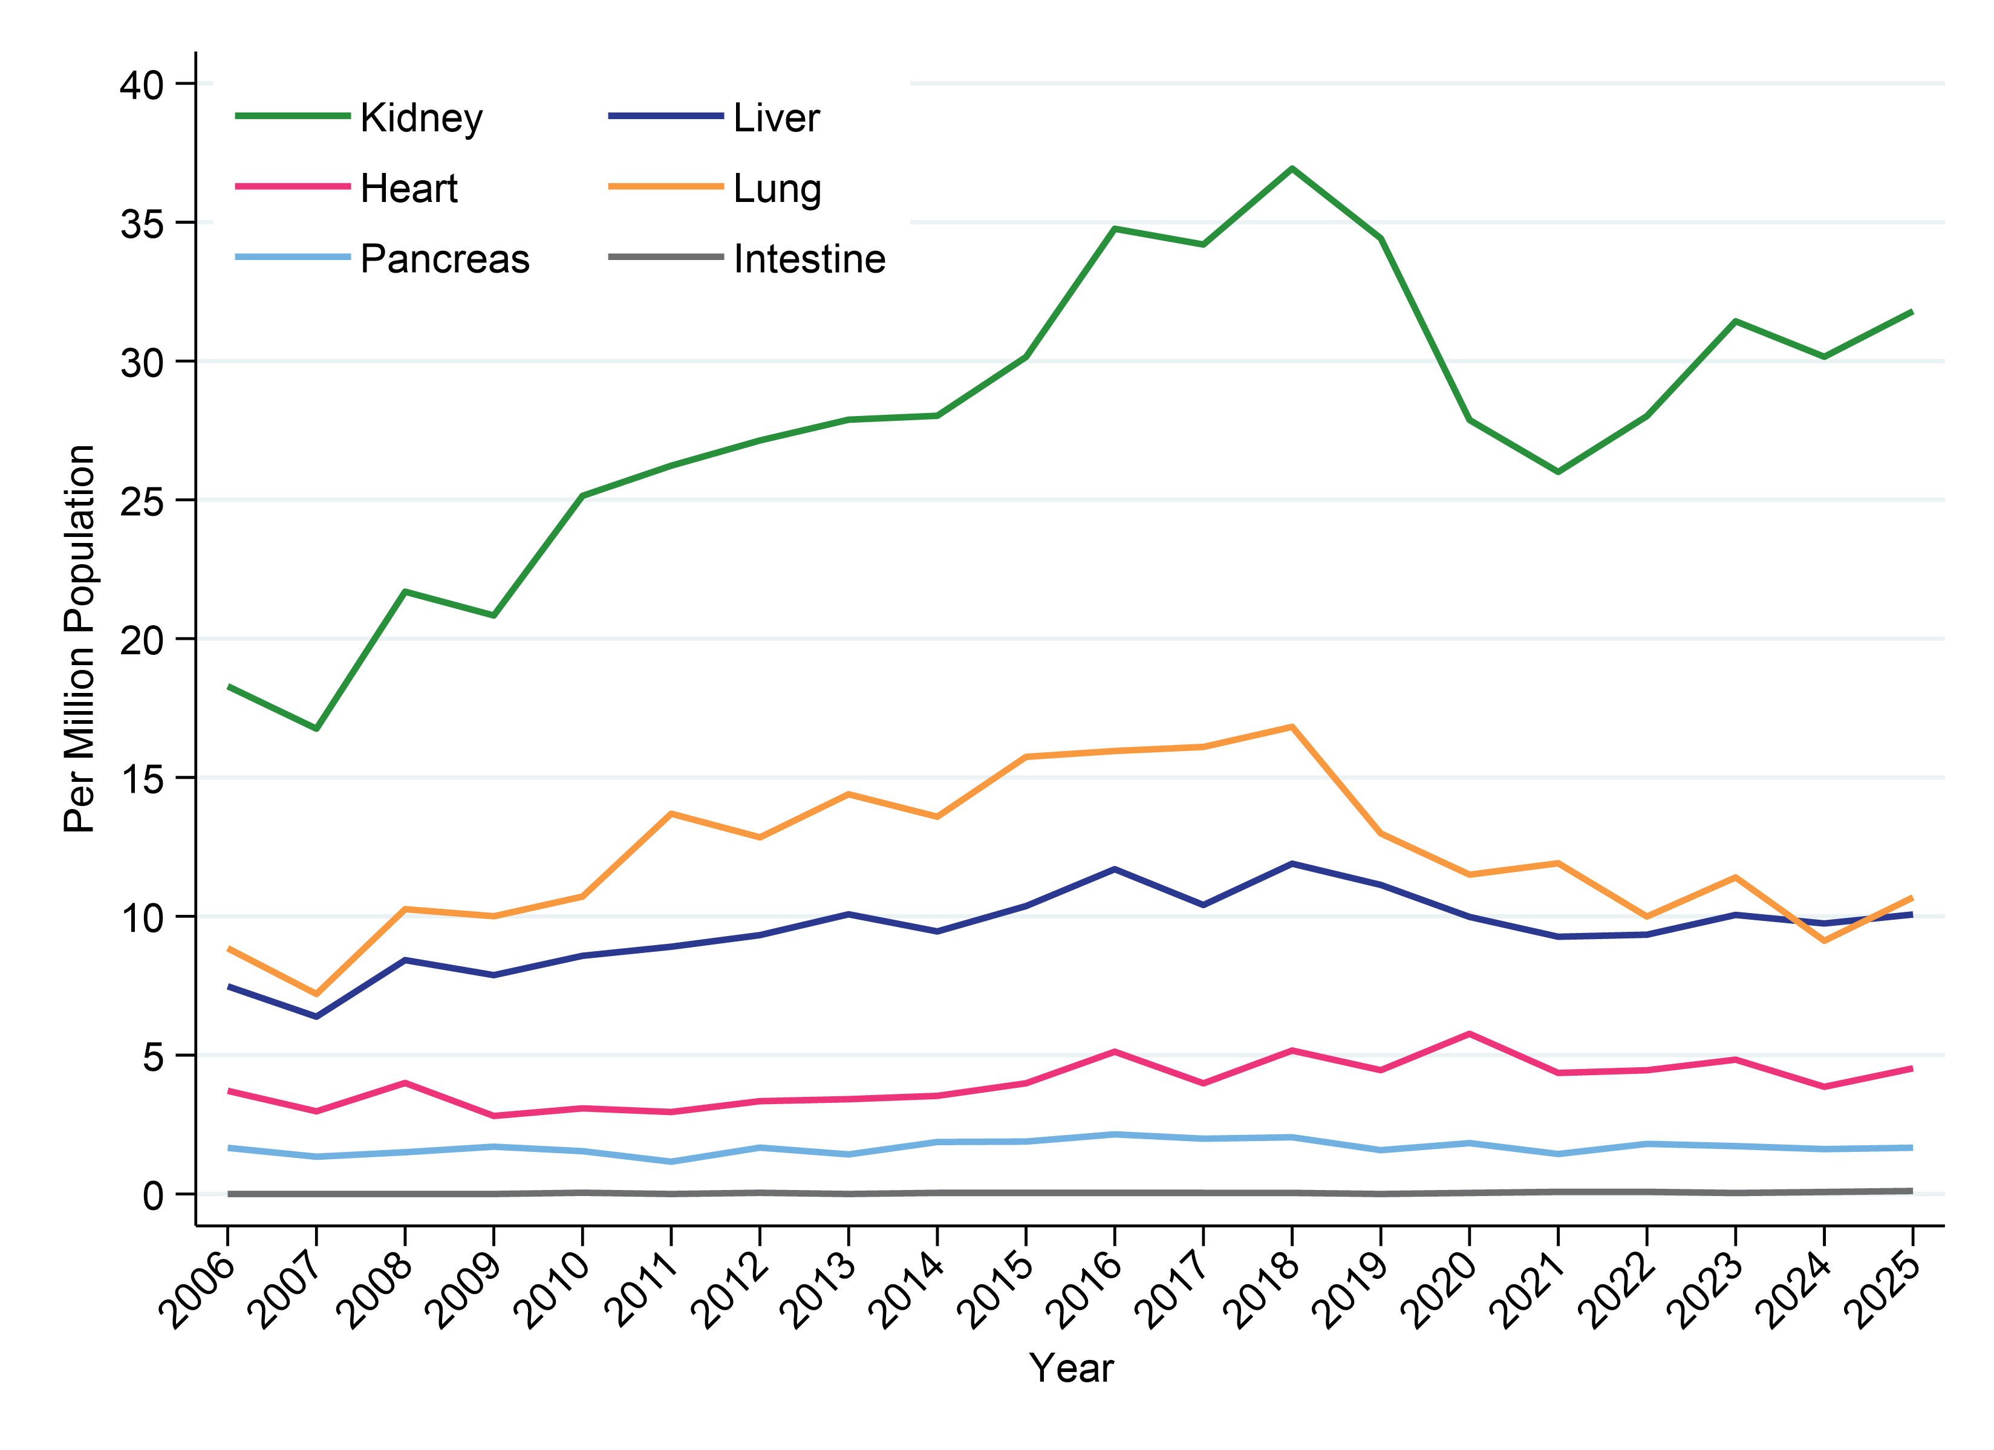
Figure 2.5.1
Organs Transplanted by Organ Type 2006–2025 Per Million Population, Australia

Slide 10
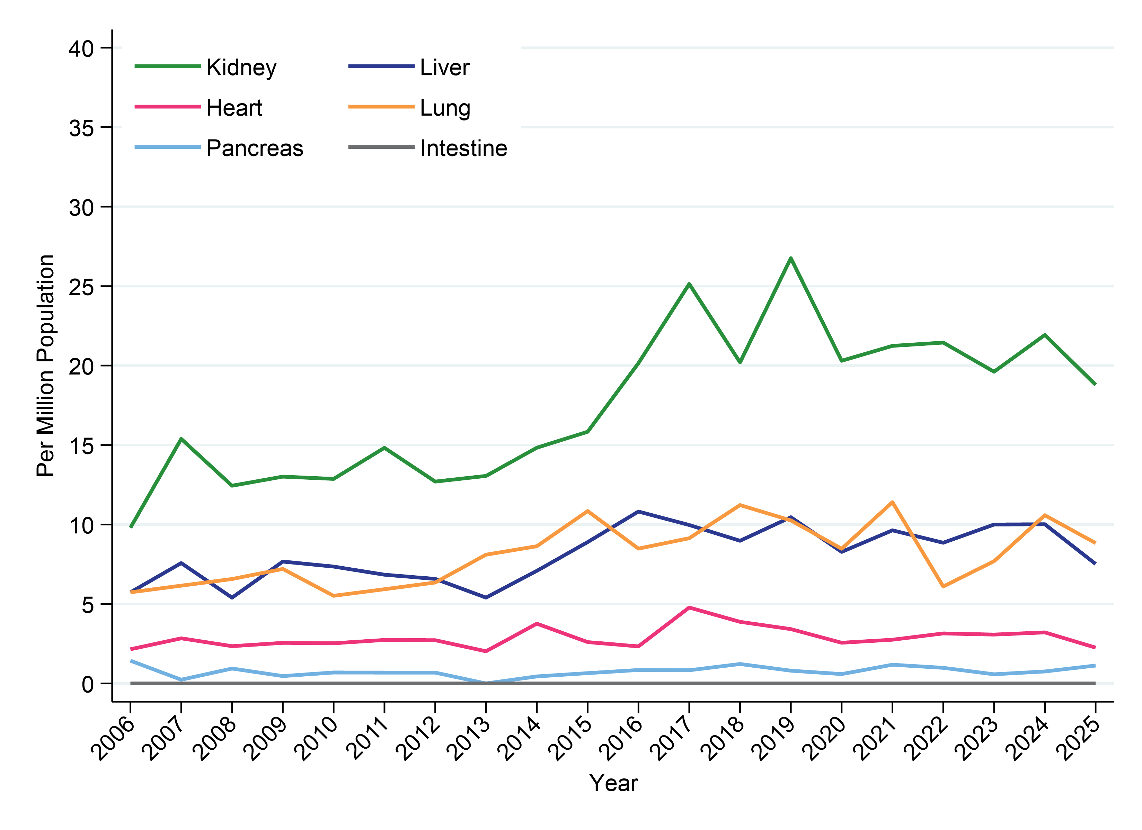
Figure 2.5.2
Organs Transplanted by Organ Type 2006–2025 Per Million Population, New Zealand

Slide 11
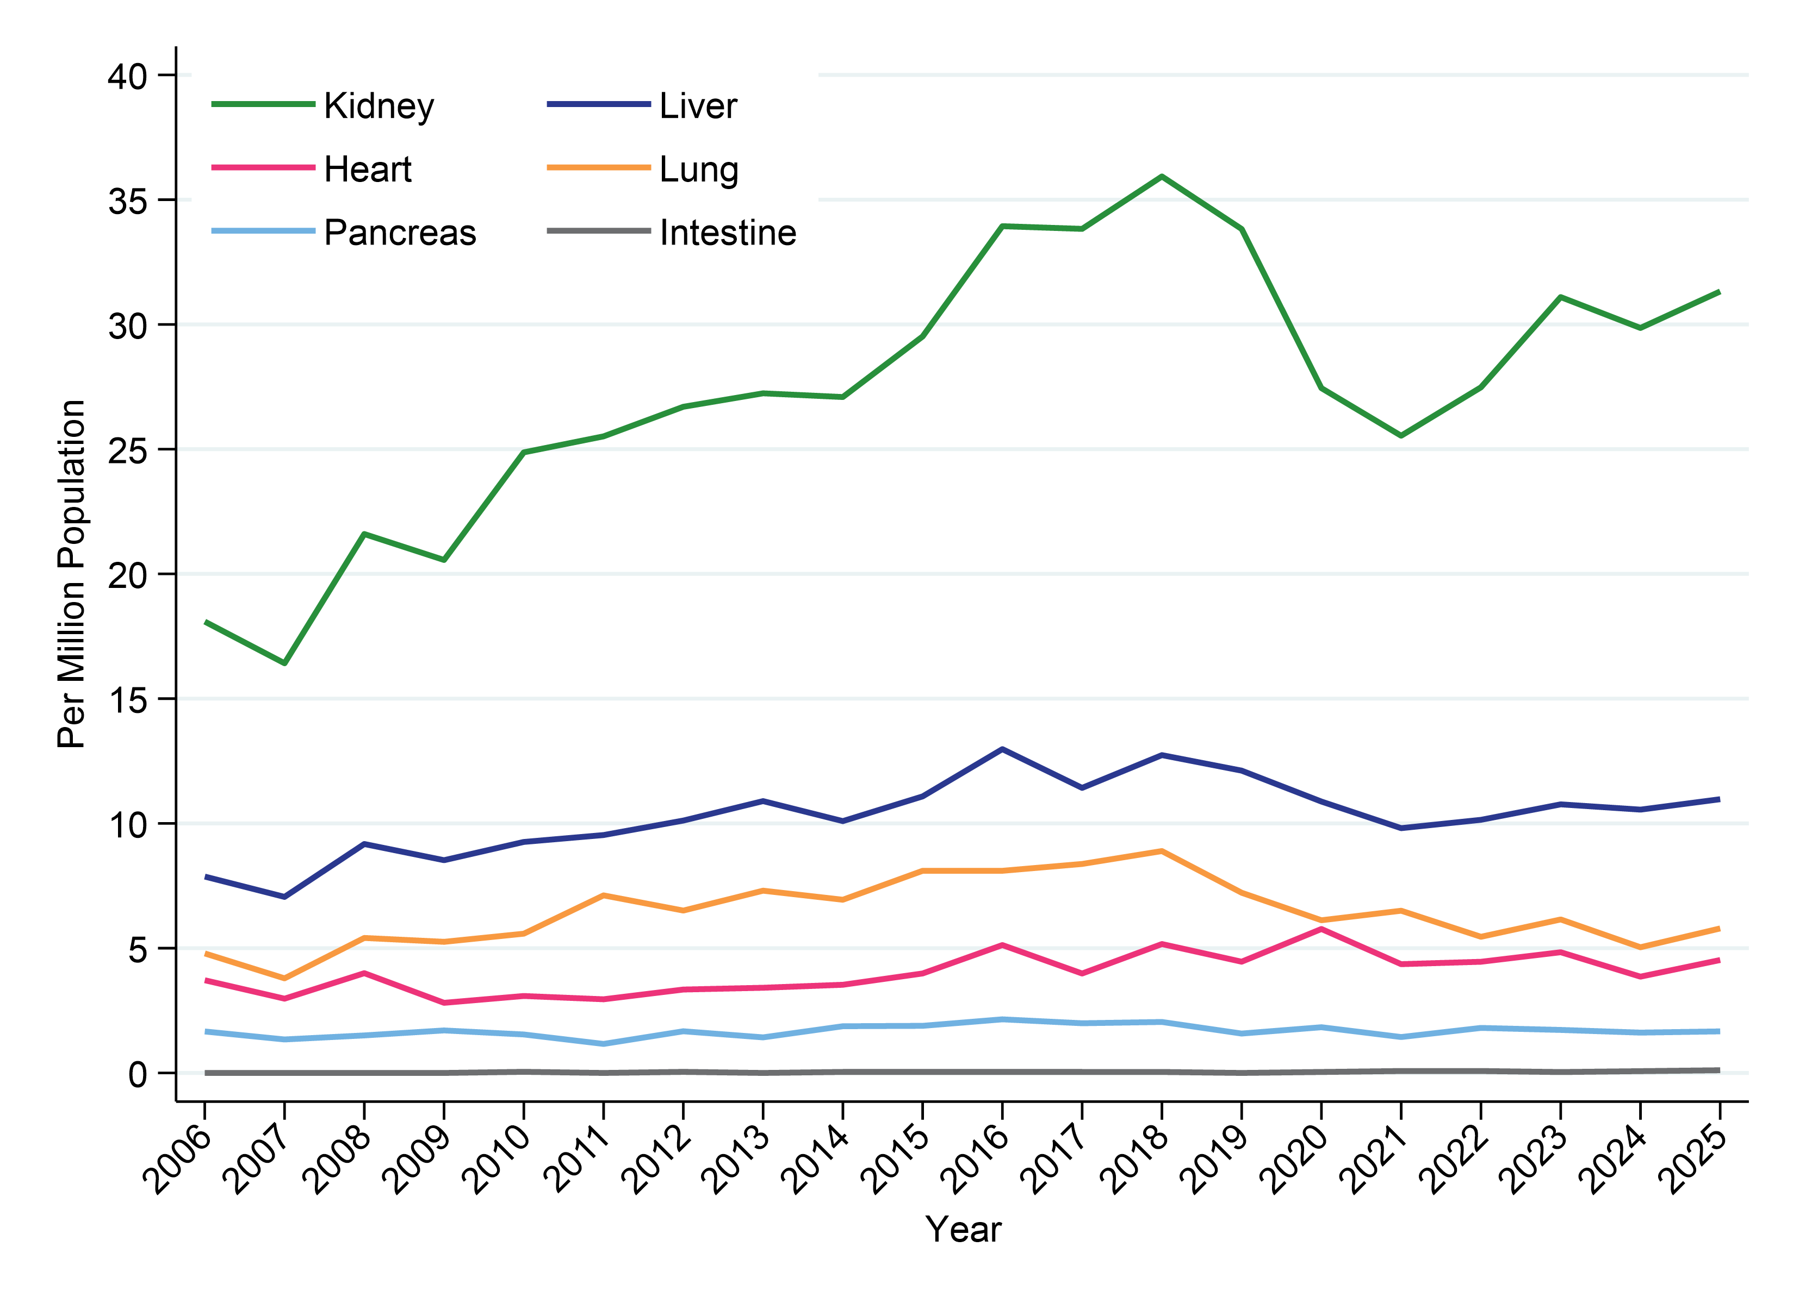
Figure 2.6.1
Organ Recipients by Organ Type 2006–2025 Per Million Population, Australia

Slide 12
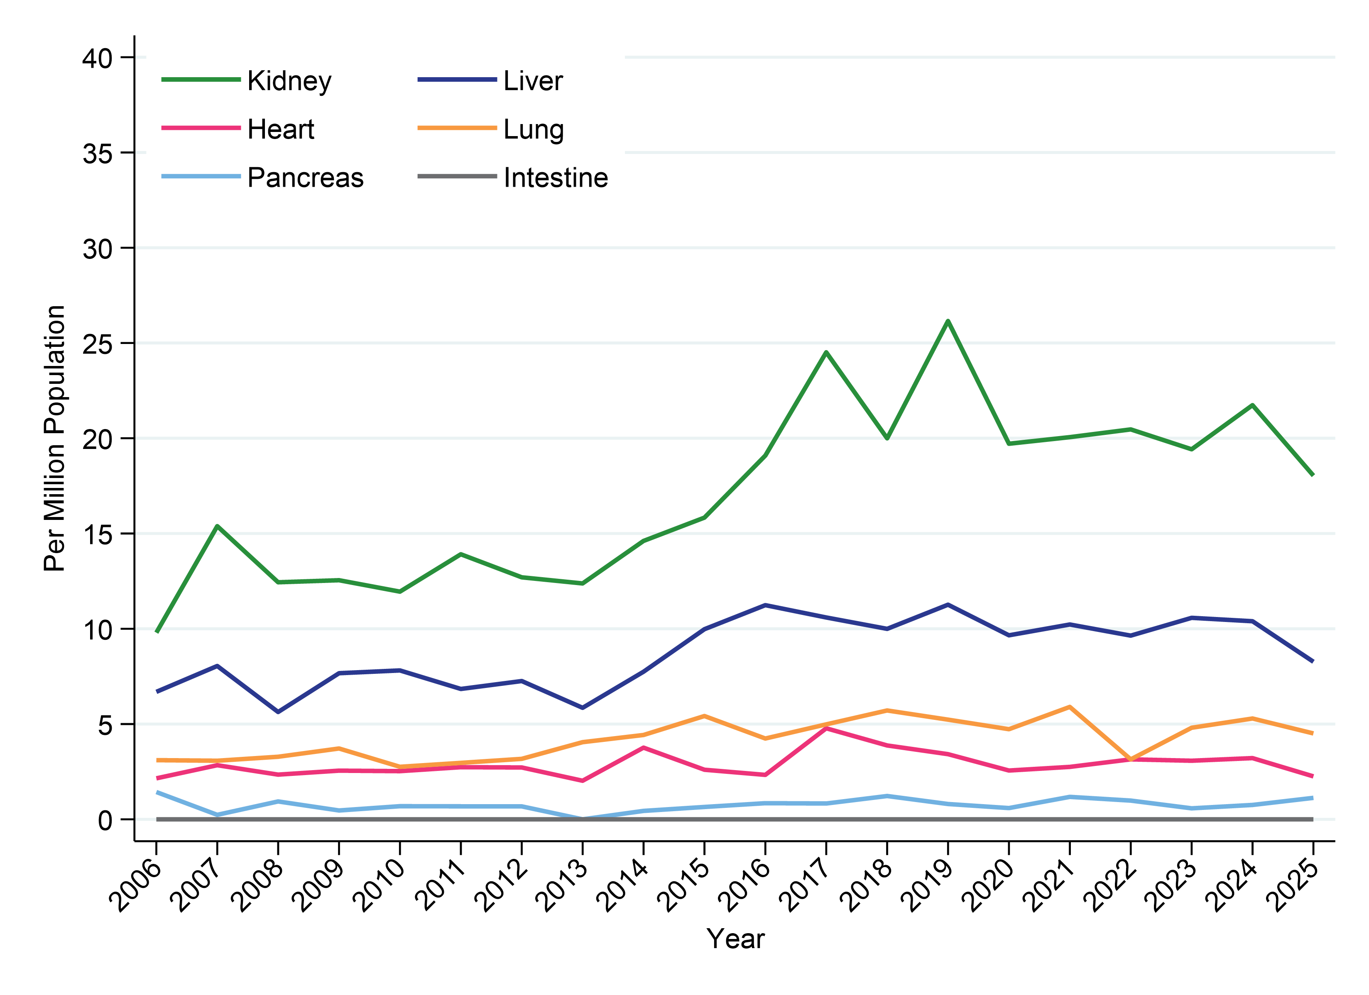
Figure 2.6.2
Organ Recipients by Organ Type 2006–2025 Per Million Population, New Zealand

Slide 13
Citation
H Opdam, F Kholmurodova, K Marshall, C Davies, L Datson, M McDonald, E Cavazzoni, J Ritchie, A Dinant, C Milton, G Irish, 30th Report. Chapter 2: Overview of Organ Donation Activity in Australia and New Zealand. Australia and New Zealand Organ Donation Registry, Adelaide, Australia. 2026.
Available at: https://anzorrg.org.au

