Slide 1
End Stage Kidney Disease in Aboriginal and Torres Strait Islander Australians
ANZDATA Registry 44th Annual Report Data to 31-Dec-2020
Chapter 10 - Graphs

Slide 2

Figure 10.1 Percentage of New Patients Commencing on Haemodialysis - Australia
Figure 10.2 Unadjusted Incident KRT Rate - Australia
Figure 10.3 Relative Incidence Rate of Treated Kidney Failure for Indigenous Patients by Gender (Comparison to Non-Indigenous Australians) - 2016-2020
Figure 10.4 Age-specific Incidence Rates of Treated Kidney Failure - Among Indigenous Australians, by State and Age at KRT start 2016-2020
Figure 10.5.1 Age-specific Incidence Rates of Treated Kidney Failure - Non-Indigenous, Australia
Figure 10.5.2 Age-specific Incidence Rates of Treated Kidney Failure - Indigenous, Australia
Figure 10.6.1 Prevalent Patients by Modality - Australia - Indigenous
Figure 10.6.2 Prevalent Patients by Modality - Australia - Non-Indigenous
Figure 10.7 Prevalent Haemodialysis at Home* (% of all HD) by Ethnicity - Australia
Figure 10.8 Donor Type by Ethnicity - Australia 2011-2020
Figure 10.9 Donor Type by Ethnicity and Year - Australia
List of Figures

Slide 3
Figure 10.10 Percentage of Patients Starting KRT with Pre-emptive Kidney Transplant - Australia
Figure 10.11 Patient Survival, Recipients of Primary DD Transplants - Australia 2011 - 2020
Figure 10.12 Graft Survival, Recipients of Primary DD Transplants - Australia 2011-2020
Figure 10.13 Transplant Outcomes - Primary Deceased Donor Kidney-only Transplants Australia 2011-2020
Figure 10.14 Dialysis Modality End 2020 - Australia, by Ethnicity
Figure 10.15 Incident Dialysis Patient Survival 2011-2020 - Australia
Figure 10.16 eGFR at Dialysis Initiation - Australia
Figure 10.17 Incidence of New Indigenous Australian Patients
Figure 10.18 Incidence of New Transplants Indigenous Australian Patients - By referring state
Figure 10.19 Median Time to Primary Transplant Indigenous Australian Patients - By referring state, Transplants during 2013-2016 vs 2017-2020
List of Figures
continued

Slide 4
List of Figures
continued
Figure 10.20 Prevalent Indigenous Australian Haemodialysis Patients
Figure 10.21 Prevalent Indigenous Australian Peritoneal Dialysis Patients
Figure 10.22 Prevalent Indigenous Australian Transplant Patients
Figure 10.23 Deaths of Indigenous Australian KRT patients
Figure 10.24 Incident Indigenous Australian Kidney Replacement Therapy Patients 2016-2020 - By Postcode
Figure 10.25 Percentage of Prevalent Kidney Replacement Therapy Patients Identifying as Indigenous Australian - 2020 By State
Figure 10.26 Prevalent Indigenous Australian Dialysis Patients 2020 - By Statistical Area Level 3
Figure 10.27 Cause of Death by Modality and Ethnicity, Australia - Deaths Occurring During 2020

Slide 30
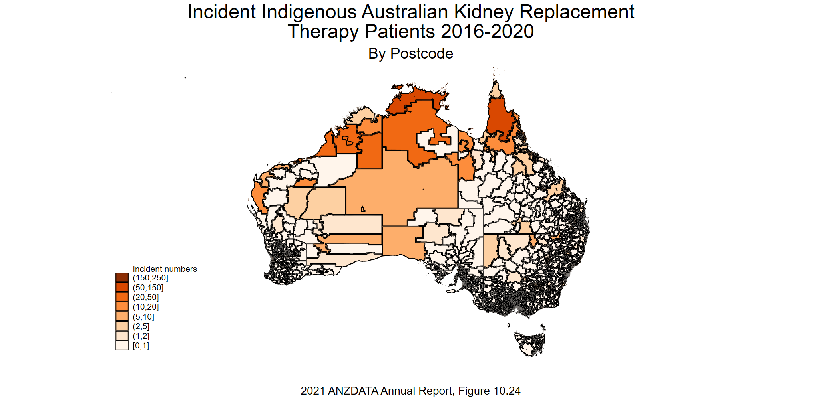

Slide 31
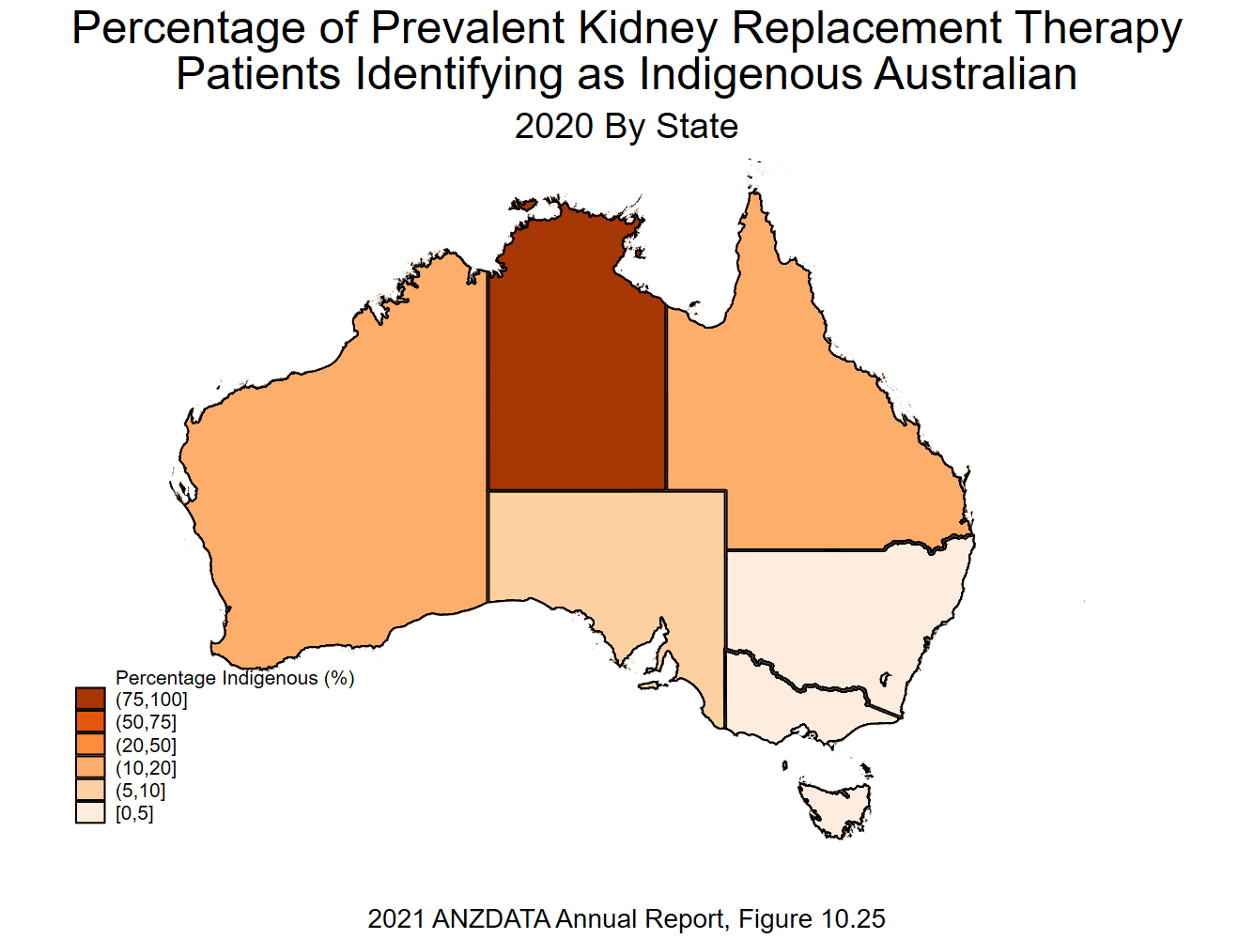

Slide 32
