Slide 1
Section 5
Deceased Donor Kidney Donation
Annual Report 2021
(Data analysis to 31-December-2020)

Slide 2
Contents
Figure 5.2.1 Kidneys Transplanted by Donation Pathway Australia 1998-2020
Figure 5.2.2 Kidneys Transplanted by Donation Pathway New Zealand 1998-2020
Figure 5.3 Deceased Donor Kidney Transplant Recipients* by Transplant Region, Australia and New Zealand, 2019-2020
Figure 5.4.1 Age of Donors Providing Retrieved Kidneys Australia 2020
Figure 5.4.2 Age of Donors Providing Retrieved Kidneys New Zealand 2020
Figure 5.5.1 Non-utilisation Rate of Retrieved Kidneys - Australia 2016-2020
Figure 5.5.2 Non-utilisation Rate of Retrieved Kidneys - New Zealand 2016-2020
Citation

Slide 3
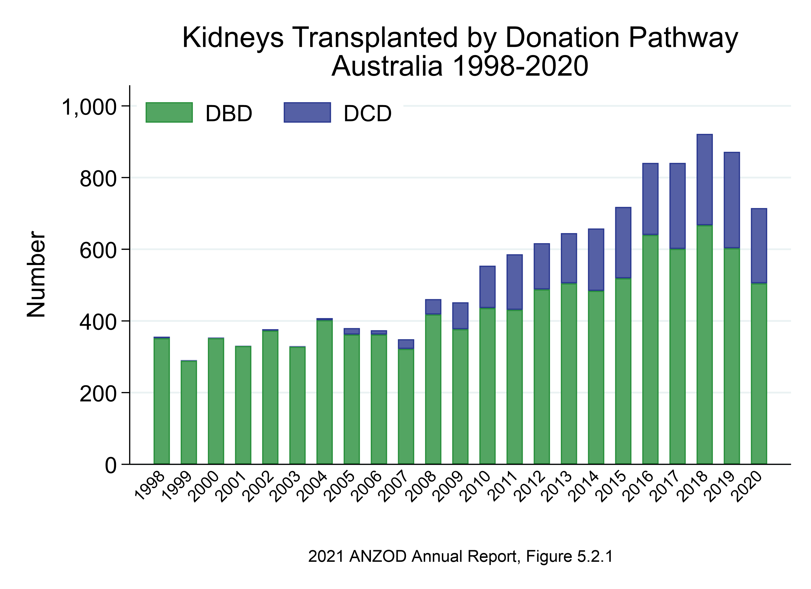

Slide 4
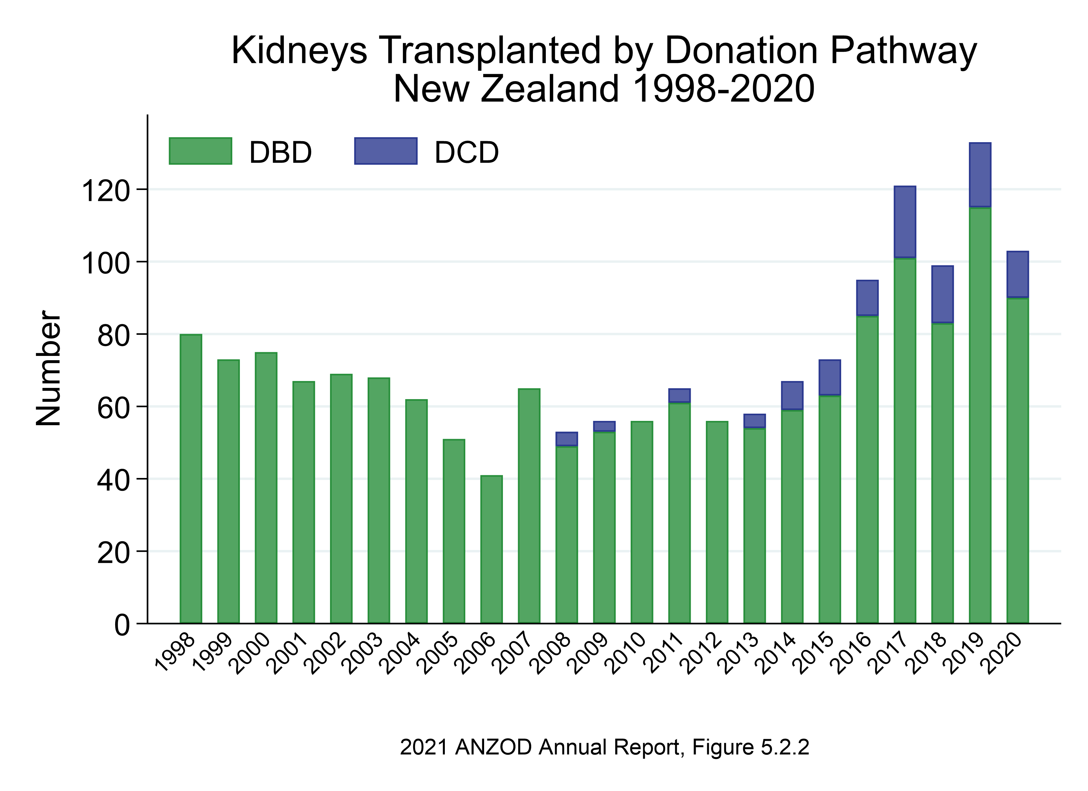

Slide 5
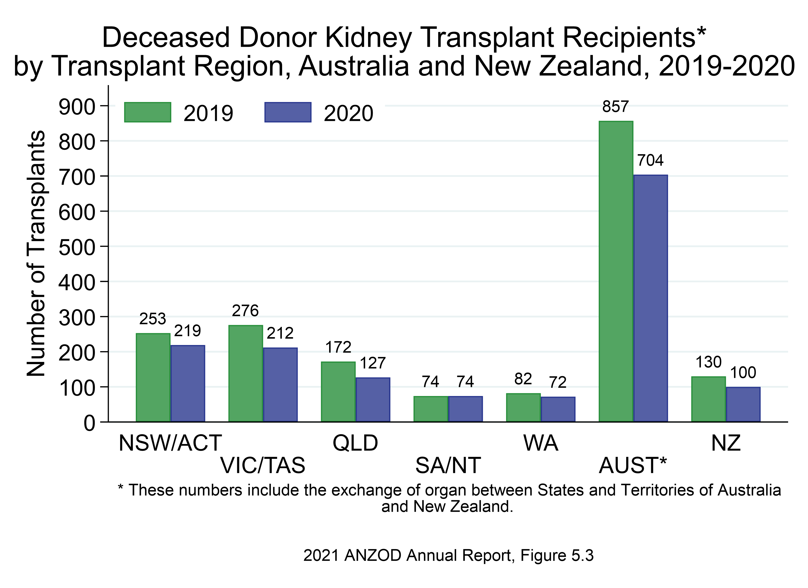

Slide 6
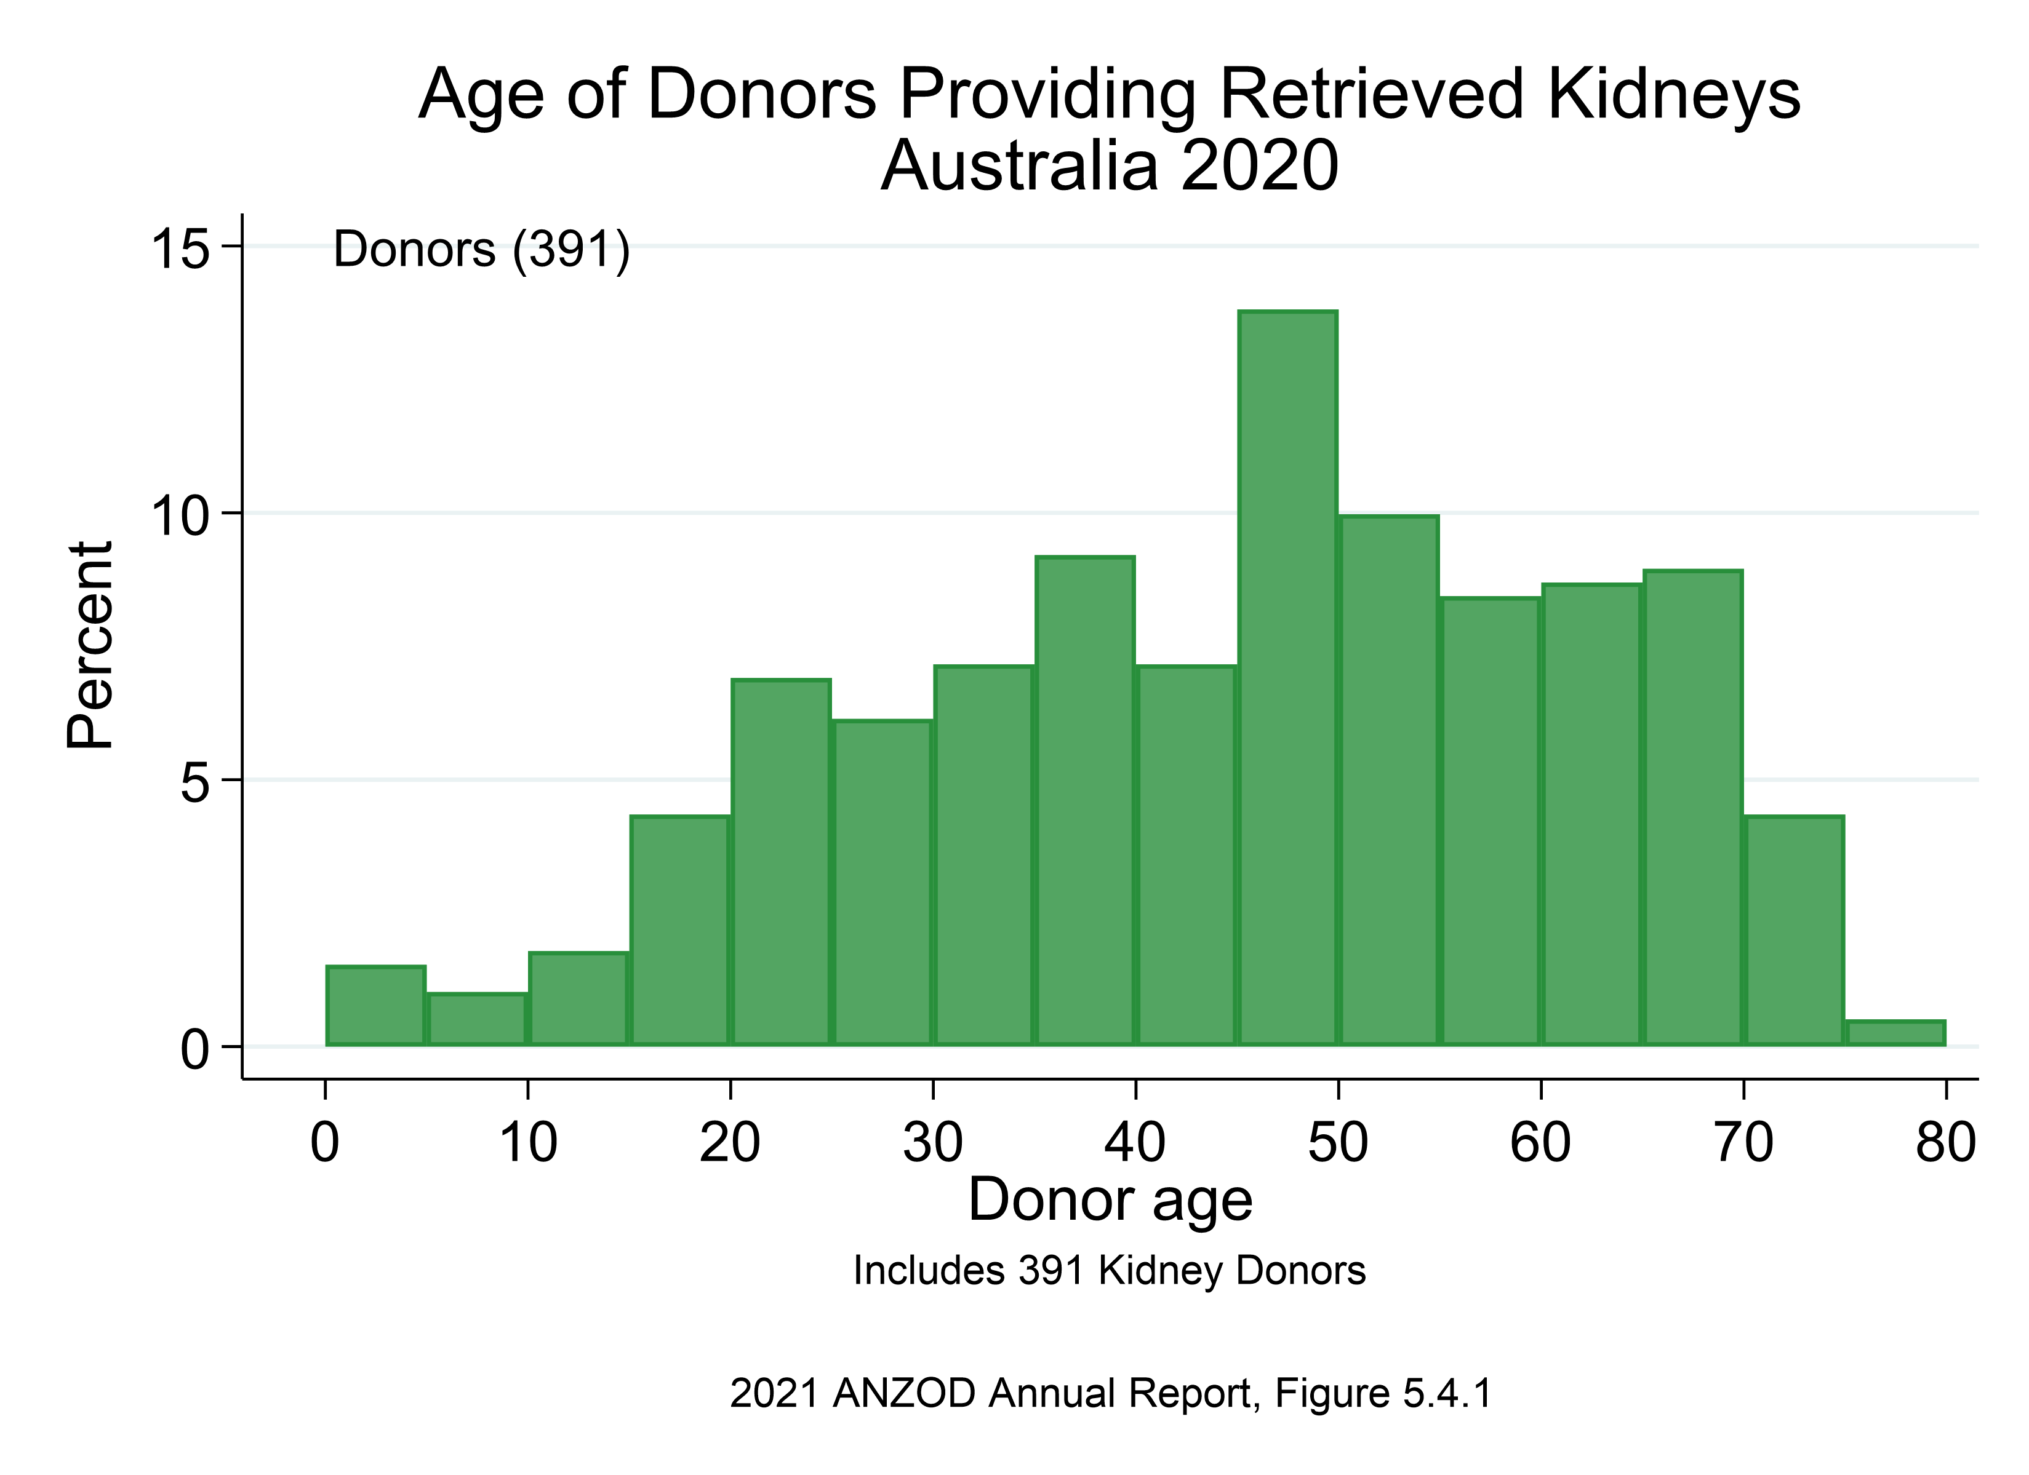

Slide 7
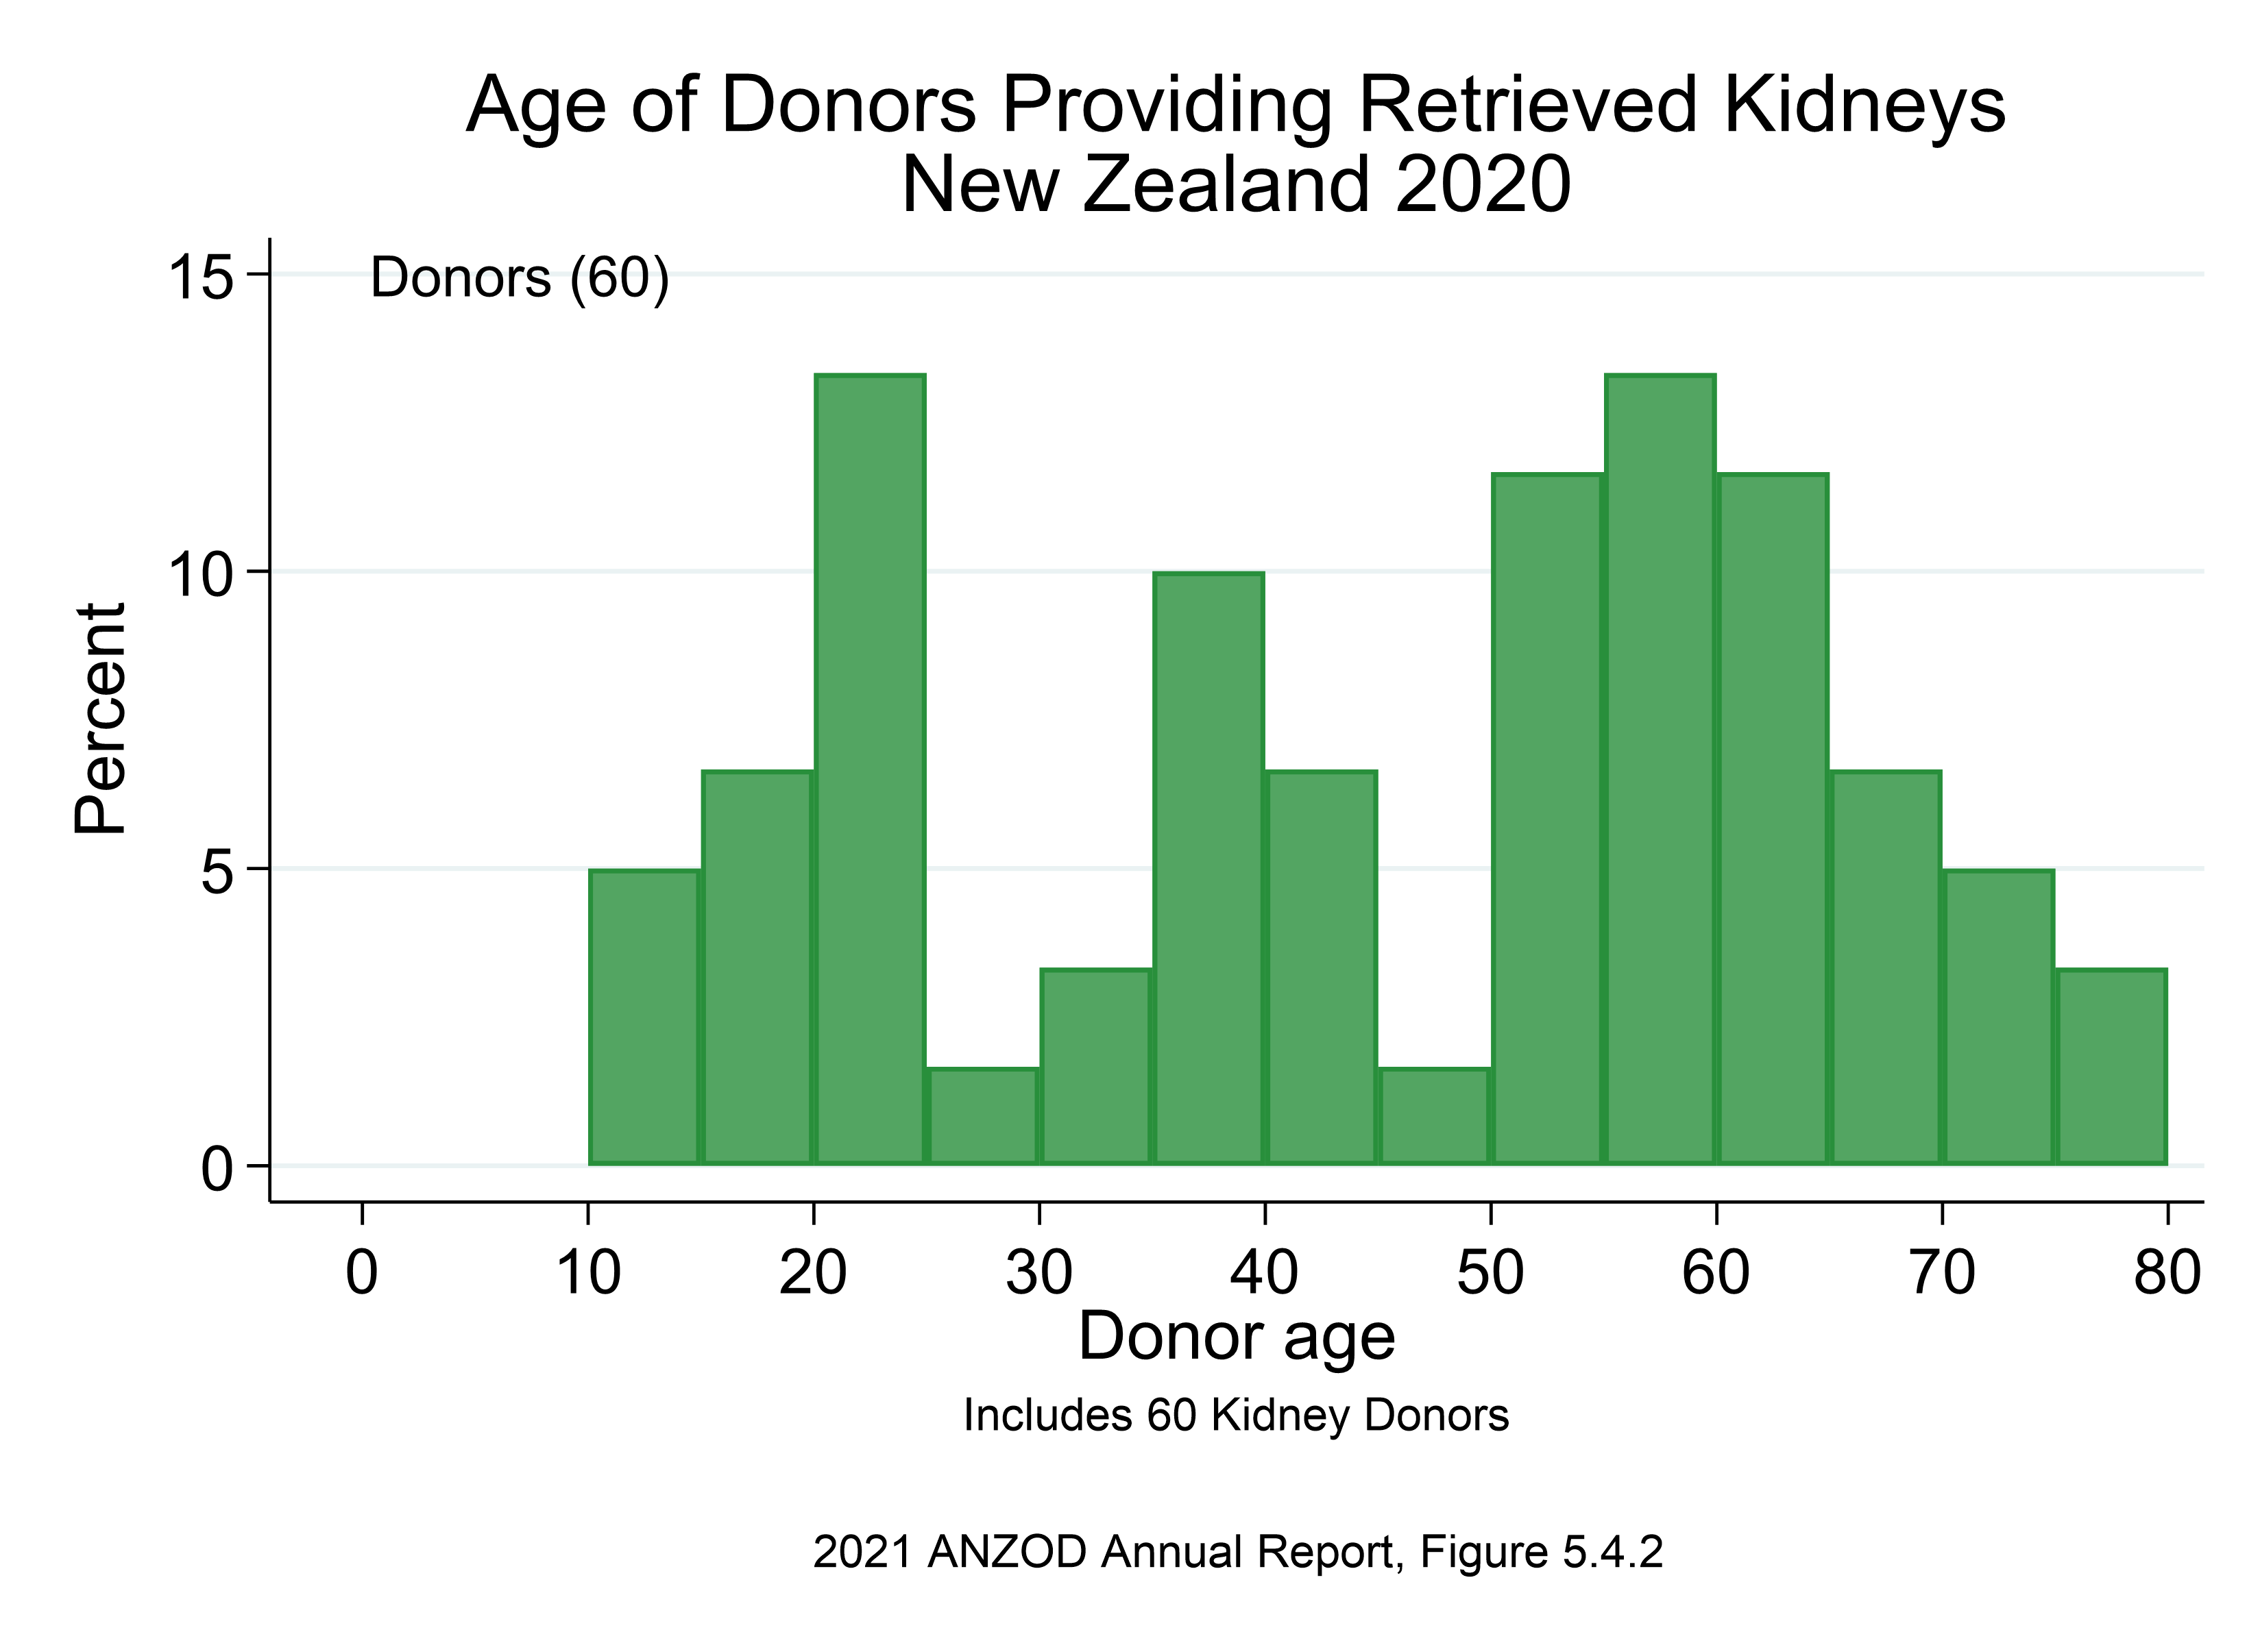

Slide 8
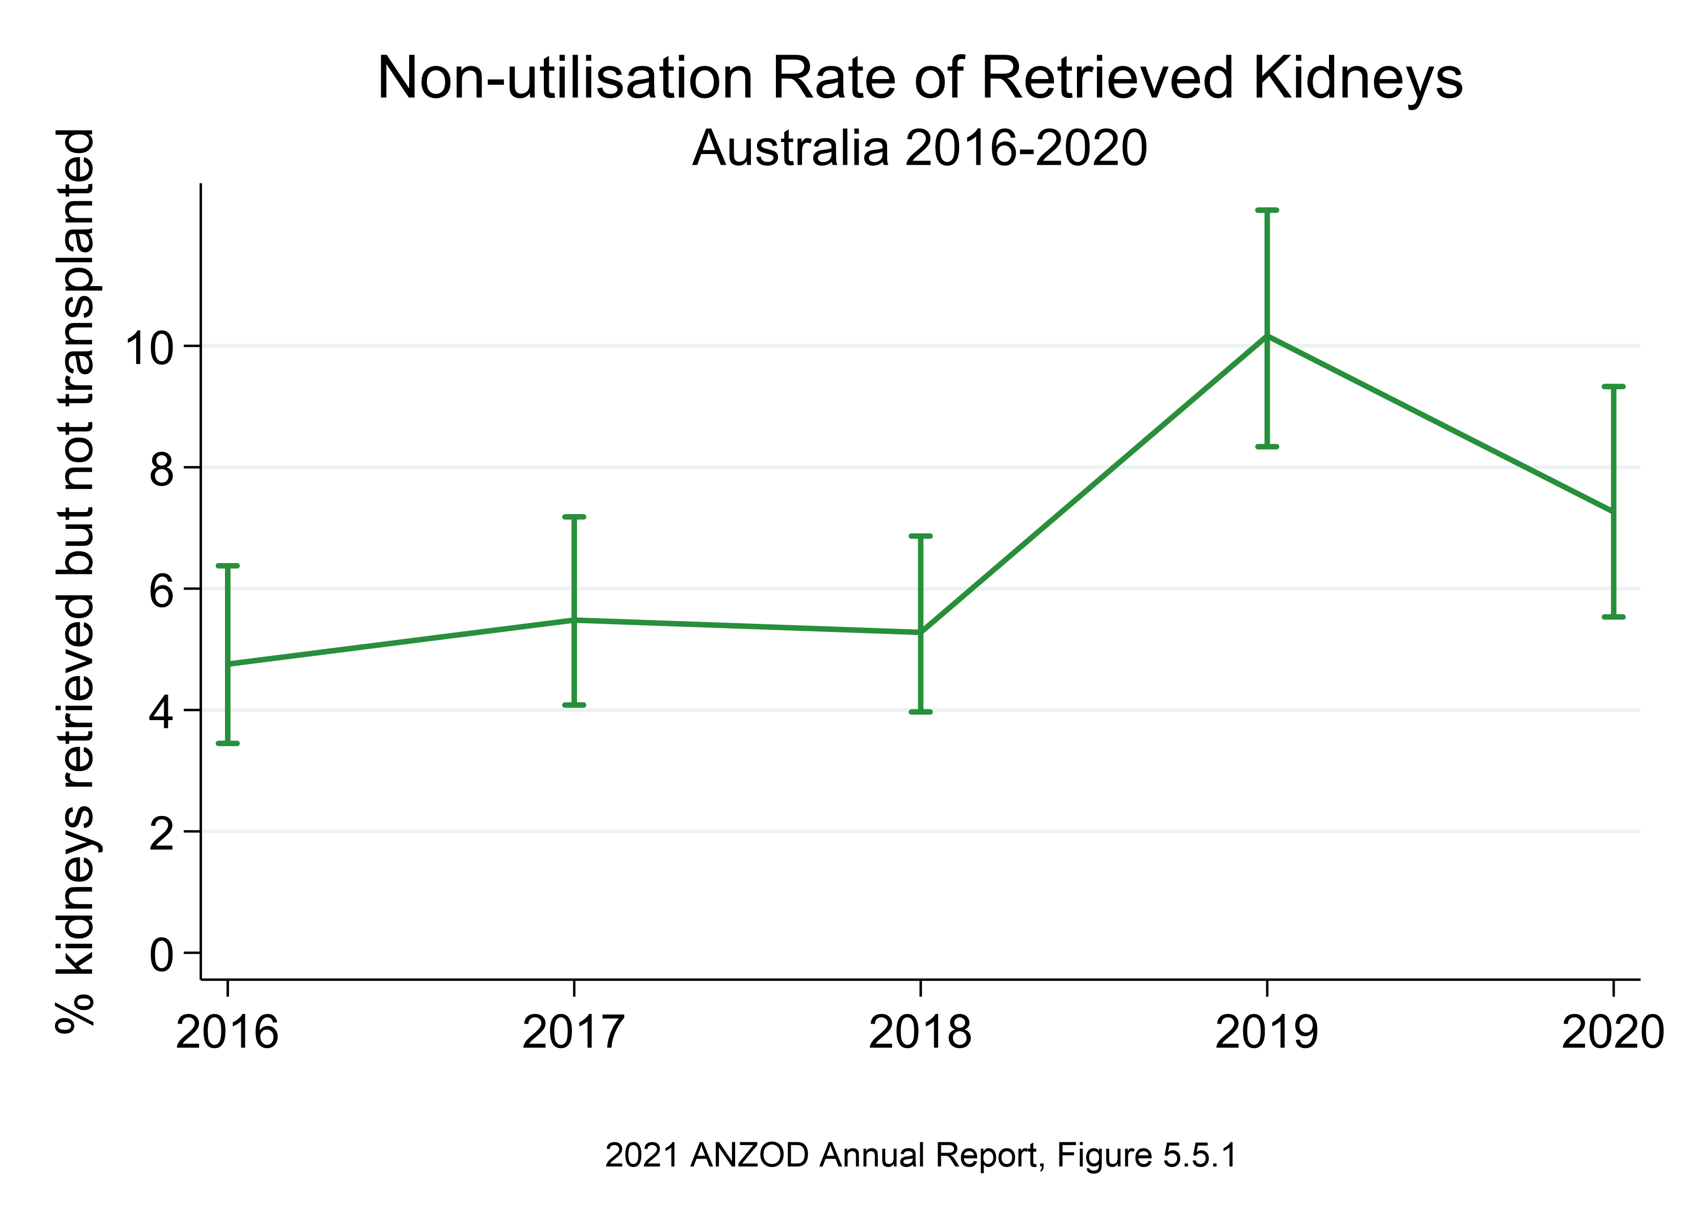

Slide 9
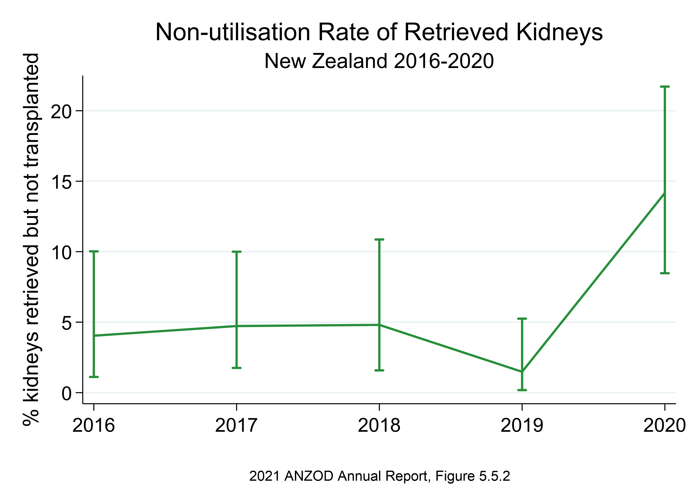

Slide 10
Citation
ANZOD Registry. 2021 Annual Report, Section 5: Deceased Donor Kidney Donation. Australia and New Zealand Dialysis and Transplant Registry, Adelaide, Australia. 2021.
Available at: https://www.anzdata.org.au/report/anzod-annual-report-2021/

