Slide 1
Section 6 Deceased Donor Liver and Intestine Donation
Annual Report 2021
(Data analysis to 31-December-2020)

Slide 2
Contents
Figure 6.2.1 Recipients of Liver Transplantation by Donation Pathway Australia 1998-2020
Figure 6.2.2 Recipients of Liver Transplantation by Donation Pathway New Zealand 1998-2020
Figure 6.3 Deceased Donor Liver Transplant Recipients* by Transplant Region, Australia and New
Zealand, 2019-2020
Figure 6.4.1 Age of Donors Providing Retrieved Livers Australia 2020
Figure 6.4.2 Age of Donors Providing Retrieved Livers New Zealand 2020
Figure 6.5.1 Non-utilisation Rate of Retrieved Livers - Australia 2016-2020
Figure 6.5.2 Non-utilisation Rate of Retrieved Livers - New Zealand 2016-2020
Figure 6.6 Intestine Transplants Australia 2016-2020
Citation

Slide 3
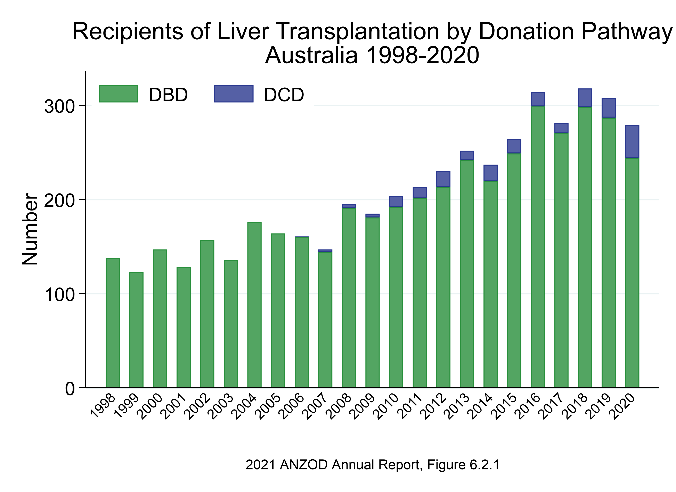

Slide 4
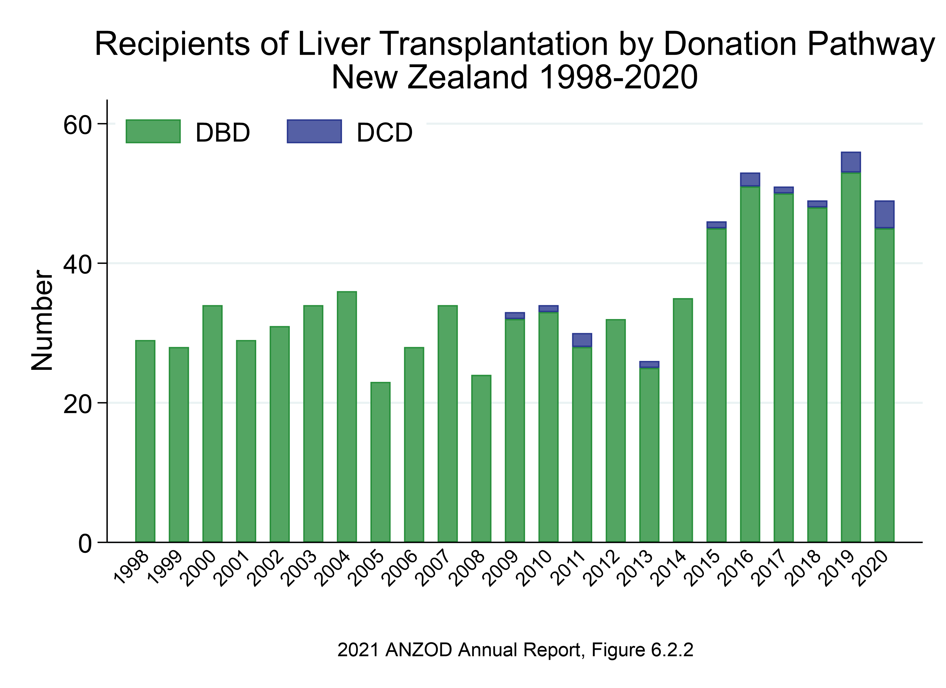

Slide 5
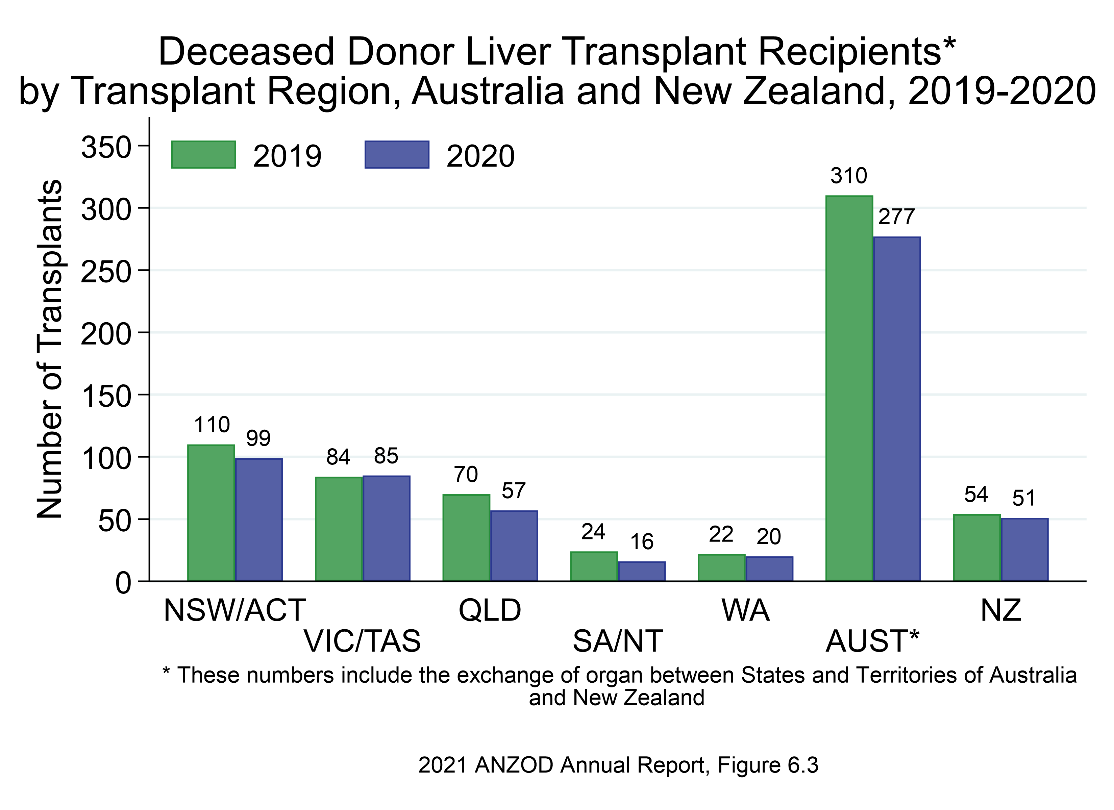

Slide 6
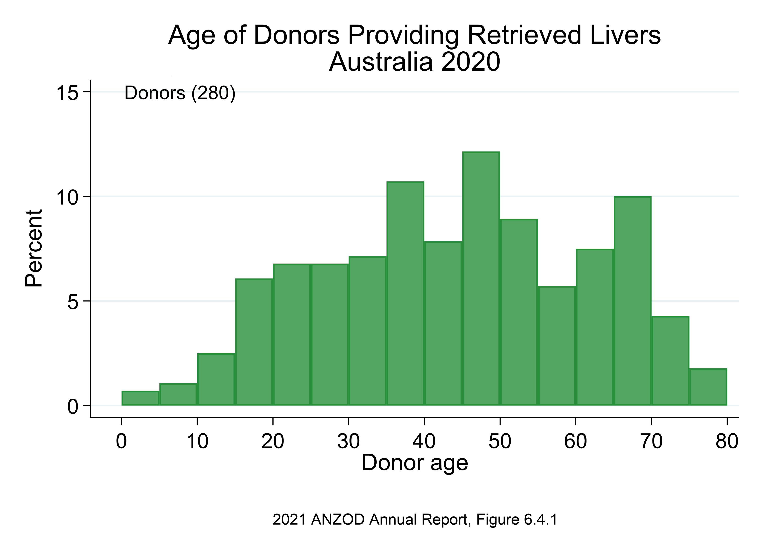

Slide 7
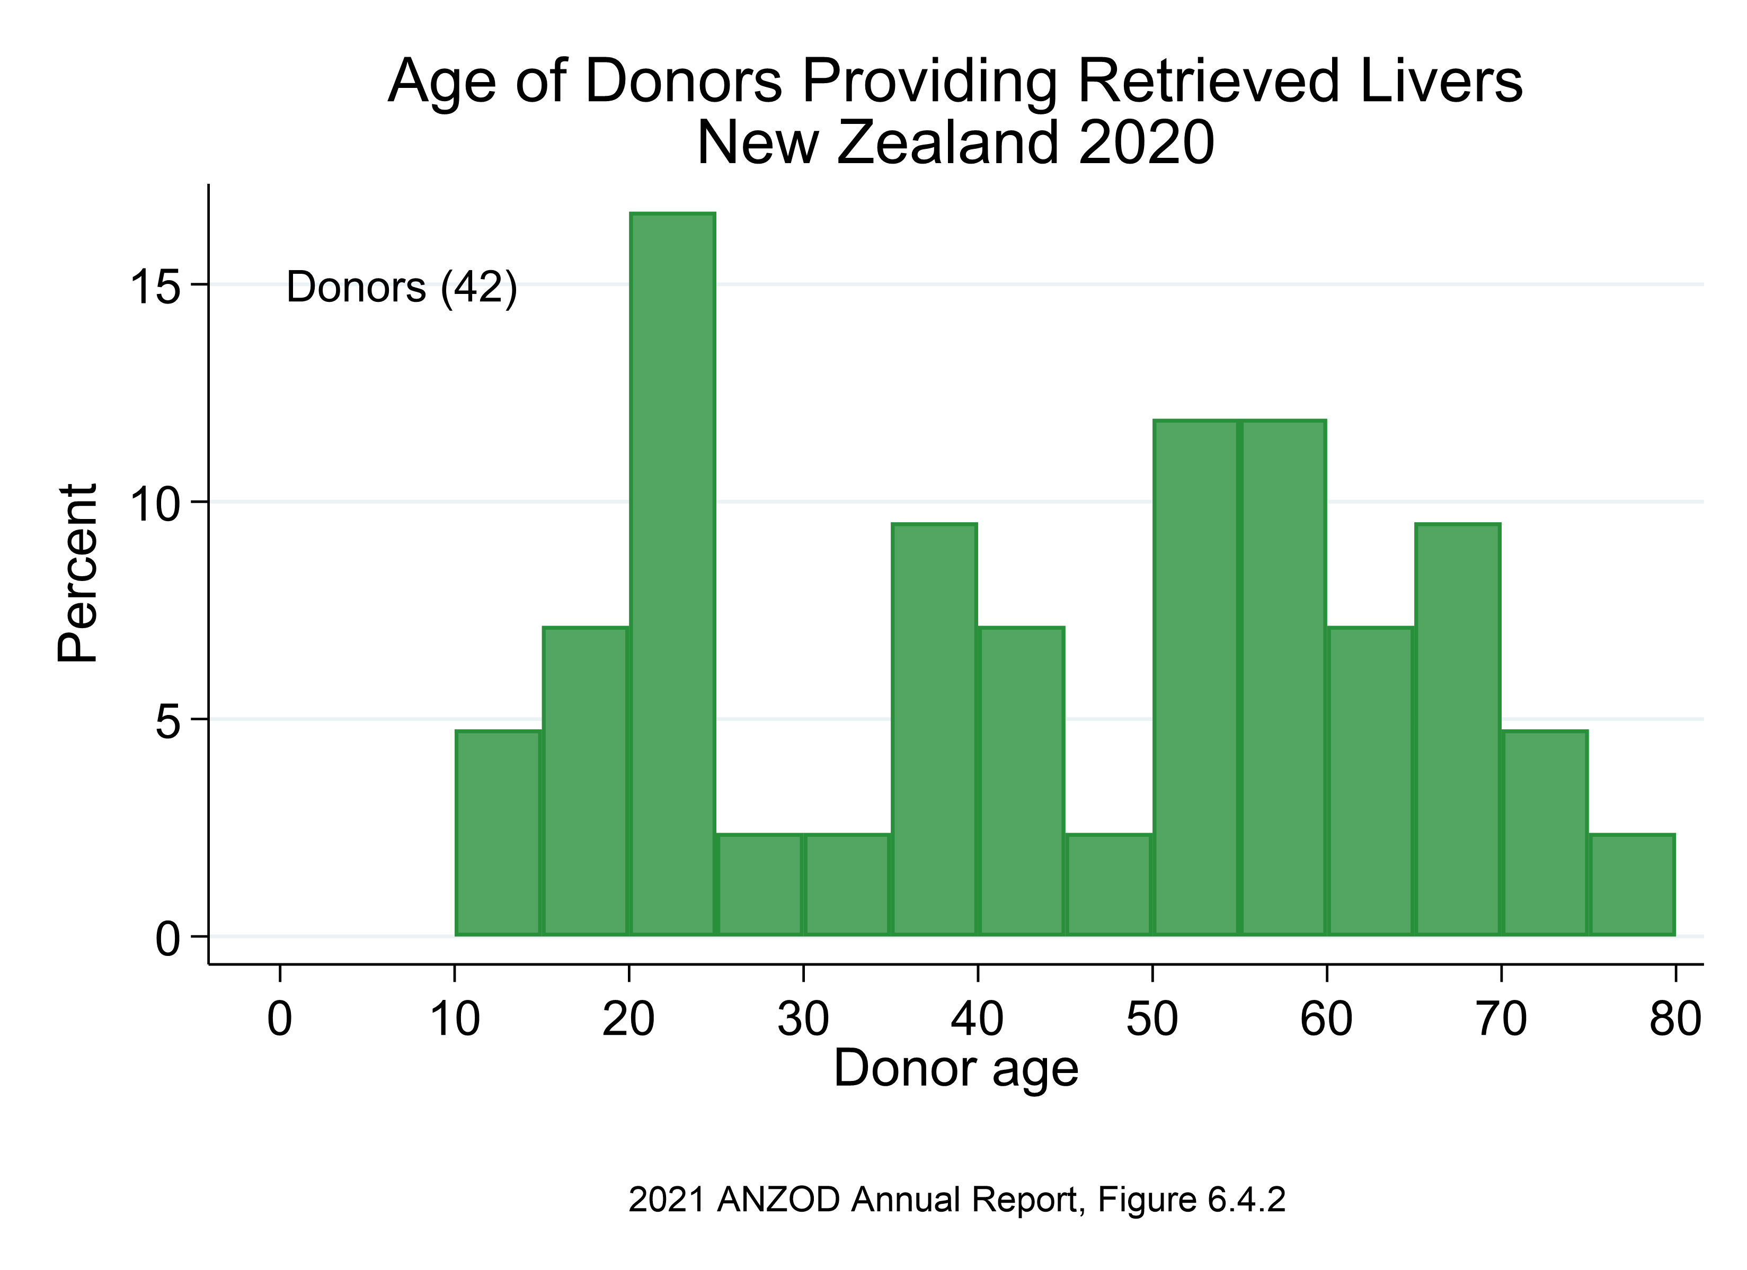

Slide 8
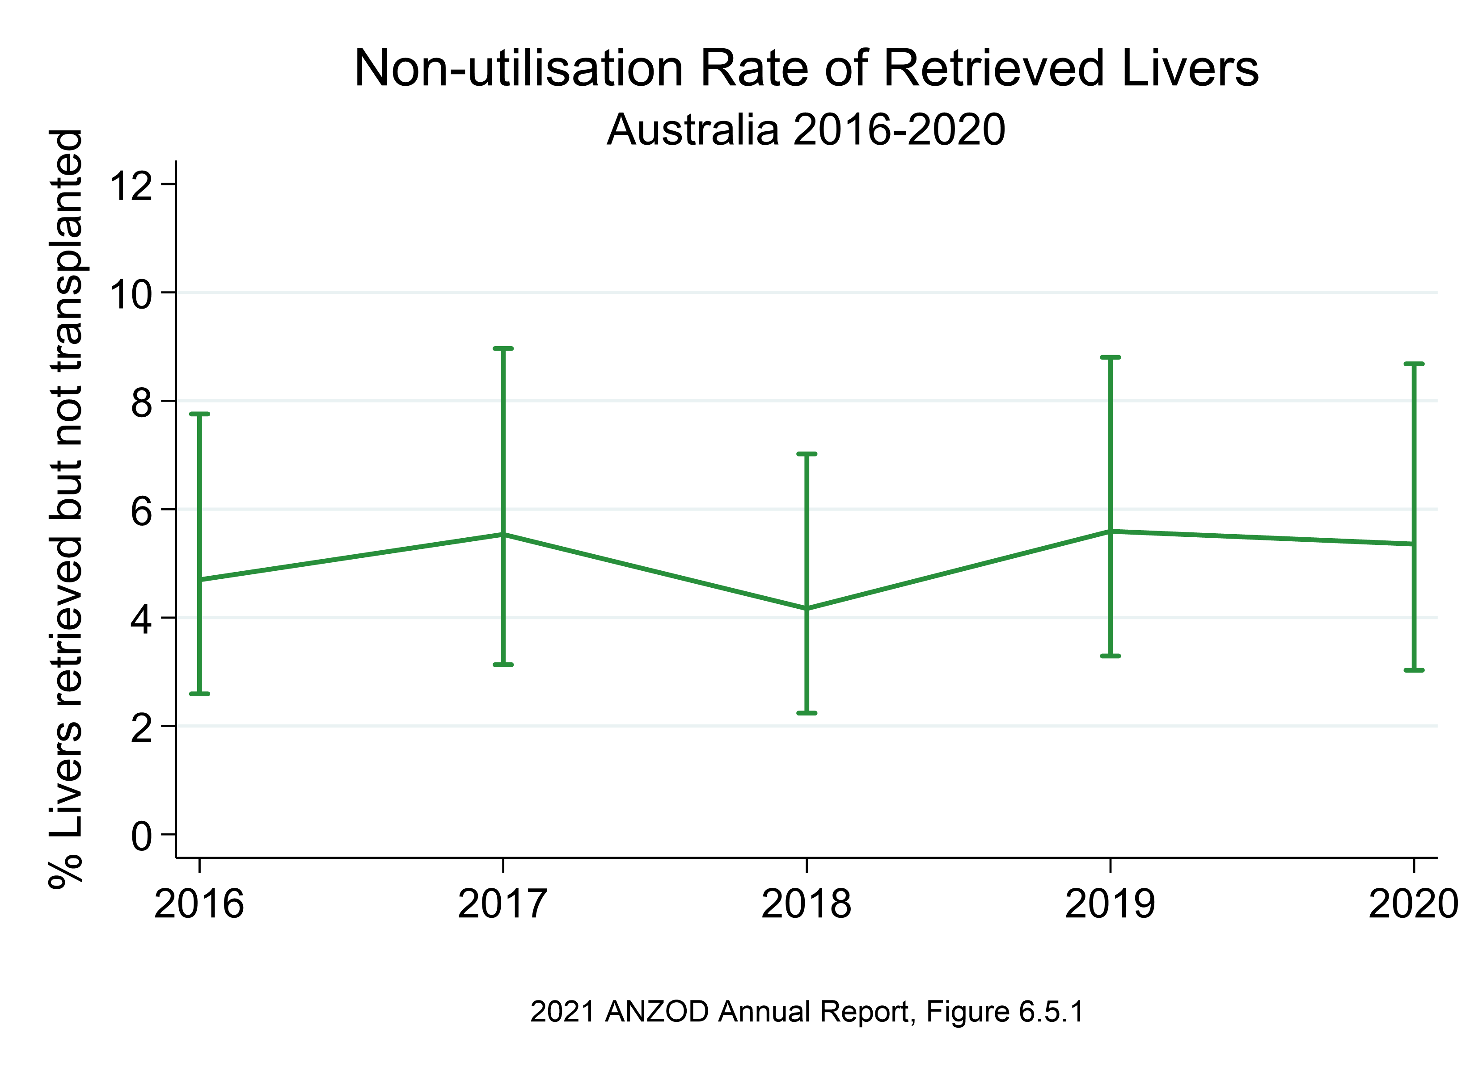

Slide 9
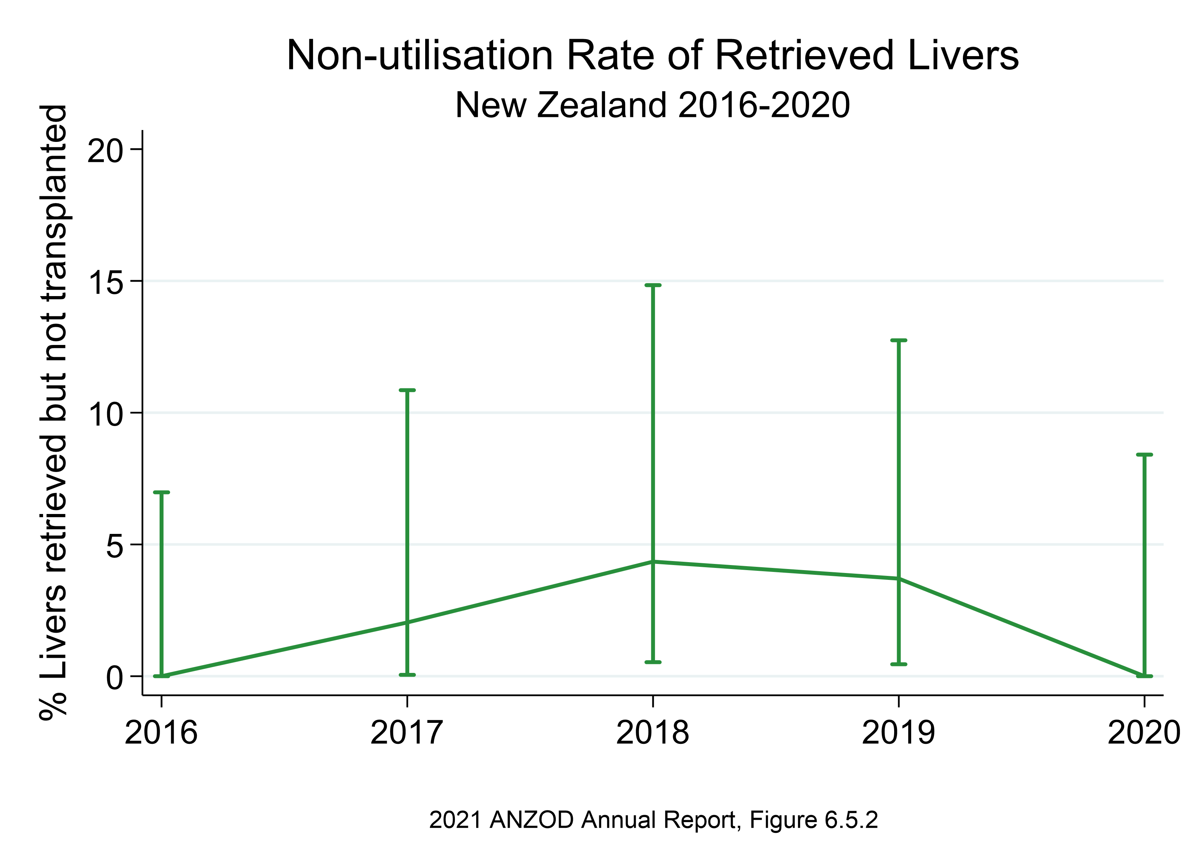

Slide 10
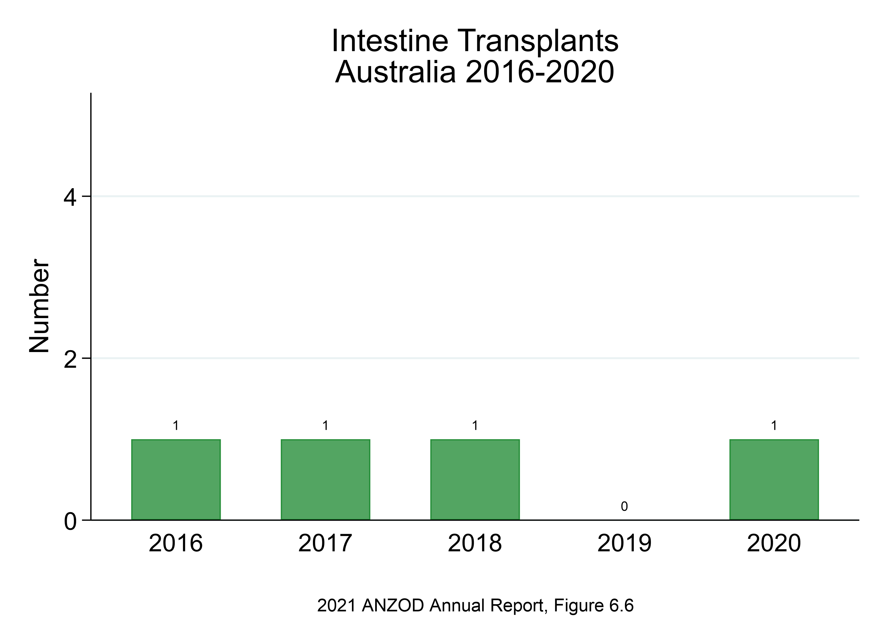

Slide 11
Citation
ANZOD Registry. 2021 Annual Report, Section 6: Deceased Donor Liver and Intestine Donation. Australia and New Zealand Dialysis and Transplant Registry, Adelaide, Australia. 2021. Available at: https://www.anzdata.org.au/report/anzod-annual-report-2021/

