Slide 1
Section 7
Deceased Donor Heart Donation
Annual Report 2021
(Data analysis to 31-December-2020)

Slide 2
Contents
Figure 7.2.1 Hearts Transplanted by Donation Pathway Australia 1998-2020
Figure 7.2.2 Hearts Transplanted by Donation Pathway New Zealand 1998-2020
Figure 7.3 Deceased Donor Heart Transplant Recipients* by Transplant State, Australia and New Zealand, 2019-2020
Figure 7.4.1 Age of Donors Providing Retrieved Hearts Australia 2020
Figure 7.4.2 Age of Donors Providing Retrieved Hearts New Zealand 2020
Figure 7.5.1 Non-utilisation Rate of Retrieved Heart - Australia 2016-2020
Figure 7.5.2 Non-utilisation Rate of Retrieved Heart - New Zealand 2016-2020
Citation

Slide 3
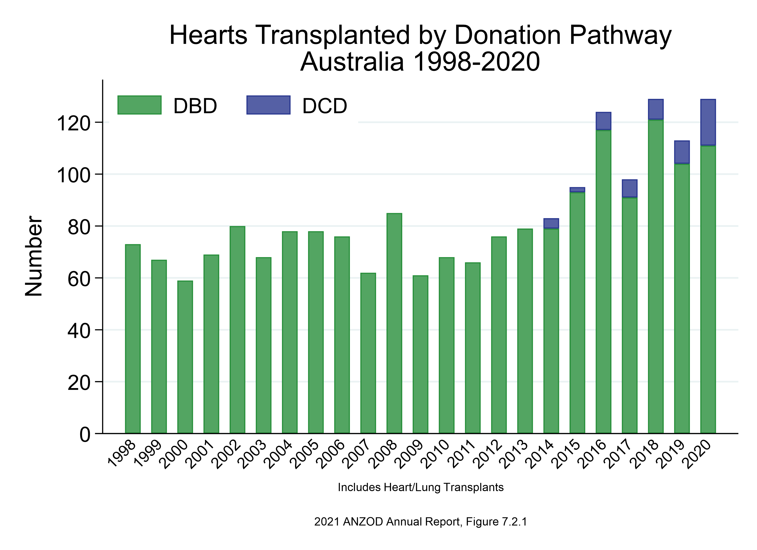

Slide 4
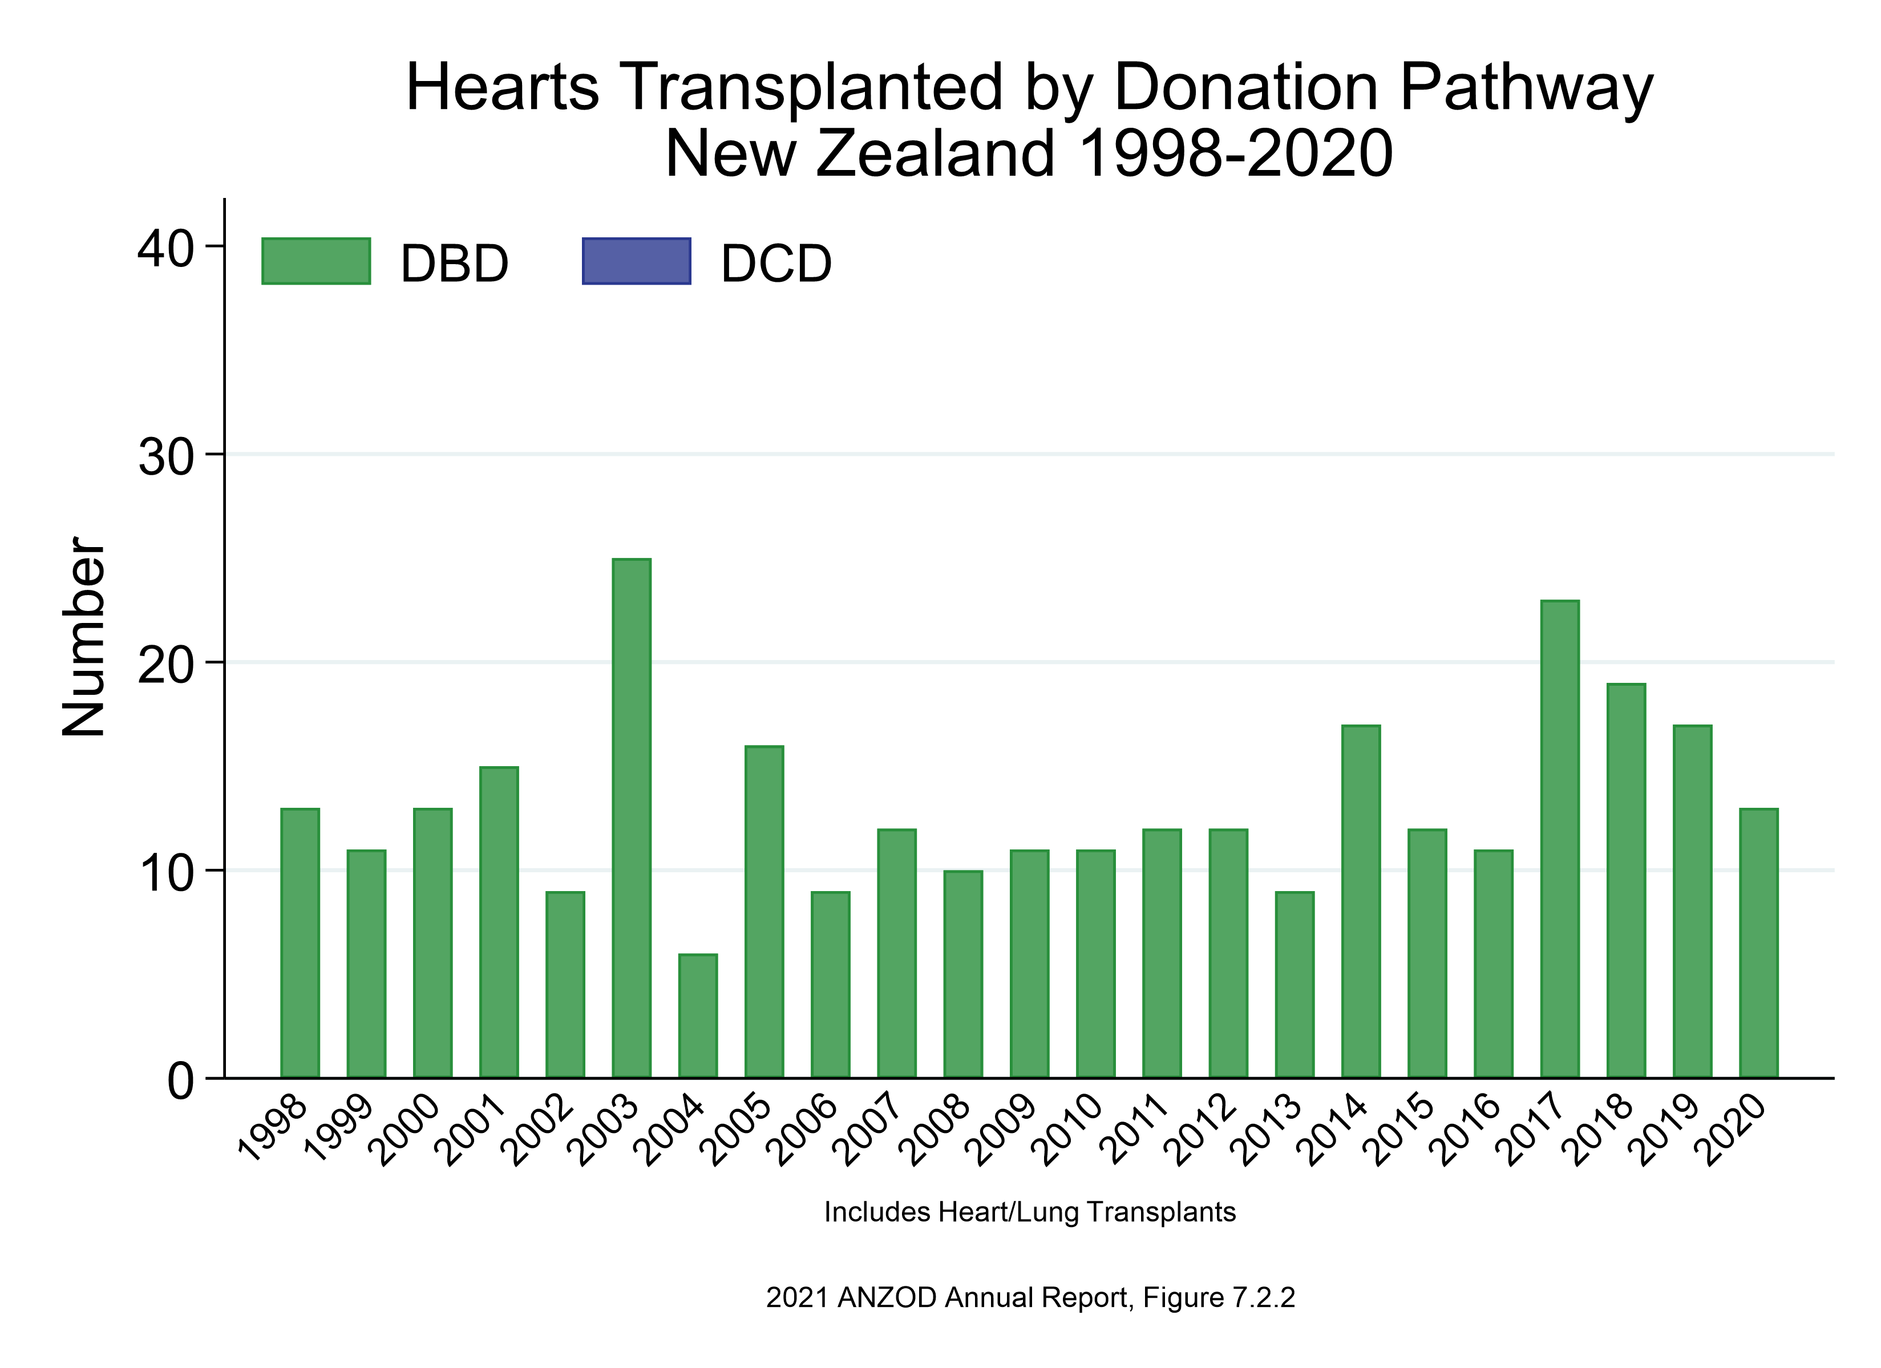

Slide 5
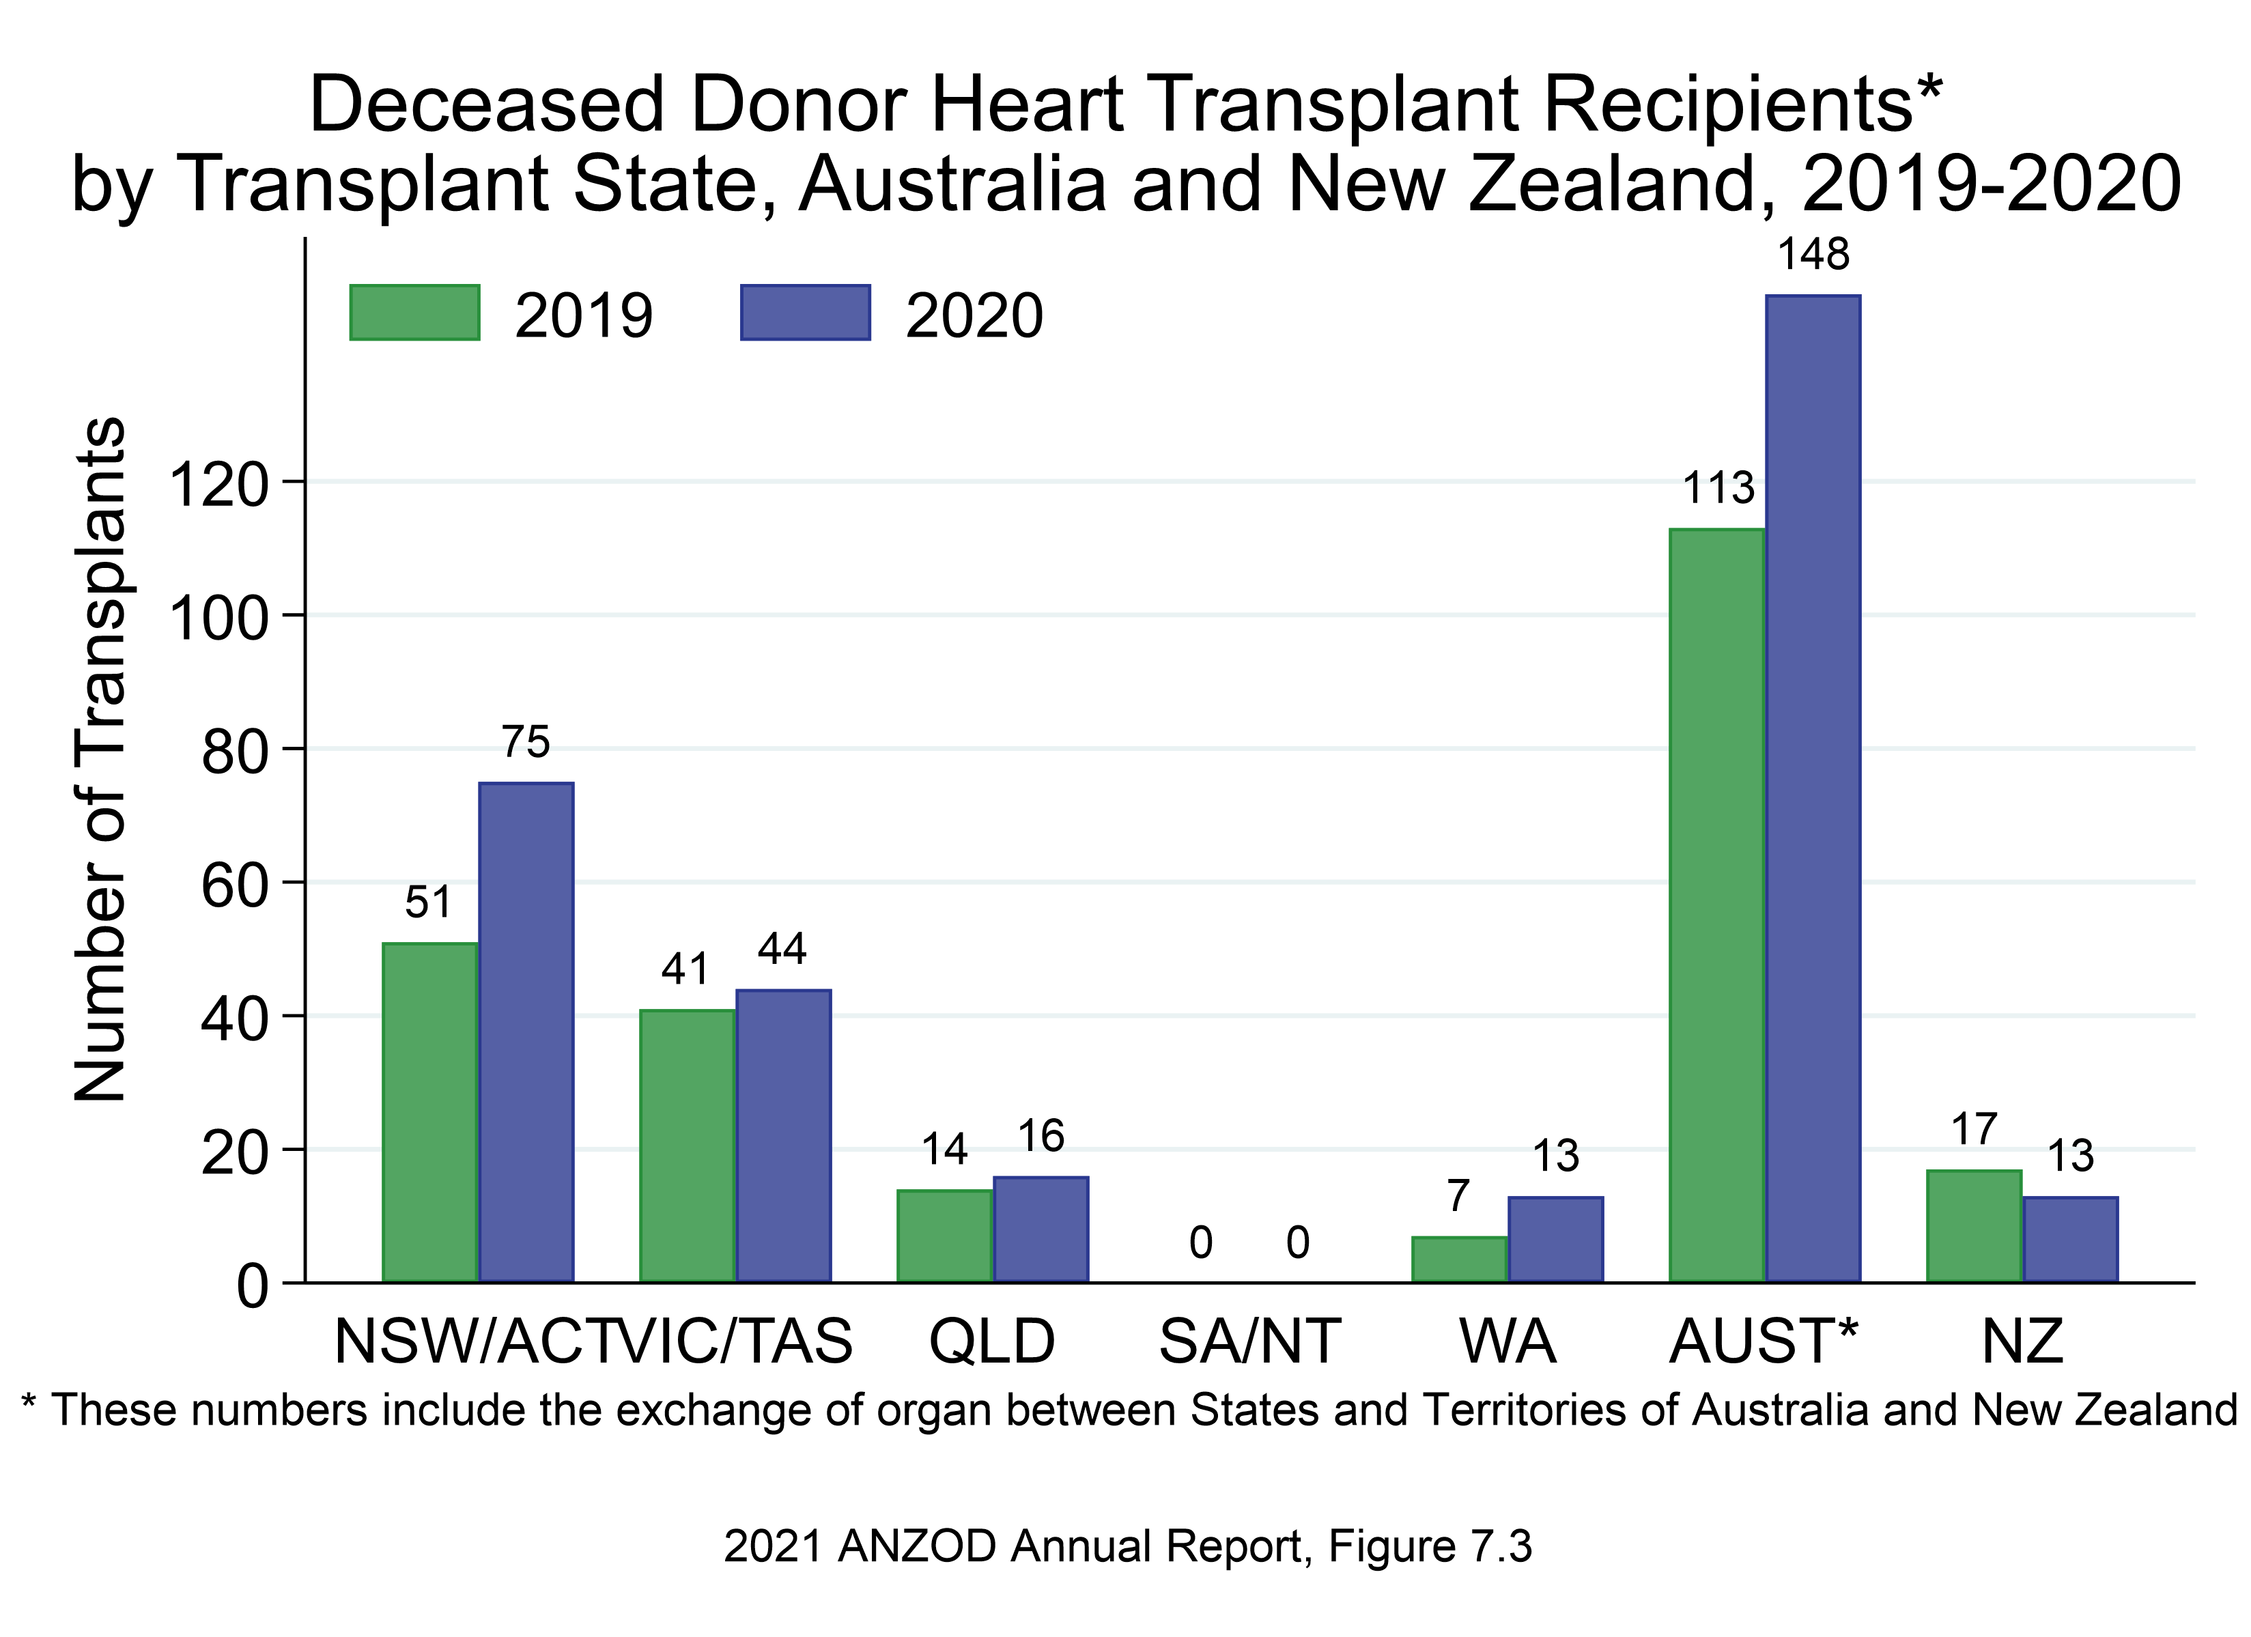

Slide 6
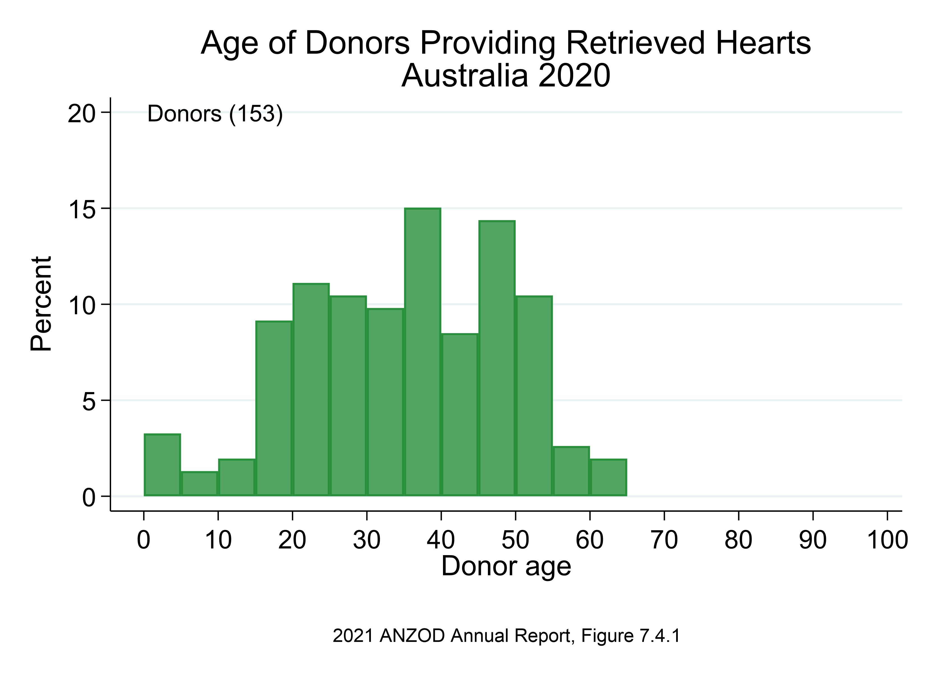

Slide 7
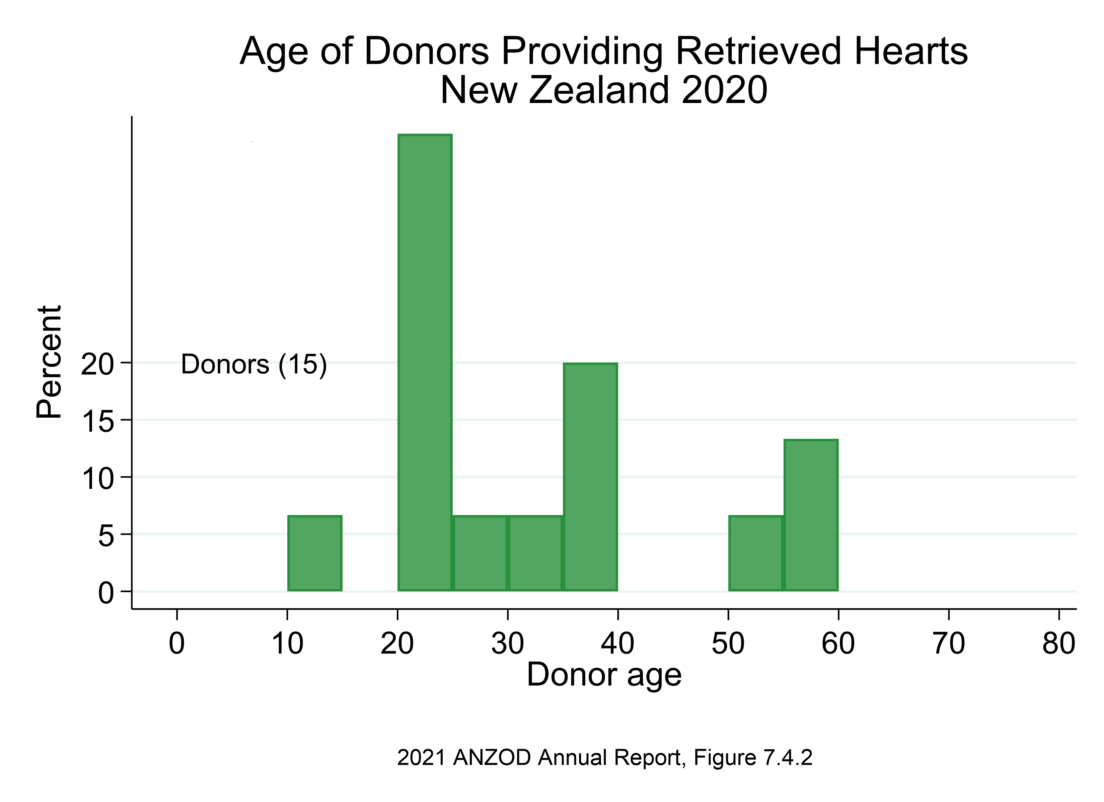

Slide 8
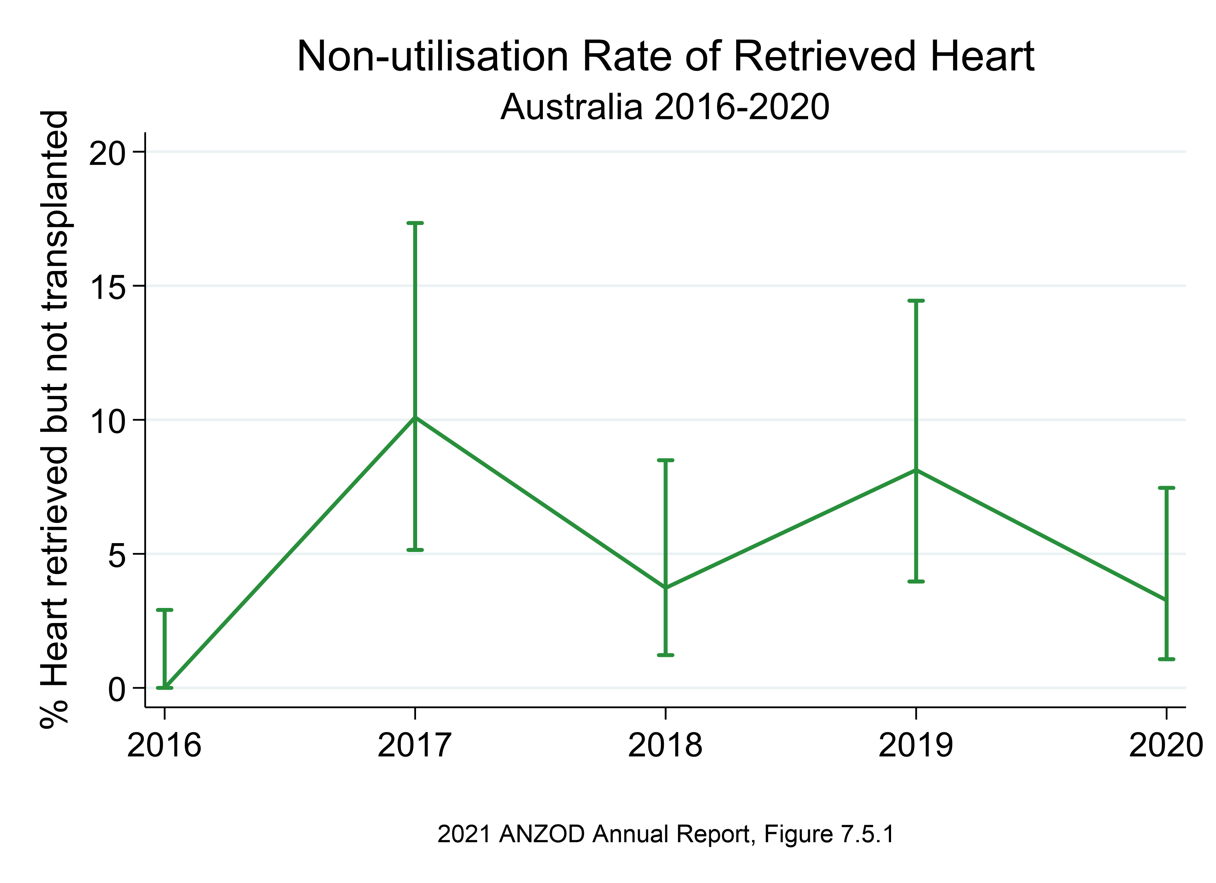

Slide 9
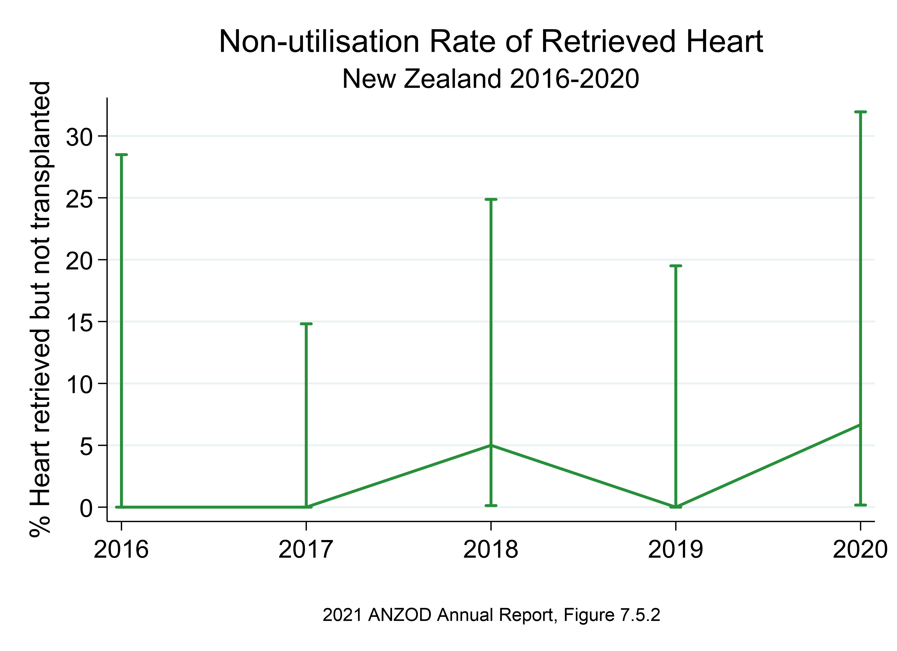

Slide 10
Citation
ANZOD Registry. 2021 Annual Report, Section 7: Deceased Donor Heart Donation. Australia and New Zealand Dialysis and Transplant Registry, Adelaide, Australia. 2021.
Available at: https://www.anzdata.org.au/report/anzod-annual-report-2021/

