Slide 1
Section 9 Deceased Donor Pancreas Donation
Annual Report 2021
(Data analysis to 31-December-2020)

Slide 2
Contents
Figure 9.2.1 Recipients of Whole Pancreas Transplant by Donation Pathway, Australia 1998-2020
Figure 9.2.2 Recipients of Whole Pancreas Transplant by Donation Pathway, New Zealand 1998-2020
Figure 9.3 Deceased Donor Pancreas Transplant Recipients* by Transplant Region, Australia and New Zealand, 2019-2020
Figure 9.4.1 Age of Donors Providing Retrieved Pancreas Australia 2020
Figure 9.5.1 Non-utilisation Rate of Pancreas Retrieved for Organ Transplantation - Australia 2016-2020
Figure 9.5.2 Non-utilisation Rate of Pancreas Retrieved for Organ Transplantation - New Zealand 2016-2020
Citation

Slide 3
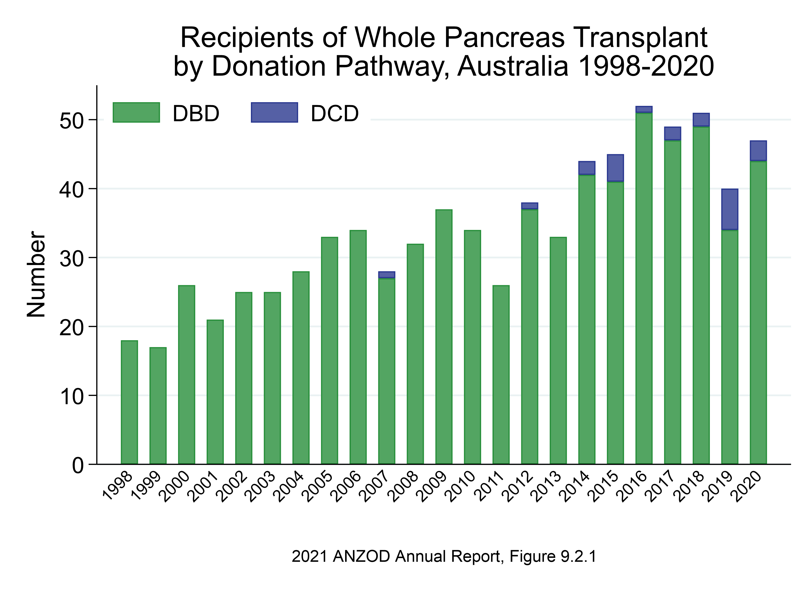

Slide 4
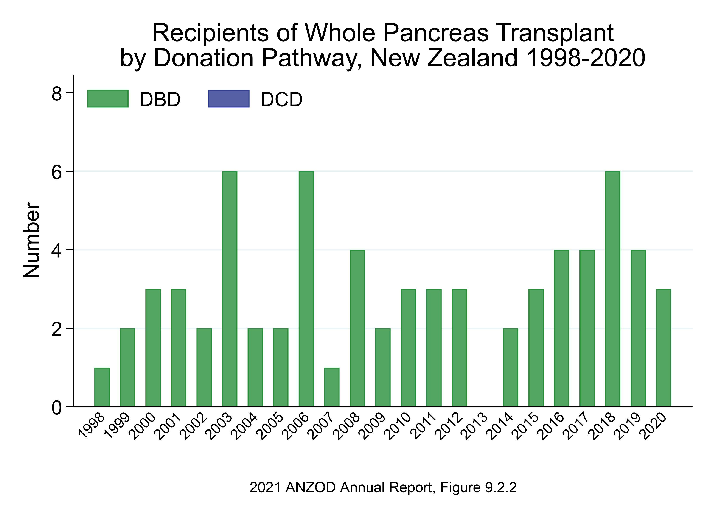

Slide 5
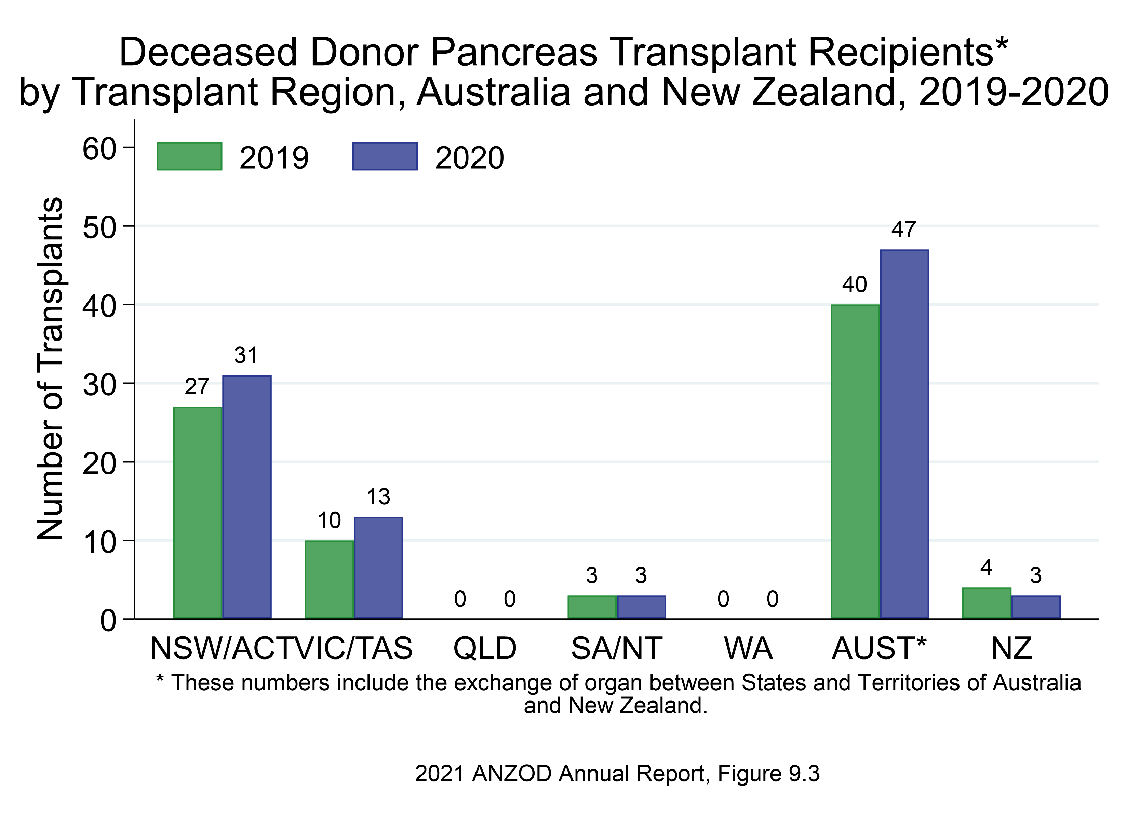

Slide 6
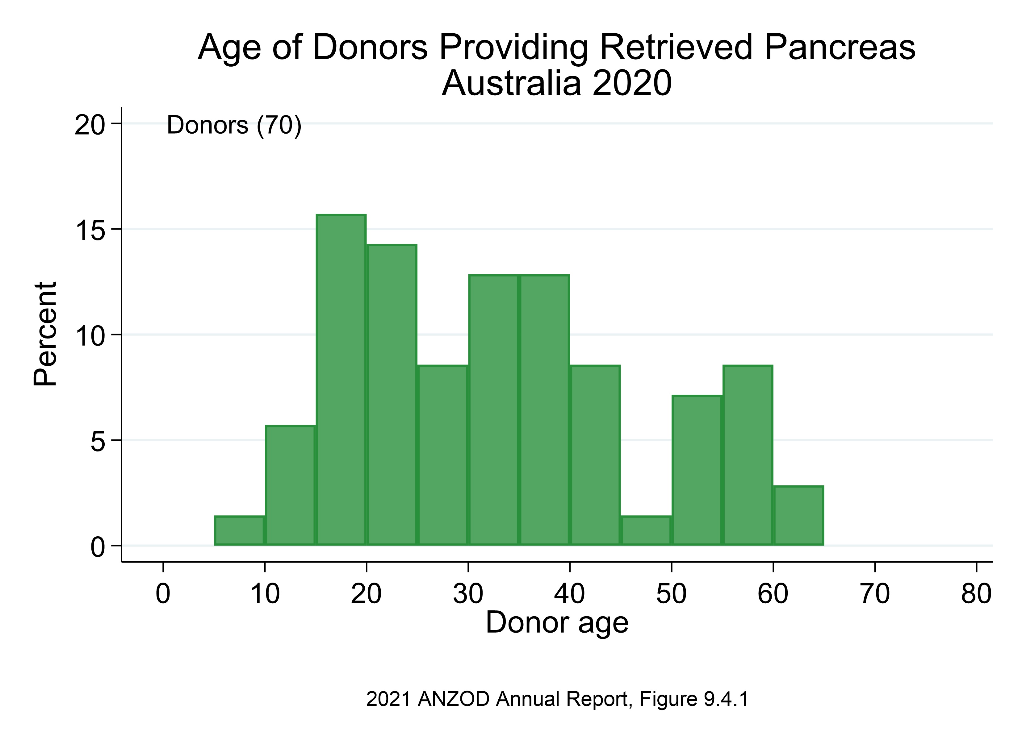

Slide 7
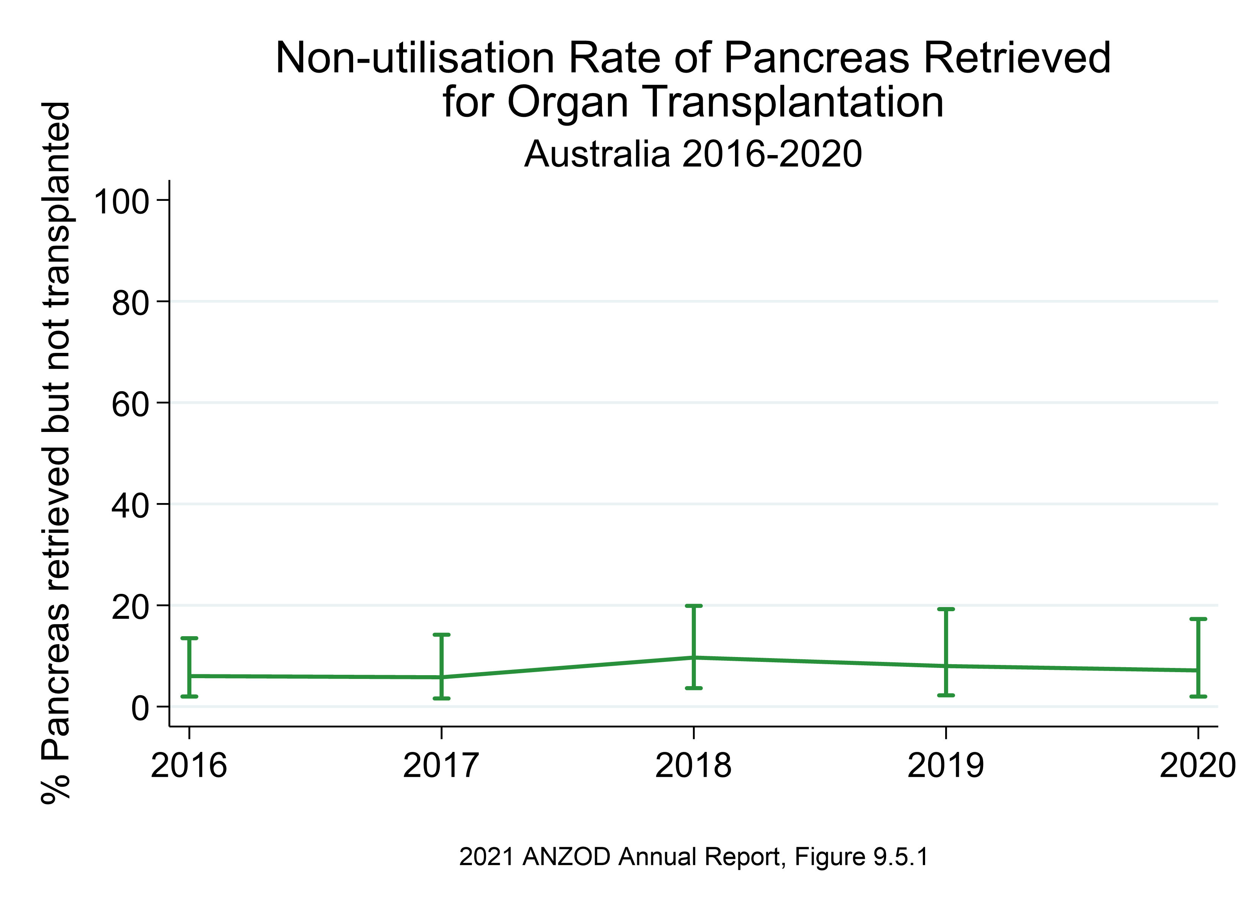

Slide 8
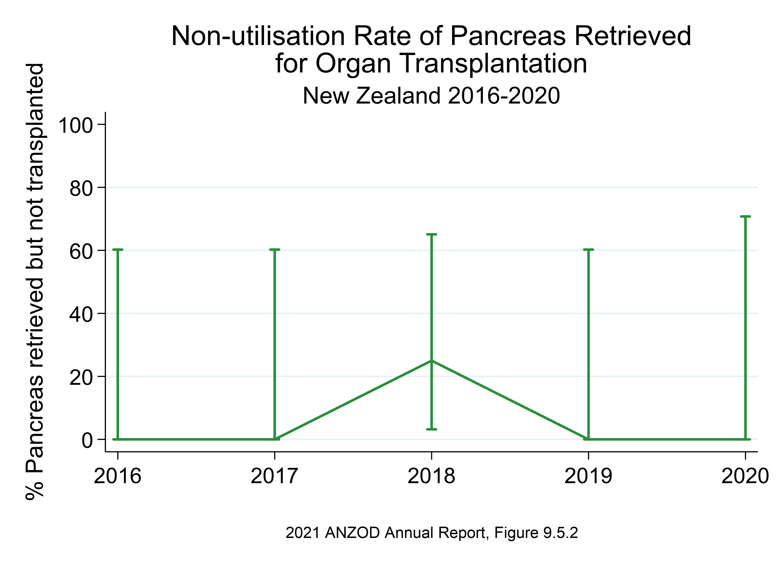

Slide 9
Citation
ANZOD Registry. 2021 Annual Report, Section 9: Deceased Donor Pancreas Donation. Australia and New Zealand Dialysis and Transplant Registry, Adelaide, Australia. 2021. Available at: https://www.anzdata.org.au/report/anzod-annual-report-2021/

